Slide 1

BUREY SA –
Grunelabs.com
March 2019 presentation
Montevideo, Apr 10, 2019

Slide 2
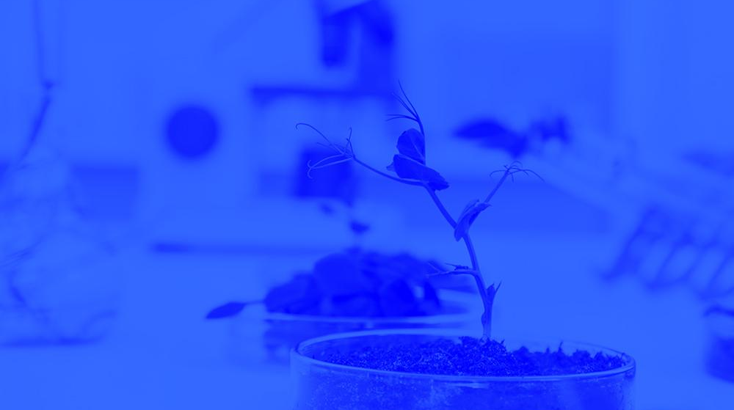
INDEX
Cash flow available data
Management tools
  Balance Sheet
  Income Statement
March Highlights
Next steps

Slide 3
INDEX
Cash flow available data
Management tools
  Balance Sheet
  Income Statement
March Highlights
Next steps

Slide 4
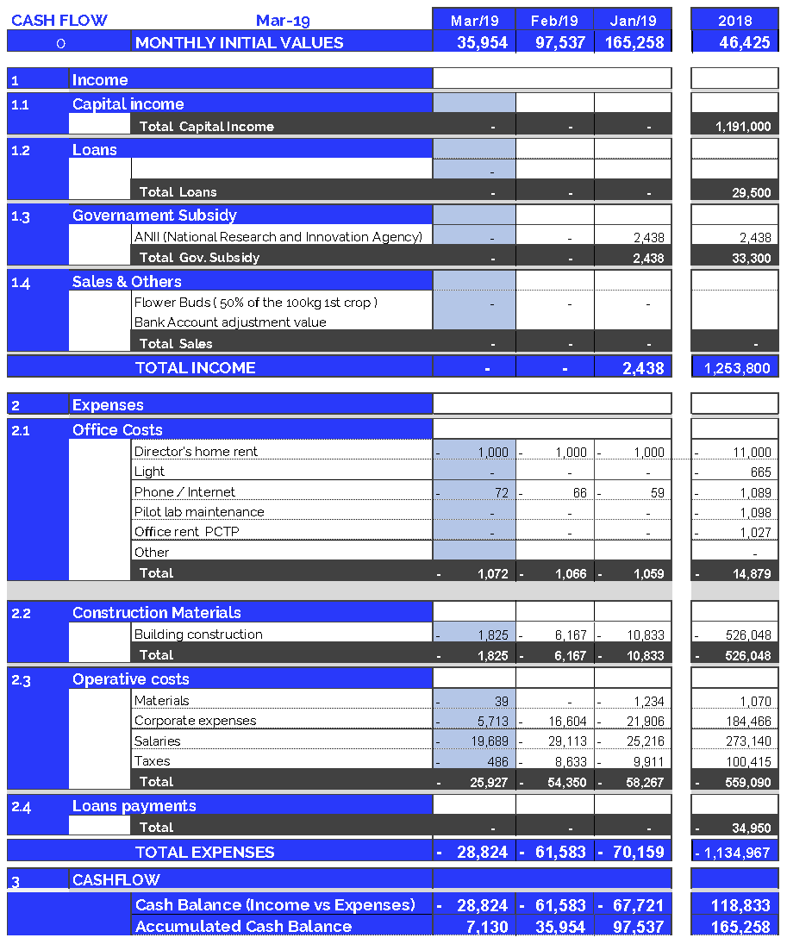
Cash Flow available data: March 2019
4
Accumulated cash balance at the end of 2018:
USD 165.258.
  Opening balance 2018 (end of 2017): USD 46,425
  Income 2018: USD 1.253.800 (partner contributions and loans)
  Expenses 2018: USD (-) 1.134.967.
  Final accumulated cash balance 2018: USD 165,258
Accumulated cash balance at the end of March 2019: USD 7,130.
  Opening balance (end of Feb/19): (+) USD 35,954.
  Building Construction Mar/19: (-) USD 1,825
  Operating Expenses Feb/19: (-) USD 26,999
  Final accumulated cash balance Mar 2019 : USD 7,130.
  Cash outflows for Mar/19 (USD 28,824) are composed of: 6% Investment in equipment and structure and 94% Operating expenses.
  March operating costs were 46% below last year monthly average.
New partner contributions and Loans: March 2019
  Contribution of partners: USD 0
  Short term loan: USD 0

Slide 5
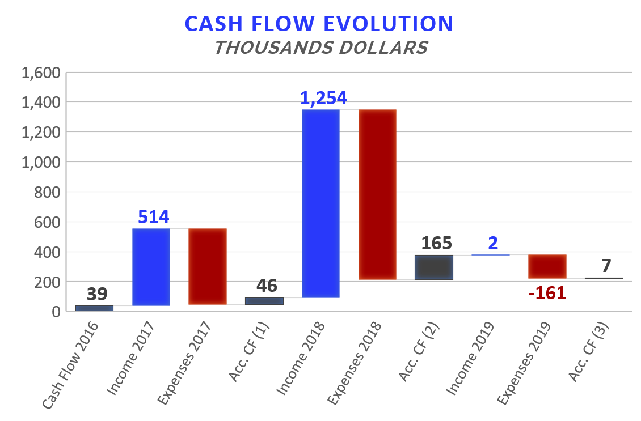

Accumulated Cash Flow – March 2019
5
Final Cash Balance 2016: USD 39 thousand
Final Cash Balance 2017: USD 46 thousand
Final Cash Balance 2018: USD 165 thousand
Final Cash Balance 2019: USD 7 thousand
  January 2019: USD (-) 67.7 thousand.
  February 2019: USD (-) 61.5 thousand.
  March 2019: USD (-) 28.8 thousand.
Accumulated 2019
-1.135
-506
-1.135
Acc. CF (1) – Accumulated Cash Flow (2016 - 2017)
Acc. CF (2) – Accumulated Cash Flow (2016 - December 2018)
Acc. CF (3) – Accumulated Cash Flow (2016 – March 2019)

Slide 6
INDEX
Cash flow available data
Management tools
  Balance Sheet
  Income Statement
March Highlights
Next steps

Slide 7
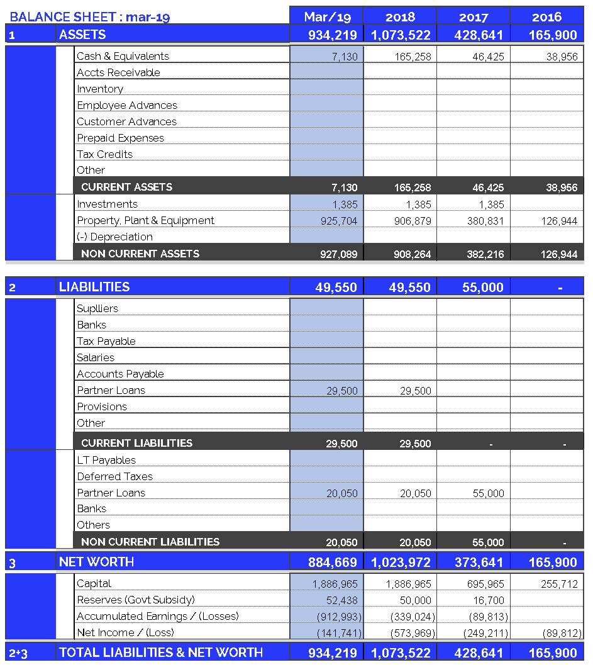
Balance Sheet: March 2019
7
Continuous growth of plant and equipment
  Property, Plant & Equipment growth in 2017: 200%
  Property, Plant & Equipment growth in 2018: 138%
  Property, Plant & Equipment growth in 2019: 2%
  (Investments include Value Added Taxes: Tax Credit)
No loan payments were made in March 2019.
Fixed assets totally funded by capital injections and Government Subsidy.

Slide 8
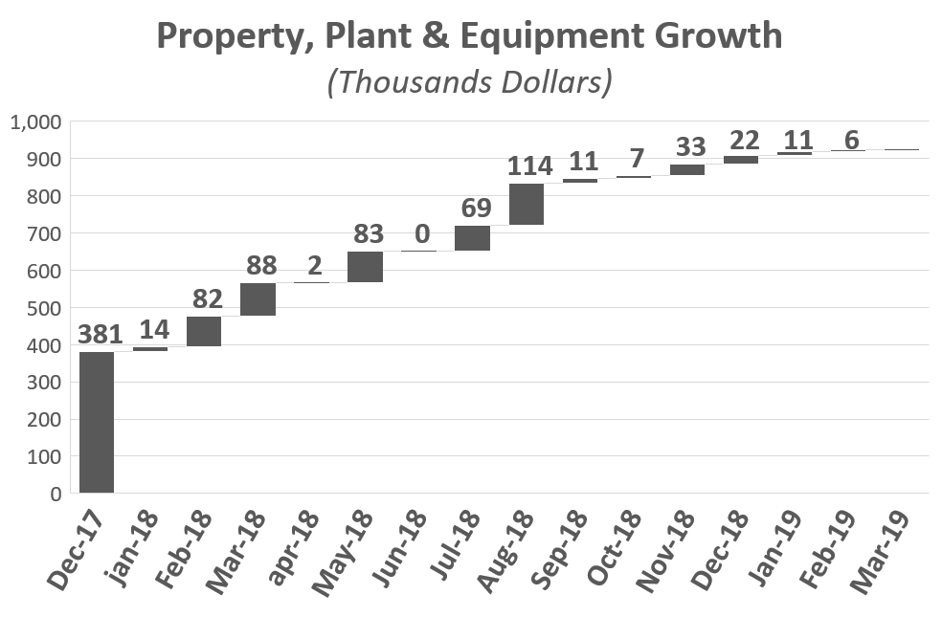
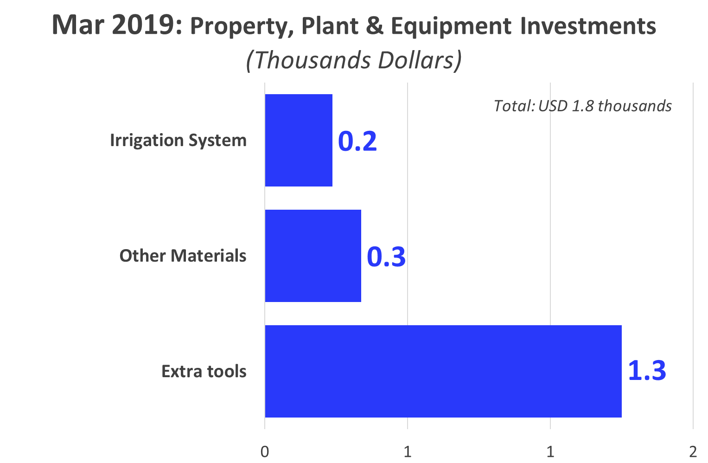
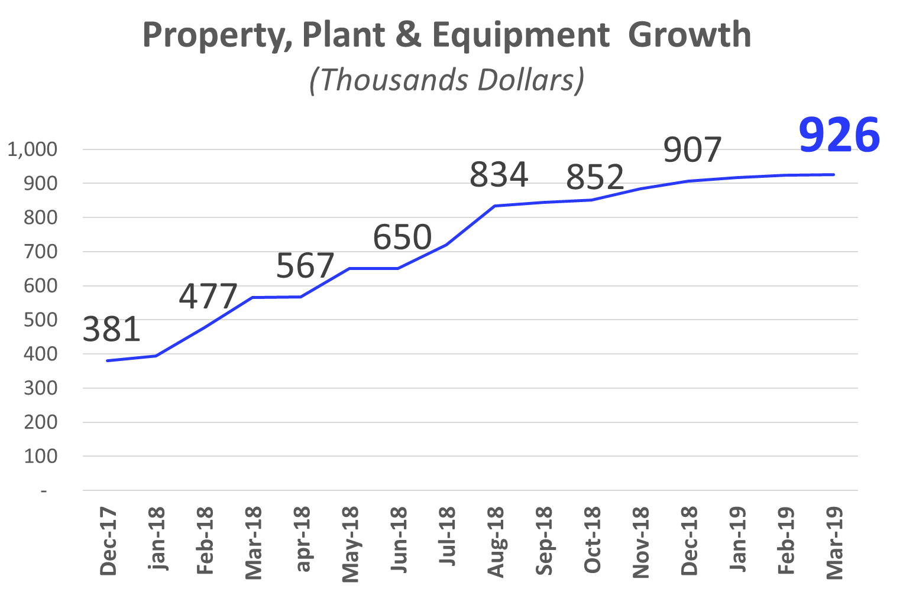
Investments: March 2019
8
2

Slide 9
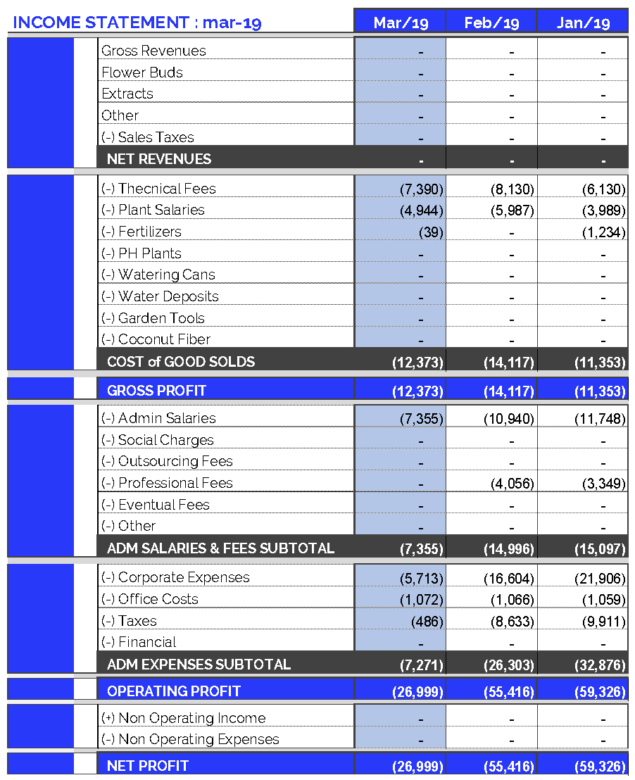
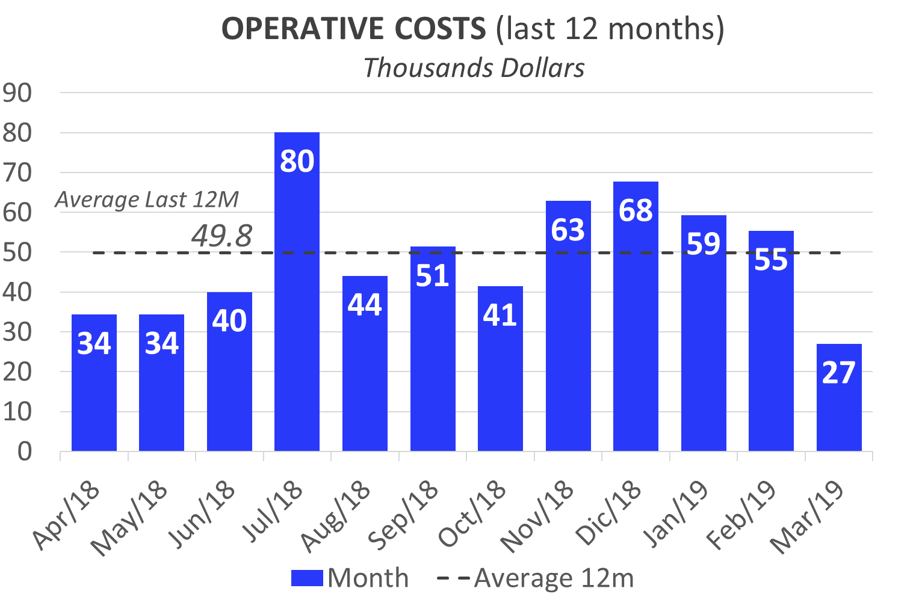
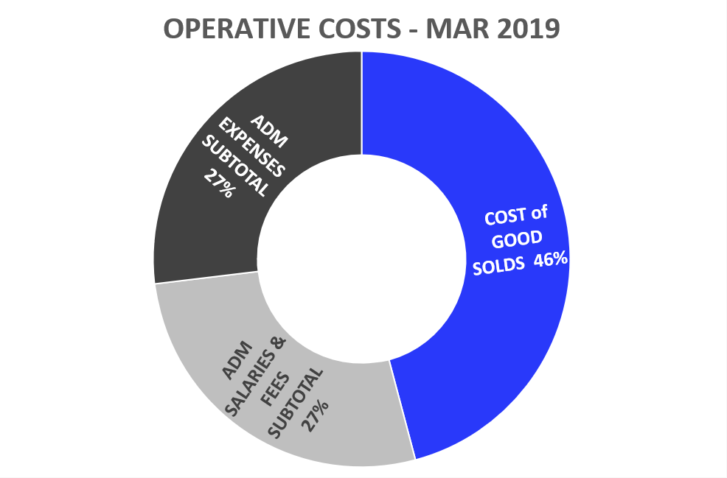
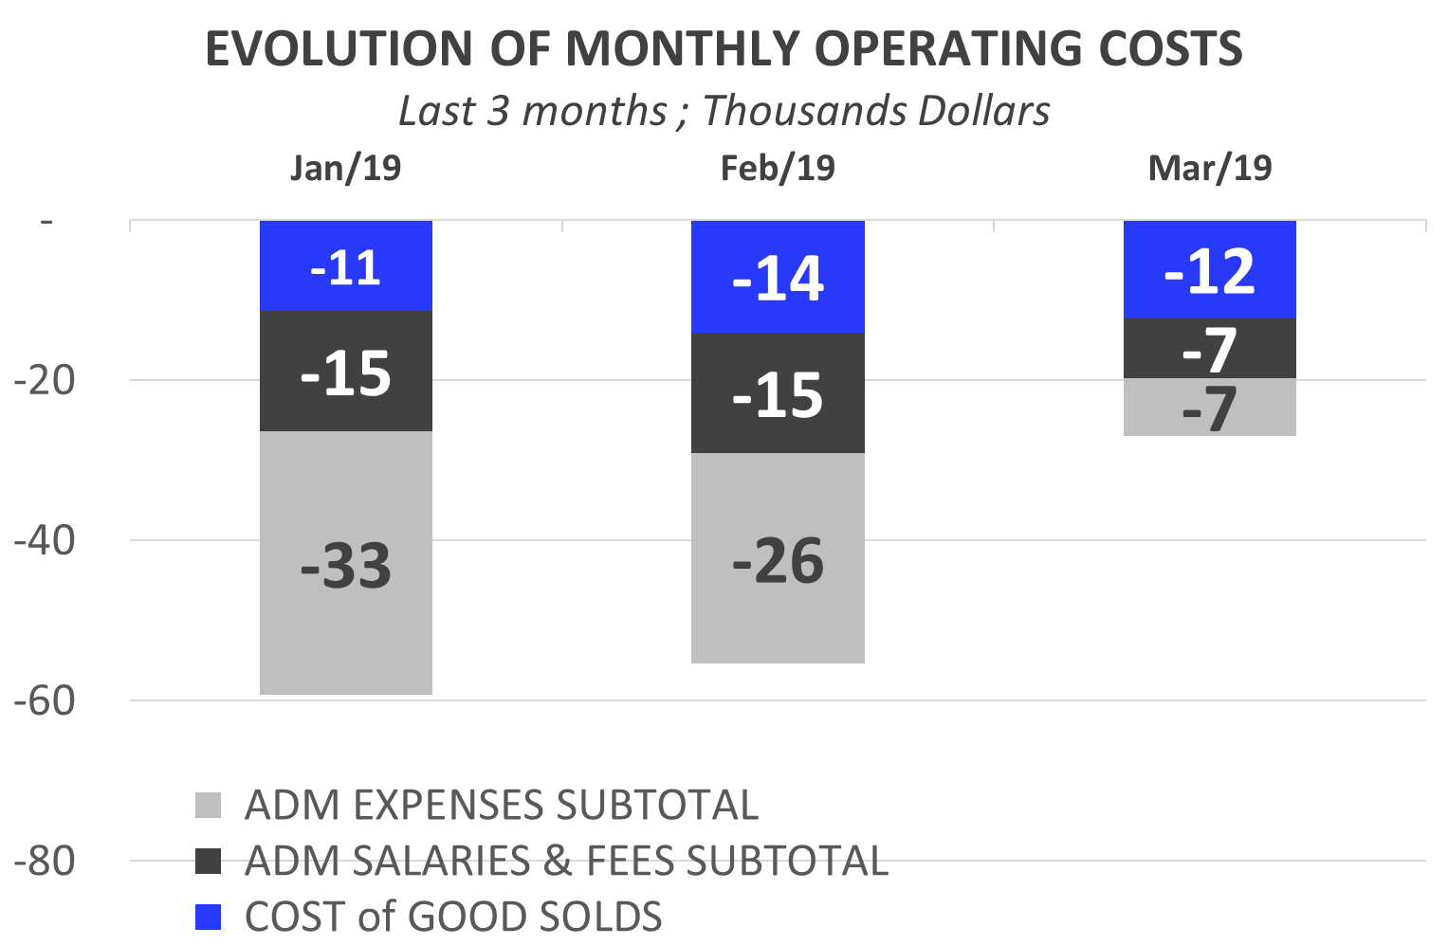
Income Statement: Mar 2019
9
Highlights of March 2019 Expenses: USD 26,999
Total operating costs for March above the last 12 months average
  Corporate Expenses : USD 5,713
    Car Rental: USD 1.590.
    Rental booking deposit: USD 1.070
    Collaborators travel and apartment expenses: USD 1.019.
    Ministry of Public Health Registry: USD 796
  Admin Salaries: USD 7,355 (includes Bonus).
  Taxes: USD 486.

Slide 10
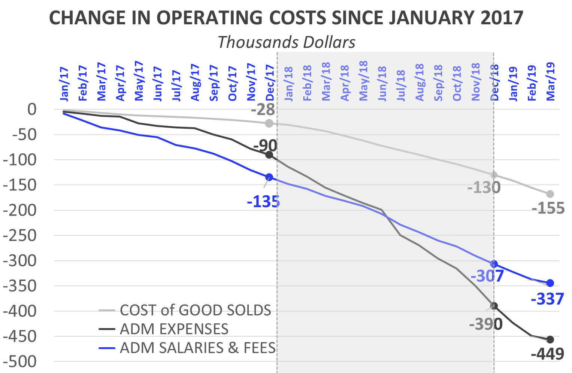
Income Statement: Change in Expenses
10
Burey’s operations have increased compared to 2017. This can be observed in the change of Operating Costs since Jan/17.
Cost of Goods Sold
  In 2018 (compared to the accumulated amount for 2017) the Cost of Goods Sold increased 369%: between Jan/18 and Dec/18 USD 102,042 was spent. Mainly this is due to: increase in technical fees and plant salaries.
  On Mar / 19, 1.8 times more was spent than Mar / 18; It should be clarified: the increase in professional fees materialized itself as of April / May 2018.
Administrative Expenses
  In 2018 (compared to the accumulated amount for 2017) Administrative Expenses increased 333%: between Jan/18 and Dec/18 USD 299,759 was spent.
  In Mar / 19, Administrative Expenses amounted to USD 7,271 (-70% compared to Mar / 18).
  Mar/19: Taxes and social security payments (BPS): USD 486.
Administrative Salaries & Fees
  No notable change compared to 2017
  In Mar / 19, Administrative Salaries & Fees accounted for 50% of
  Mar / 18.

Slide 11
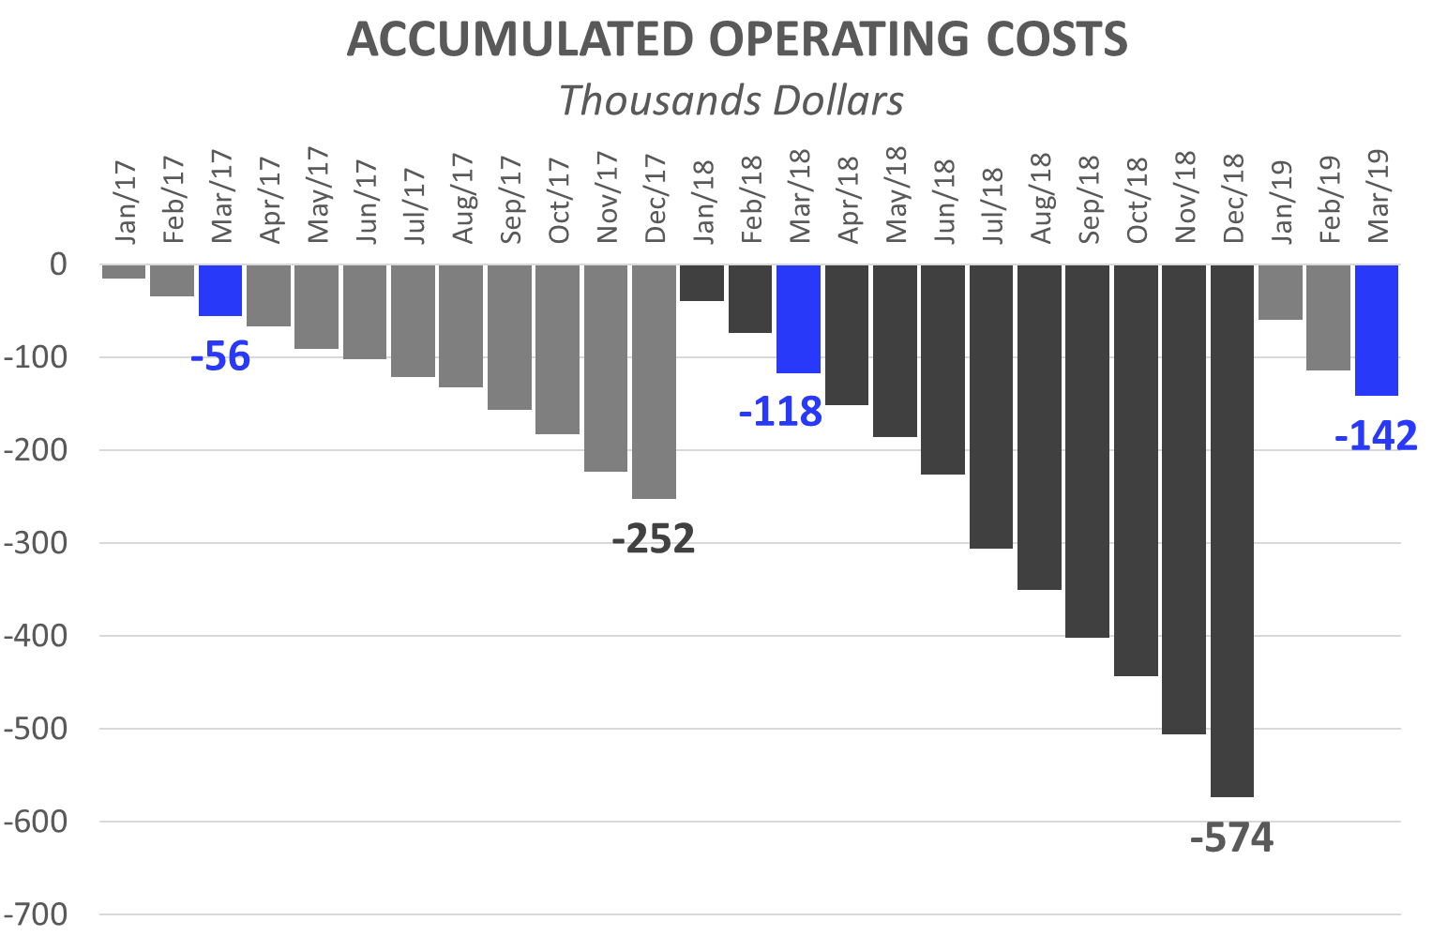
Income Statement: 3 months of 2019
11
Operating Costs accumulated for calendar year
The accumulated expenses for the 12 months (12M) of 2018 represent 227% of total 2017 expenses. This reflects the increase in operating costs mentioned in the previous slide and is the result of research performed and preparations for our first commercial production. By 2019, It is expected this trend will continue, driven by production and commercialization.
First 3 Months (3M): Comparison 2019 vs. 2018:
While in the first 3M 2018 we spent USD 117,769, in the first 3M of 2019 we reached USD 141,741. This growth in expenses is principally attributed to:
  First 3M of 2018, corporate expenses were USD 40,681. While, in the first 3M of 2019, USD 44,223 has been invested. (See Corporate Expenses in the previous slide).
  First 3M 2019: The monthly average of admin salaries increased: + USD 1,656 (compared to first 3M 2018). This is due to:
    Increase in compensation for Sergio, Joao, Sonia (Secretary) and Calo (general maintenance)
    Two new employees: Elsa y Pedro (Cleaning and Key Management)
  First 3M 2019: Technical Fees reached USD 21,650, while in 2018 (3M) they were USD 8,844. This was due to the increased workload of the professionals.
  First 3M 2019: Plant Salaries rose (First 3M 2019: USD 14,920 vs. First 3M 2018: USD 6.699). As of Feb-18 a Janitor and Auxiliary Corp were hired.
  At the same time, the raise in salaries increased contributions required by law (BPS), in 2019/2018 with respect to 2017.

Slide 12
INDEX
Cash flow available data
Management tools
    Balance Sheet
    Income Statement
March Highlights
Next steps

Slide 13
March 2019 Highlights:
Agricultural Engineer and Technical Lead: Esteban Sosa
13
Final details: Preparation of Irrigation and Drainage System.
It is expected that, by the end of May 2019, all facilities will be ready to begin production.
Pharmaceutical Chemist: Eleonora Scosería
Request for the Enabling of the plant before the Public Health Ministry has been submitted.
It is estimated that, between July and August 2019, the inspection will be carried out.
Meanwhile, documentation is being worked on.

Slide 14
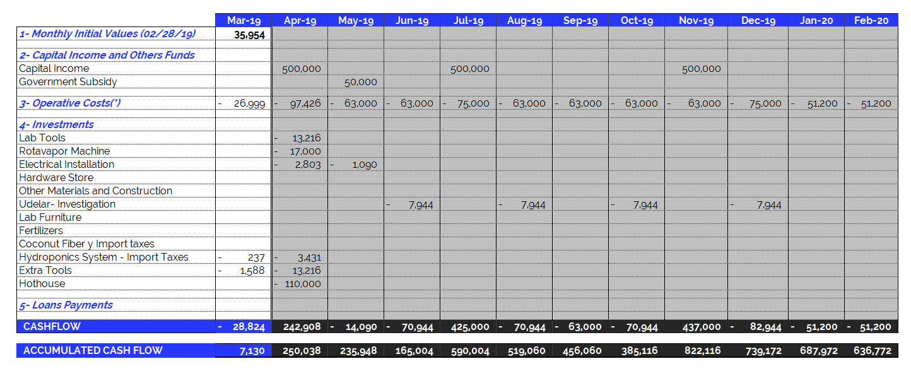
March 2019 – Projected Cash Flow for next 12 months
14
(*) Operating Expenses include 100% of the company's operating costs: salaries, professional fees, rent, etc. THE MONTHLY AVERAGE OF OPERATING EXPENSES does not include investments in equipment and labor. See the following item.

