Slide 1

BUREY SA – Grunelabs.com Jan 2019 presentation
Montevideo, January 10, 2019

Slide 2

INDEX
Cash flow available data
Management tools
Balance Sheet
Income Statement
Next steps

Slide 3
INDEX
Cash flow available data
Management tools
Balance Sheet
Income Statement
Next steps

Slide 4
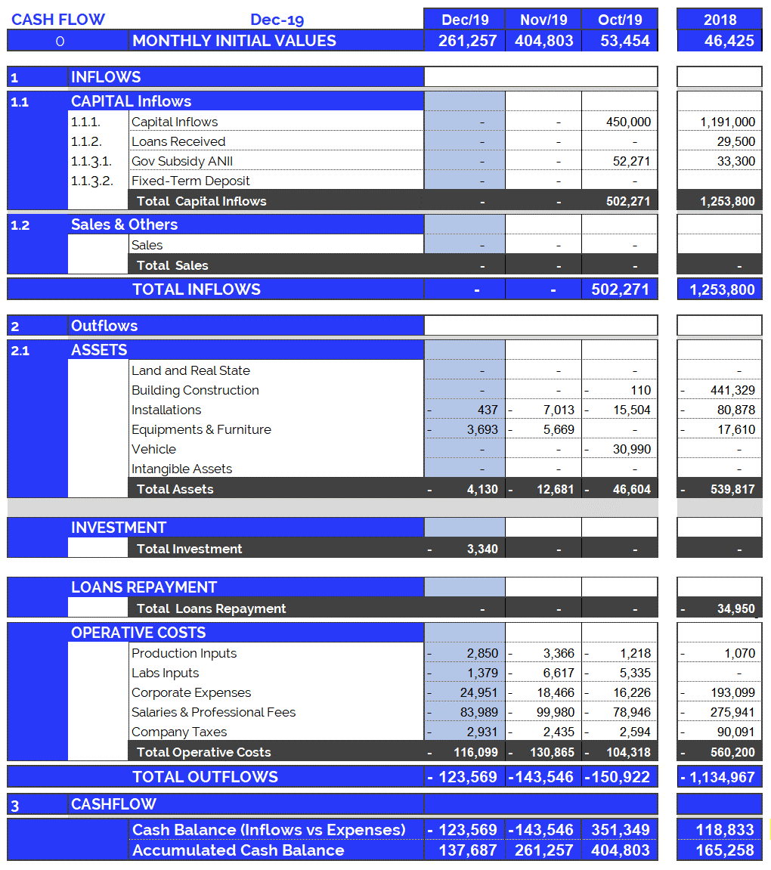
Cash Flow available data: Dec. 2019
4
Accumulated cash balance at the end of 2019: USD 165,258.
Opening balance 2019 (end of 2018): USD 165,258
Inflows 2019: USD 1,846,746 (partner contributions and others)
Outflows 2019: USD (-) 1,874,317.
Final accumulated cash balance 2018: USD 137,687
Accumulated cash balance at the end of Dec. 2019: USD 137,687.
Opening balance (end of Nov/19): (+) USD 261,257.
Capital Income Dec/19 : (+) USD 0
Fixed Assets Dec/19 : (-) USD 4,130.
Deposit Guarantee BHU Dec/19: (-) USD 3.340
Operating Expenses Dec/19 : (-) USD 116,099.
Final accumulated cash balance Dec 2019 : USD 137,687.
Cash outflows for Dec/19 (USD 123,569) are composed of: 94% Operating Expenses, 3% Guarantees and 3% Equipment and Structure.
December operating costs were +21% more than the monthly average (last 12 months).
New partner contributions and Loans: Dec. 2019
Contribution of partners: USD 0.

Slide 5
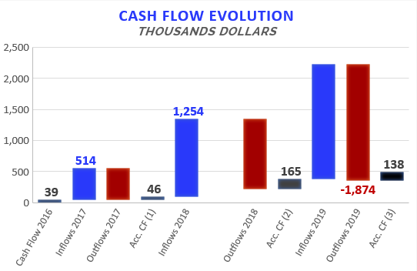

Accumulated Cash Flow – Dec 2019
5
Final Cash Balance 2016: USD 39 thousand
Final Cash Balance 2017: USD 46 thousand
Final Cash Balance 2018: USD 165 thousand
Final Cash Balance 2019: USD 138 thousand
January 2019: USD (-) 67.7 thousand.
February 2019: USD (-) 61.5 thousand.
March 2019: USD (-) 28.8 thousand.
April 2019: USD (+) 107.3 thousand.
May 2019: USD (-) 32.7 thousand.
Jun 2019: USD (+) 219.7 thousand.
Jul 2019: USD (-) 194.3 thousand.
Aug 2019: USD (-) 75.7 thousand.
Sep 2019: USD (+) 22.1 thousand.
Oct 2019: USD (+) 351,3 thousand.
Nov 2019: USD (-) 143,5 thousand.
Dec 2019: USD (-) 123.6 thousand
Accumulated 2019
1.145
-506
-1.135
Acc. CF (1) – Accumulated Cash Flow (2016 - 2017)
Acc. CF (2) – Accumulated Cash Flow (2016 - December 2018)
Acc. CF (3) – Accumulated Cash Flow (2016 – Dec 2019)

Slide 6
INDEX
Cash flow available data
Management tools
Balance Sheet
Income Statement
Next steps

Slide 7
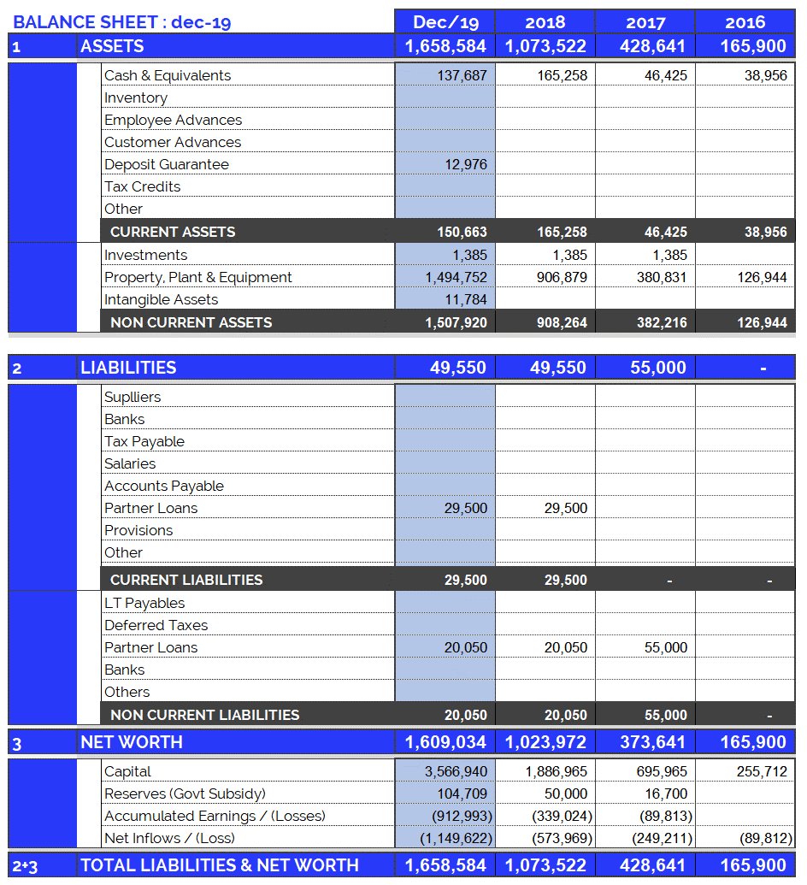
Balance Sheet: Dec. 2019
7
Continuous growth of plant and equipment
Property, Plant & Equipment growth in 2017: 200%
Property, Plant & Equipment growth in 2018: 138%
Property, Plant & Equipment growth in 2019: 65%
(Investments include Value Added Taxes: Tax Credit)
Fixed assets totally funded by capital injections and Government Subsidy.

Slide 8
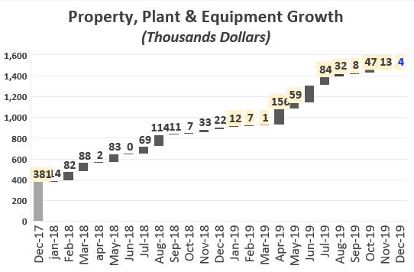
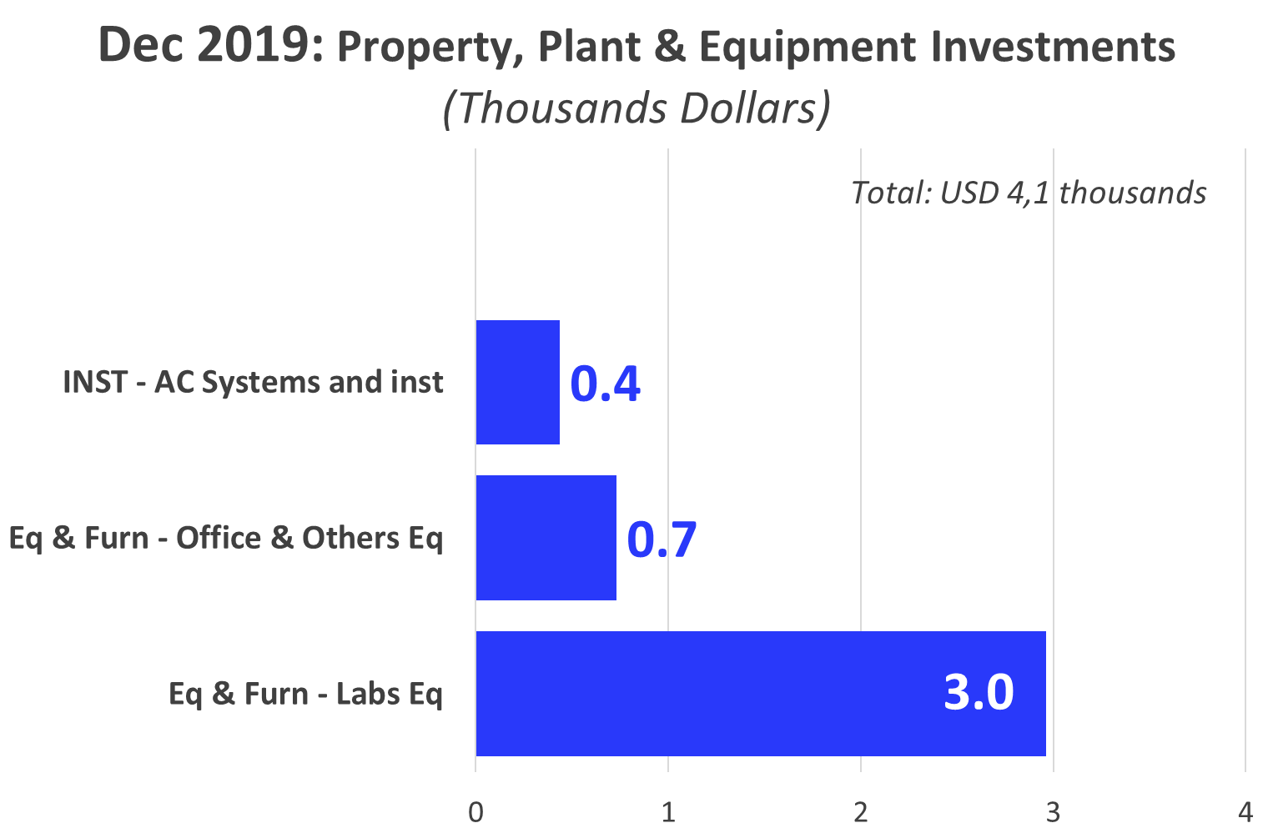

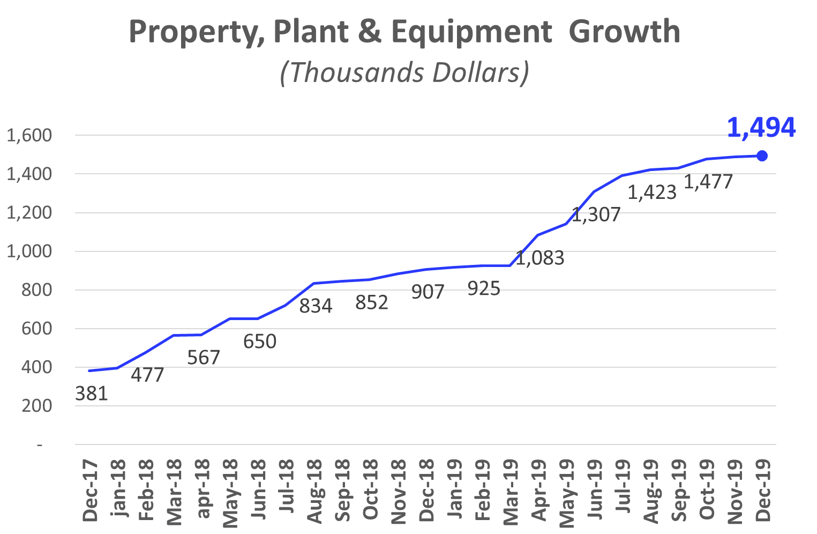
Investments_ Property, Plant & Eq.: Dec 2019
8
165

Slide 9
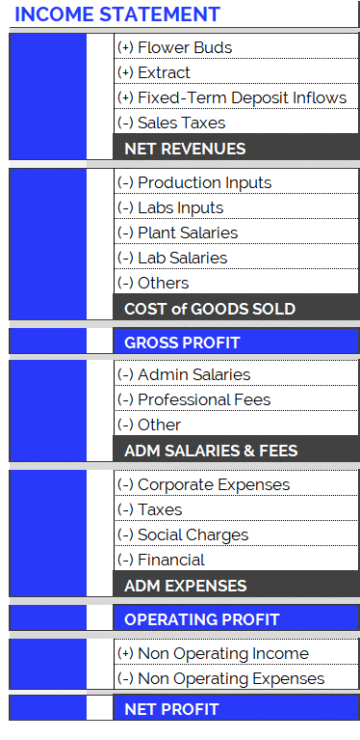
Income Statement: Change in Expenses
9
New Accounting Classification System for Operating Costs, since June 2019
In order to adequately present the company's areas of expense, the operating costs have been arranged according to item and category, as can be seen in the table on the right. Therefore:
Cost of Goods Sold
Shows direct costs of the production process: raw materials, tools, other materials and salaries of plant and laboratory employees.
Adm Salaries & Fees
Shows indirect costs of the production process: administrative salaries and professional fees.
Administration Expenses
Overhead and other expenses relating to the company’s structure.
The new accounting item classifications have generated small differences in the historical accumulated balances (in the new version of the Chart of Accounts compared to the previous one): for example, in the previous month's report (apr-19), differences can be observed in the accumulated flows of Cost of Good Sold. This is because all the accounts have been reclassified and, in order to maintain the same criteria, this generated variations in the historical presentation of the items. However, it should be kept in mind that the historical total expenditures remain unchanged, since the new order simply reorganizes the items for the purpose of better financial statements.

Slide 10
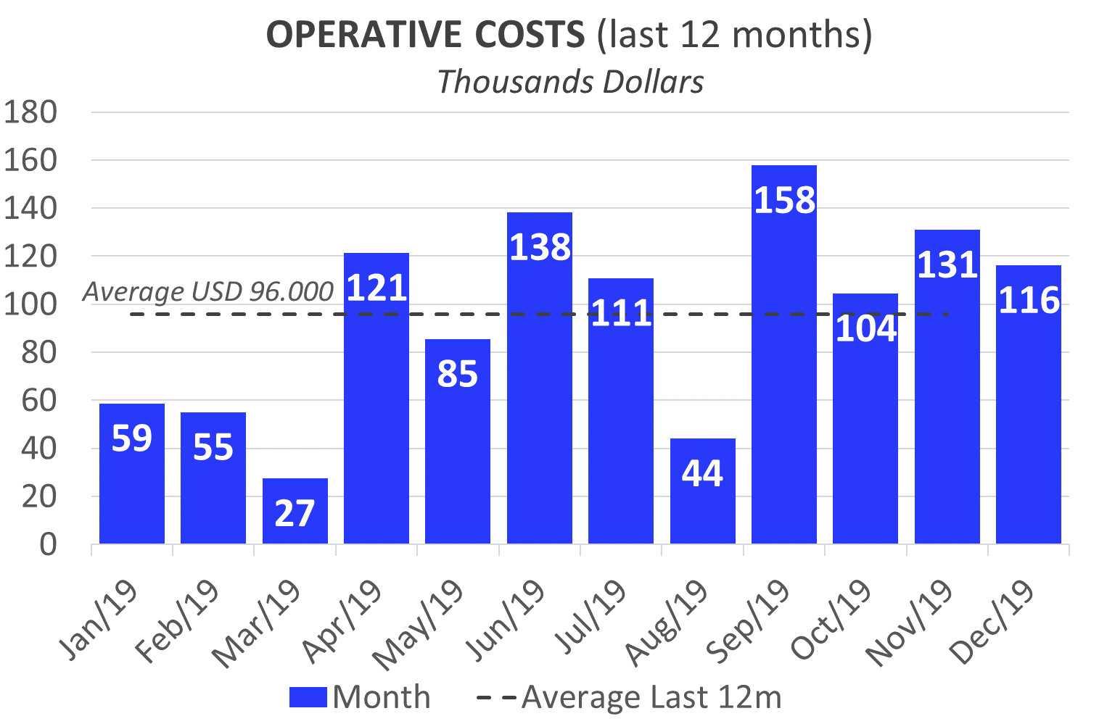
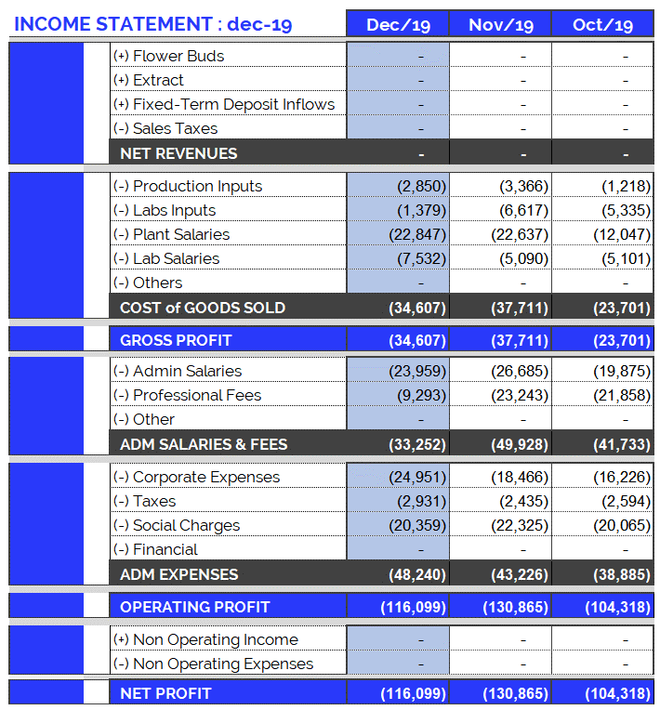
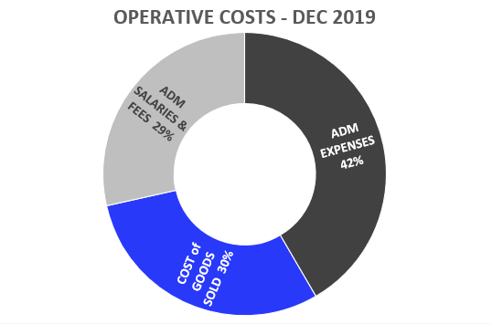
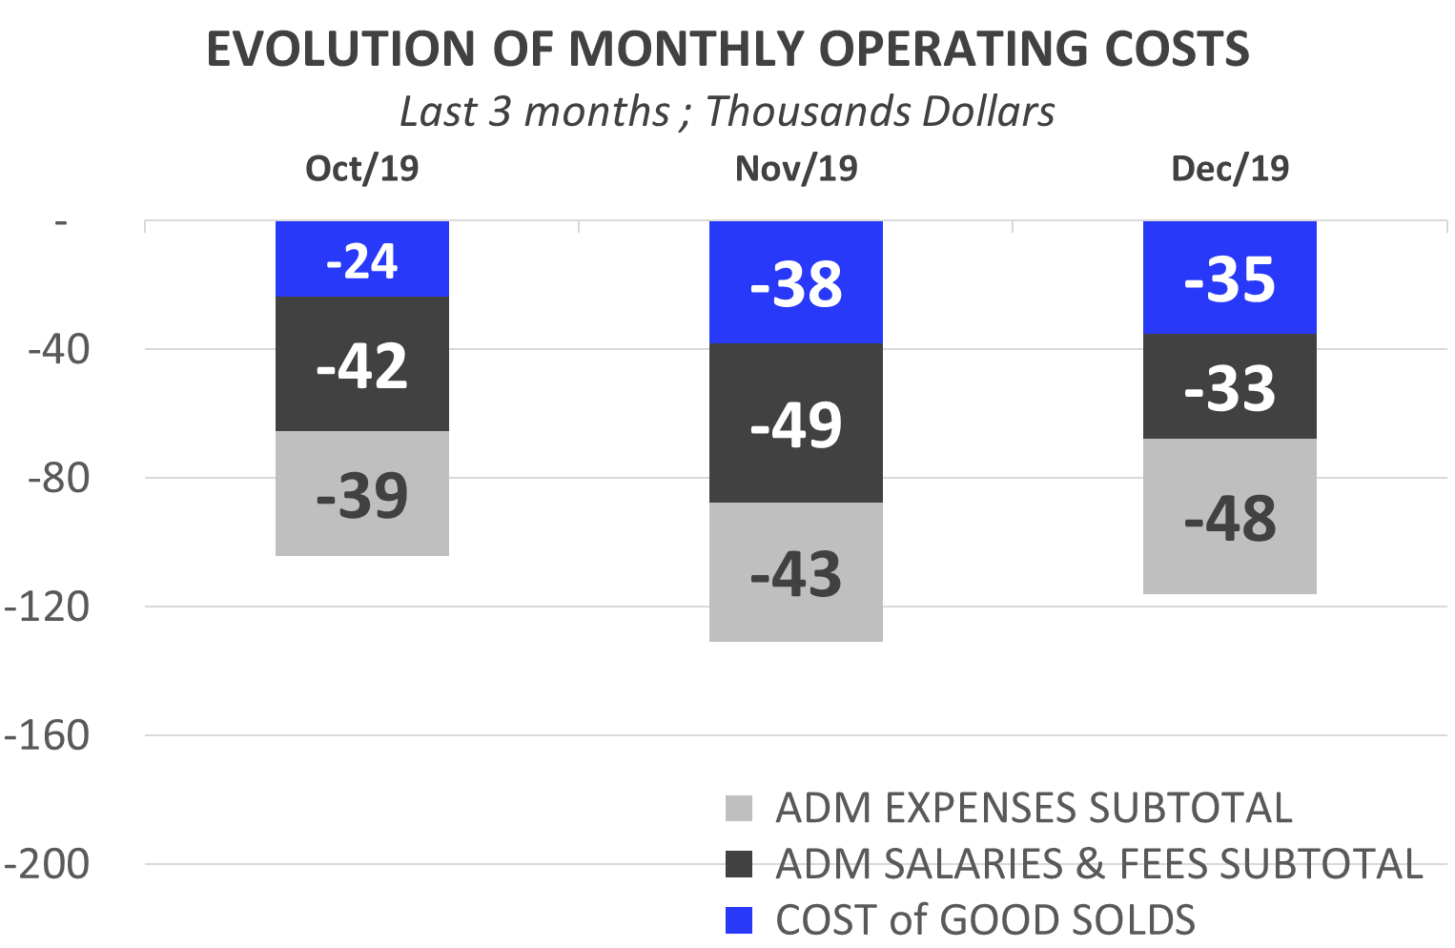
Income Statement: Dec. 2019
10
Highlights of Dec. 2019 Expenses:
USD 116.099.
Total operating costs for December are more than the average for the last 12 months (+21%).
Costs of Goods Sold: USD 34,607.
Corporate Expenses : USD 24,951.
Electricity (UTE): USD 7,508.
UdelaR: USD 6,363.
Maintenance: USD 2,285.
PCTP Land Rent USD 1,848.
Admin Salaries: USD 23,320.
Professional Fees: USD 9,293.
Taxes and Employer Contributions: USD 2,931.

Slide 11
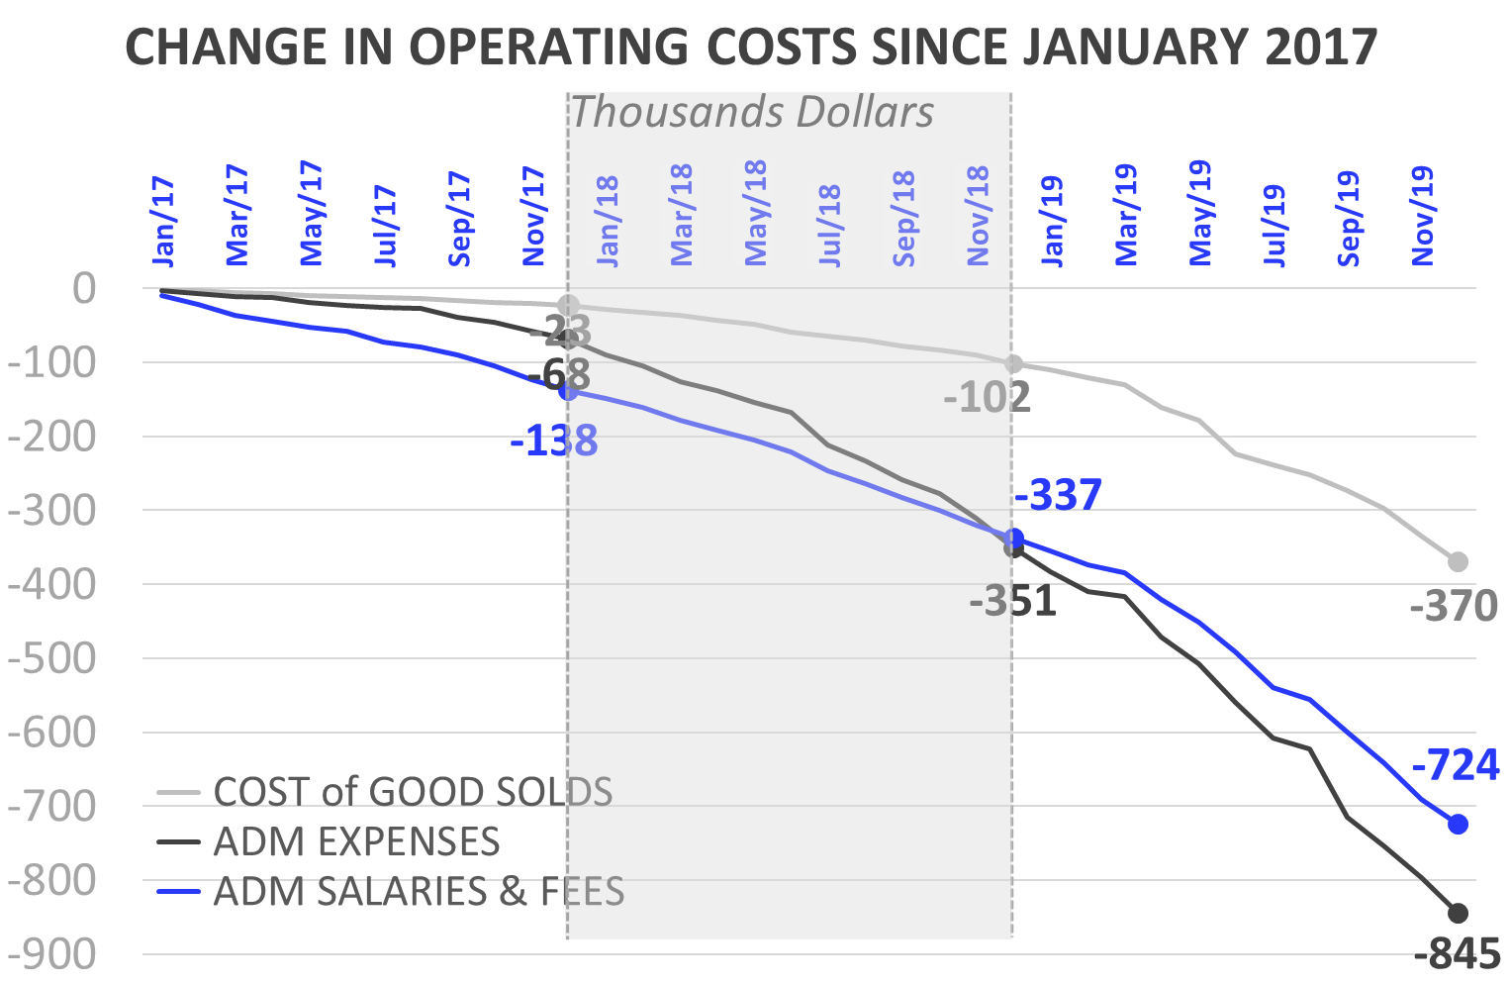
Income Statement: Change in Expenses
11
Burey’s operations have increased compared to 2017. This can be observed in the change of Operating Costs since Jan/17.
Cost of Goods Sold
In 2018 (compared to the accumulated amount for 2017) the Cost of Goods Sold increased 292%: between Jan/18 and Dec/18 USD 78,410 was spent. Mainly this is due to: increase in plant salaries.
In 2019, Cost of Goods Sold amounted to USD 268,173 (composed of 58% Plant Salaries, 16% Production Inputs, 14% Lab Salaries and 12% Labs Inputs).
Administrative Salaries & Fees
In 2018 (compared to the accumulated amount for 2017) Administrative Salaries & Fees increased 151%: between Jan/18 and Dec/18 USD 198,601 was spent.
In 2019, Administrative Salaries & Fees amounted to USD 387,507 (composed of 63% Adm. Salaries and 37% Professional Fees).
Administrative Expenses
In 2018 (compared to the accumulated amount for 2017) Administrative Expenses increased 416%: between Jan/18 and Dec/18 USD 283,190 was spent.
In 2019, Administrative Expenses amounted to USD 494,004 (composed of 51% Corporate Expenses, 24% Taxes and 24% Social Charges).

Slide 12
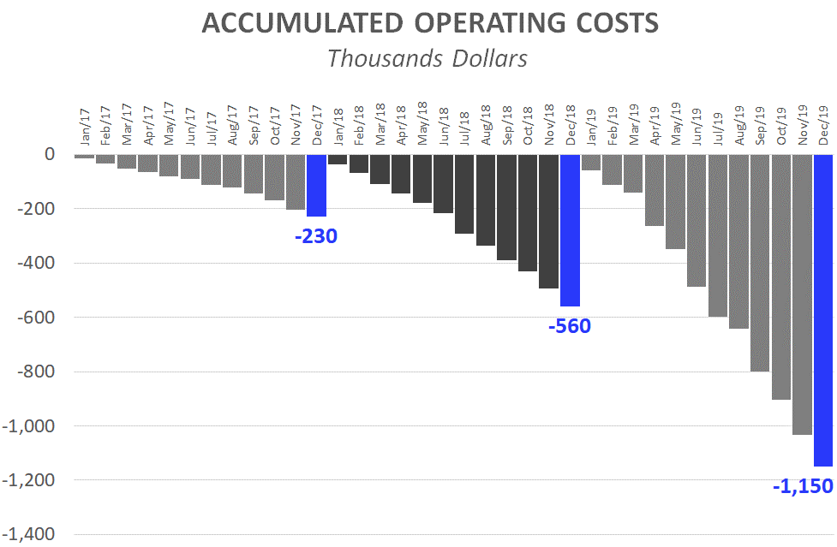
Income Statement: 12 months of 2019
12
Operating Costs accumulated for calendar year
The accumulated expenses for the 12 months (12M) of 2018 represent 243% of total 2017 expenses. This reflects the increase in operating costs mentioned in the previous slide and is the result of research performed and preparations for our first commercial production. Operating costs accrued as of December 2019 (12M), represent 205% of those for 2018 (12M).
First 12 Months (12M): Comparison 2019 vs. 2018:
While in the 12M of 2018 we spent USD 560,200, in the 12M of 2019 we reached USD 1.149,684. This growth in expenses is principally attributed to:
In 2018, corporate expenses were USD 193,099. While, in 2019, USD 252,850 has been invested.
2019: The monthly average of admin salaries increased: + USD 9,646 (compared to 2018). This is due to:
Increase in compensation for Sergio, Joao, Sonia (Secretary) and new other staff.
2019: Professional Fees reached USD 142,787, while in 2018 (12M) they were USD 69,634.
2019: Plant Salaries rose (12M 2019: USD 153,917 vs. First 12M 2018: USD 68,194). As of Feb/18 a Janitor and Auxiliary Corp were hired. As of Jan/19 a Maintenance Manager and Second Auxiliary Corp were hired.
At the same time, the raise in salaries increased contributions required by law (BPS), in 2019/2018 with respect to 2017.

Slide 13
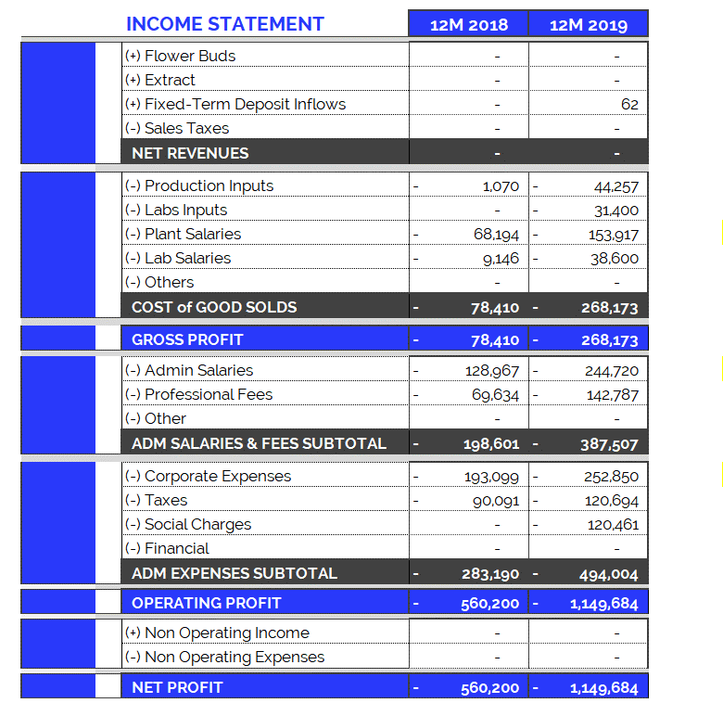
Income Statement: 12 months of 2019 vs 2018
13

Slide 14
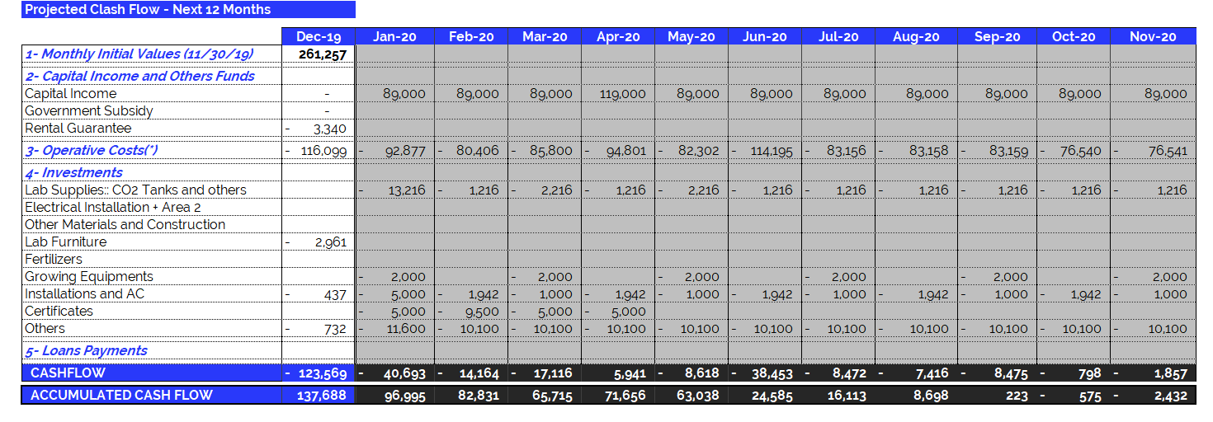
Dec 2019 – Projected Cash Flow for next 12 months
14
(*) Operating Expenses include 100% of the company's operating costs: salaries, professional fees, rent, etc. THE MONTHLY AVERAGE OF OPERATING EXPENSES does not include investments in equipment and labor. See the following item.

