Slide 1

BUREY SA –
Grunelabs.com
Mar 2020 presentation
Montevideo, March 10, 2020

Slide 2

INDEX
Cash flow available data
Management tools
  Balance Sheet
  Income Statement
Next steps

Slide 3
INDEX
Cash flow available data
Management tools
  Balance Sheet
  Income Statement
Next steps

Slide 4
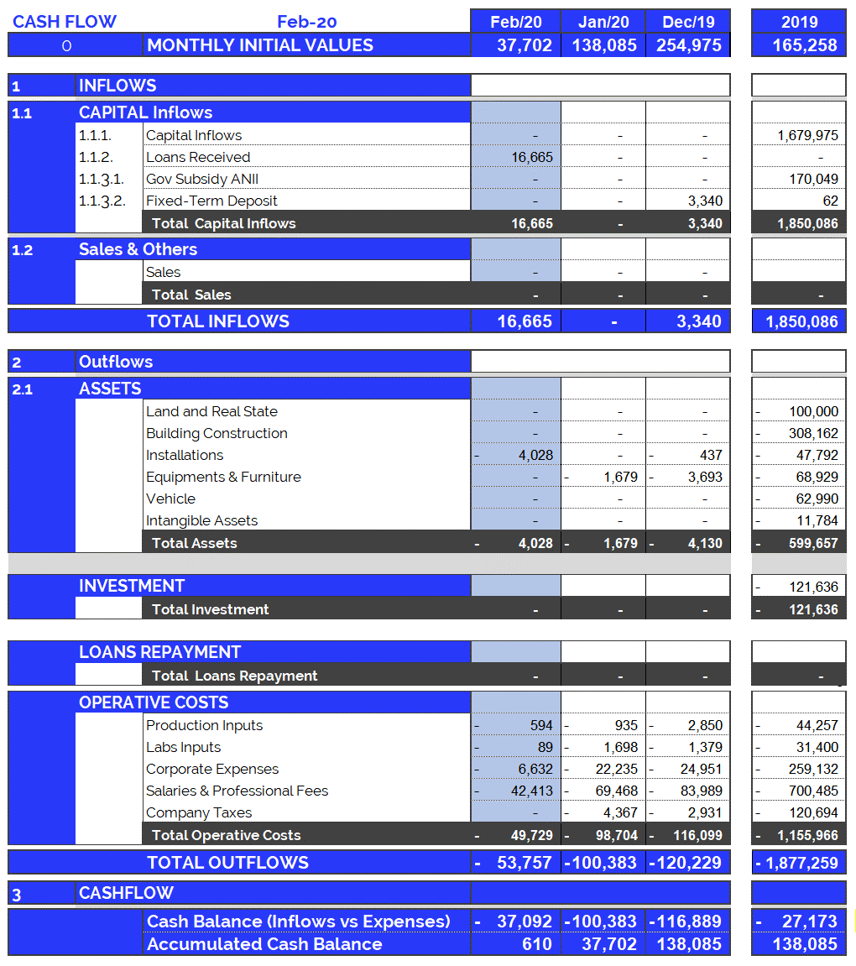
Cash Flow available data: Feb. 2020
4
Accumulated cash balance at the end of 2019:
USD 138,086.
  Opening balance 2019 (end of 2018): USD 165,258
  Inflows 2019: USD 1,850,086 (partner contributions and others)
  Outflows 2019: USD (-) 1,877,259.
  Final accumulated cash balance 2019: USD 138,086.
Accumulated cash balance at the end of Feb. 2020: USD 37,703.
  Opening balance (end of Jan/20): (+) USD 37,703.
  Capital Income Feb/20 : (+) USD 0
  Loans Received Feb/20 : (+) USD 16.665.
  Fixed Assets Feb/20 : (-) USD 4,028.
  Operating Expenses Feb/20 : (-) USD 49,729.
  Final accumulated cash balance Feb 2020 : USD 610.
  Cash outflows for Feb/20 (USD 53,757) are composed of: 93% Operating Expenses, 7% Equipment and Structure.
  February operating costs were below the average (last 12 months).
New partner contributions and Loans: Feb. 2020
  Contribution of partners: USD 0.

Slide 5
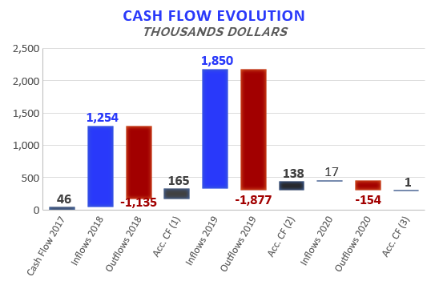

Accumulated Cash Flow – Feb 2020
5
Final Cash Balance 2016: USD 39 thousand
Final Cash Balance 2017: USD 46 thousand
Final Cash Balance 2018: USD 165 thousand
Final Cash Balance 2019: USD 138 thousand
Final Cash Balance 2020: USD 0,6 thousand
  January 2020: USD (-) 100.3 thousand.
  February 2020: USD (-) 37.1 thousand.
Accumulated 2020
Acc. CF (1) – Accumulated Cash Flow (2016 - 2018)
Acc. CF (2) – Accumulated Cash Flow (2016 - December 2019)
Acc. CF (3) – Accumulated Cash Flow (2016 – Feb 2020)

Slide 6
INDEX
Cash flow available data
Management tools
  Balance Sheet
  Income Statement
Next steps

Slide 7
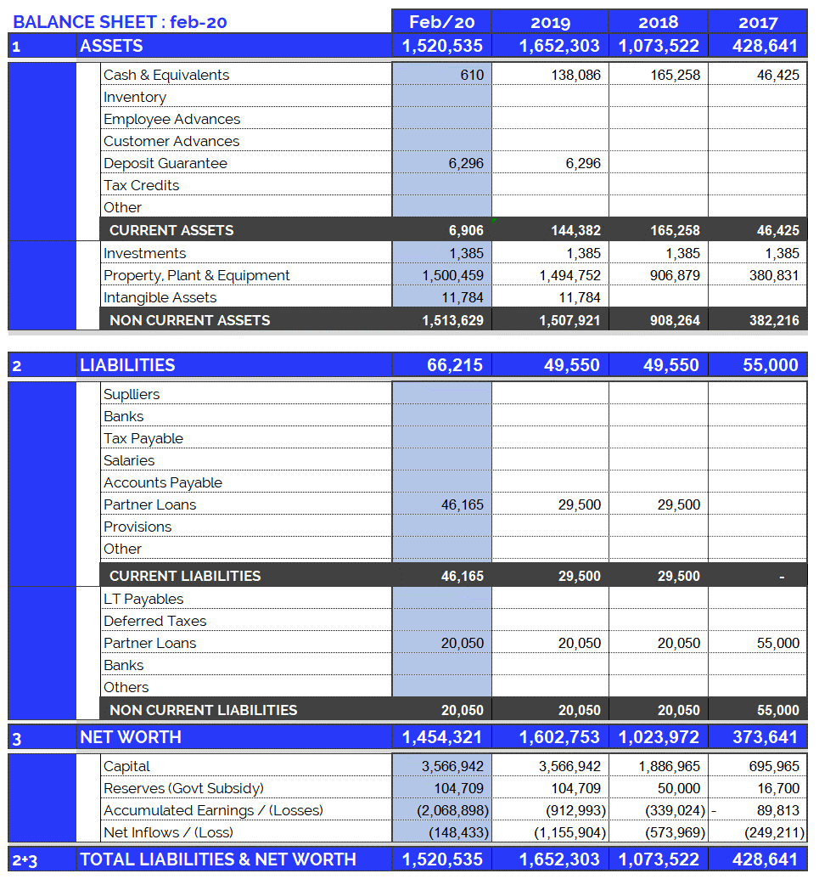
Balance Sheet: Feb. 2020
7
Continuous growth of plant and equipment
  Property, Plant & Equipment growth in 2017: 200%
  Property, Plant & Equipment growth in 2018: 138%
  Property, Plant & Equipment growth in 2019: 65%
  Property, Plant & Equipment growth in 2020: 0,4%
  (Investments include Value Added Taxes: Tax Credit)
Fixed assets totally funded by capital injections and Government Subsidy.

Slide 8
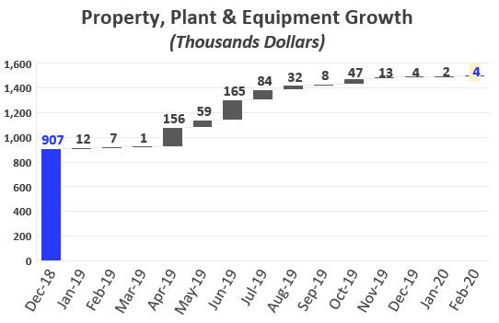
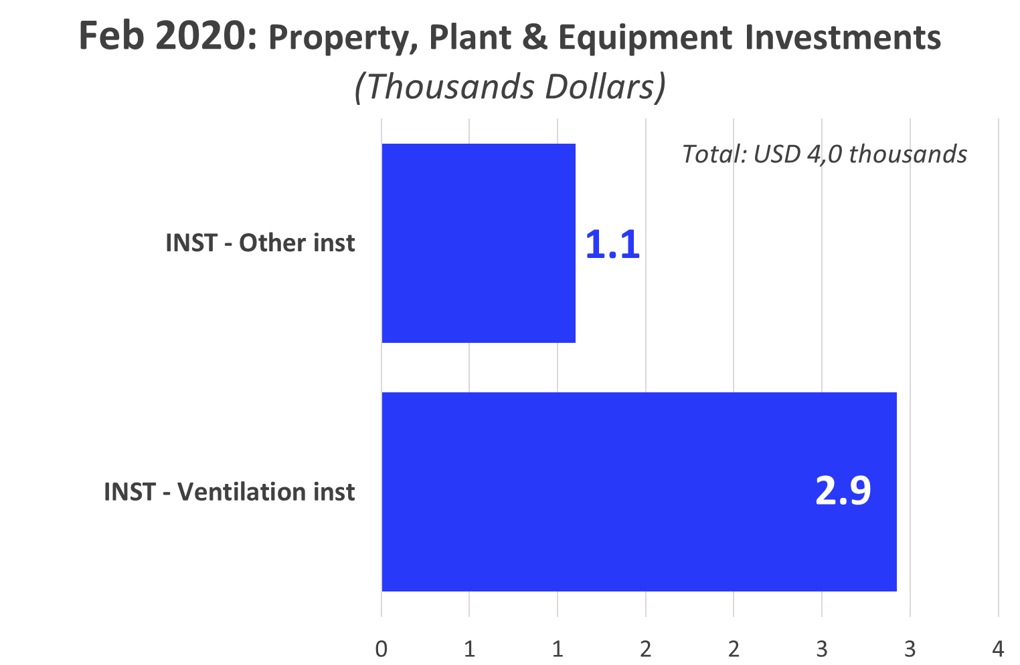
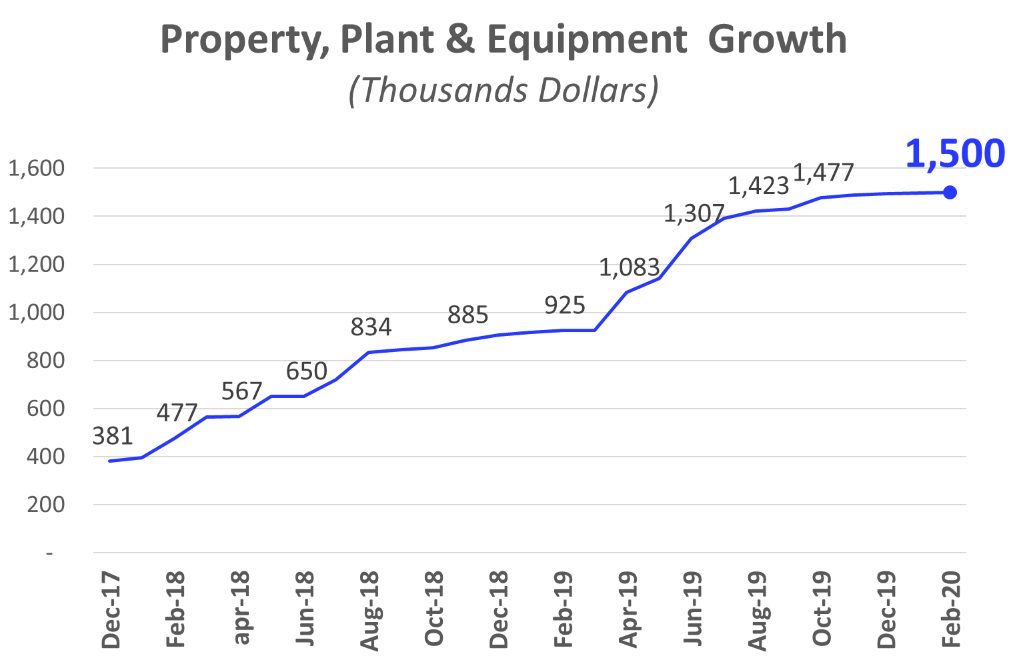
Investments_ Property, Plant & Eq.: Feb 2020
8

Slide 9
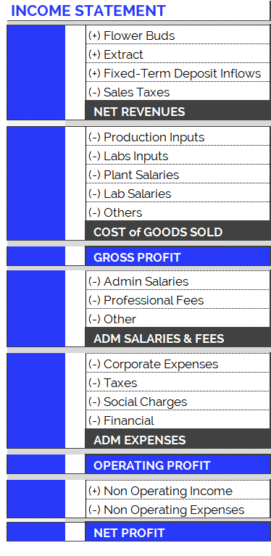
Income Statement: Change in Expenses
9
New Accounting Classification System for Operating Costs, since June 2019
In order to adequately present the company's areas of expense, the operating costs have been arranged according to item and category, as can be seen in the table on the right. Therefore:
  Cost of Goods Sold
    Shows direct costs of the production process: raw materials, tools, other materials and salaries of plant and laboratory employees.
  Adm Salaries & Fees
    Shows indirect costs of the production process: administrative salaries and professional fees.
  Administration Expenses
    Overhead and other expenses relating to the company’s structure.
The new accounting item classifications have generated small differences in the historical accumulated balances (in the new version of the Chart of Accounts compared to the previous one): for example, in the previous month's report (apr-19), differences can be observed in the accumulated flows of Cost of Good Sold. This is because all the accounts have been reclassified and, in order to maintain the same criteria, this generated variations in the historical presentation of the items. However, it should be kept in mind that the historical total expenditures remain unchanged, since the new order simply reorganizes the items for the purpose of better financial statements.

Slide 10
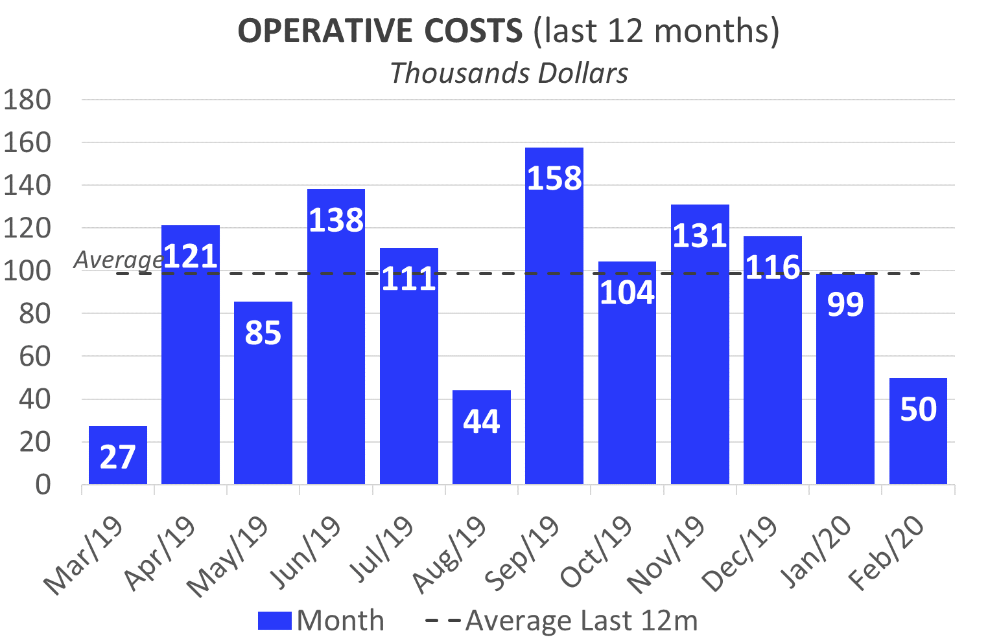
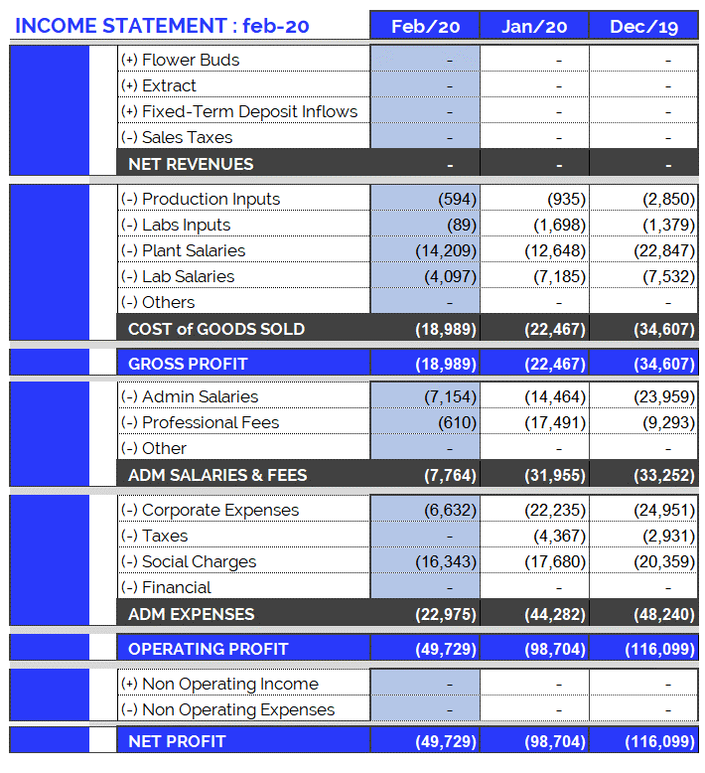
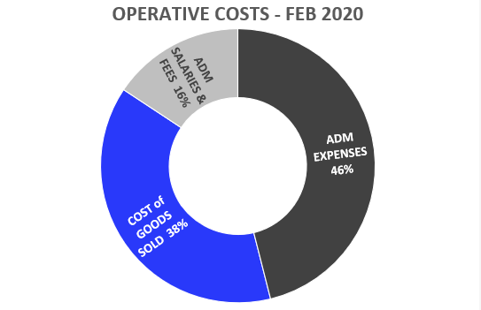
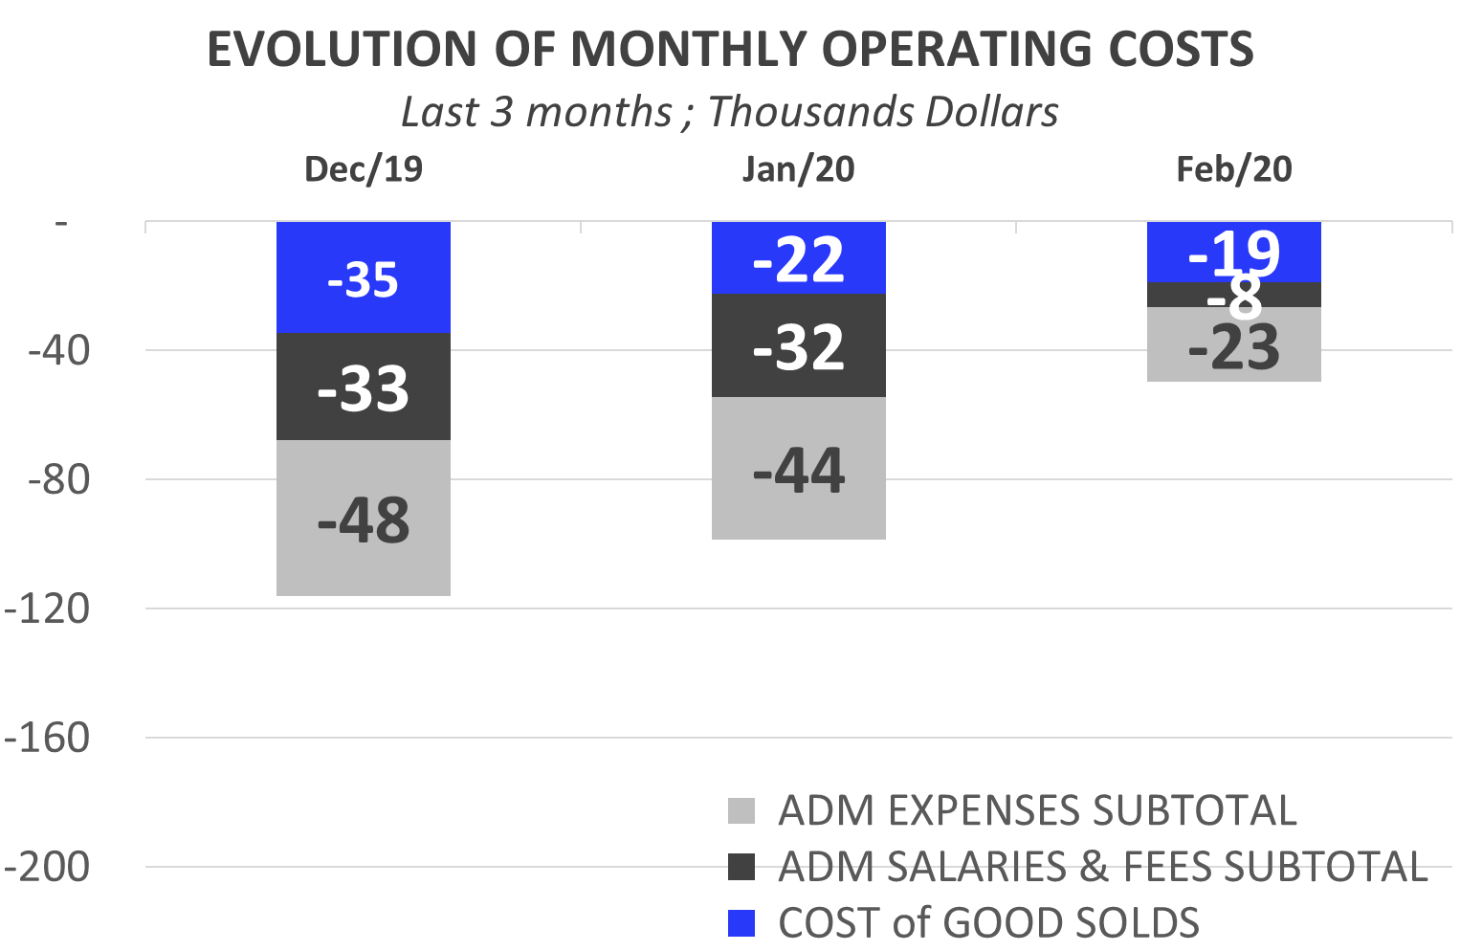
Income Statement: Feb. 2020
10
Highlights of Feb. 2020 Expenses:
USD 49.729.
Total operating costs for February are within the average (last 12 months).
  Costs of Goods Sold: USD 18,989.
  Admin Salaries: USD 7,154.
  Corporate Expenses : USD 6,632.
    PCTP Land Rent USD 1,852.
    Maintenance: USD 842.
  Professional Fees: USD 610.
  Social Charges: USD 16,343.

Slide 11
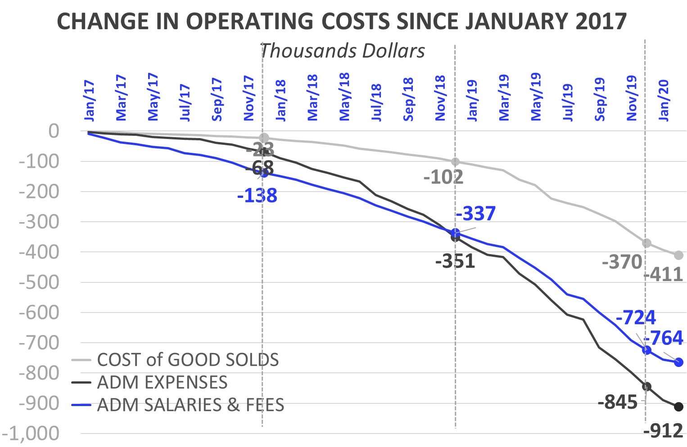
Income Statement: Change in Expenses
11
Burey’s operations have increased compared to 2017. This can be observed in the change of Operating Costs since Jan/17.
Cost of Goods Sold
  In 2019 (compared to the accumulated amount for 2018) the Cost of Goods Sold increased 242%: between Jan/19 and Dec/19 USD 268,173 was spent. Mainly this is due to: increase in plant salaries and labs inputs.
  In 2020, Cost of Goods Sold amounted to USD 41,456 (composed of 65% Plant Salaries, 27% Lab Salaries, 4% Labs Inputs and 4% Production Inputs).
Administrative Salaries & Fees
  In 2019 (compared to the accumulated amount for 2018) Administrative Salaries & Fees increased 95%: between Jan/19 and Dec/19 USD 387,507 was spent. Mainly this is due to: increase in Adm Salaries.
  In 2020, Administrative Salaries & Fees amounted to USD 39,719 (composed of 54% Adm. Salaries and 46% Adm. Salaries).
Administrative Expenses
  In 2019 (compared to the accumulated amount for 2018) Administrative Expenses increased 74%: between Jan/19 and Dec/19 USD 494,004 was spent.
  In 2020, Administrative Expenses amounted to USD 67,257 (composed of 43% Corporate Expenses, 51% Social Charges and 6% Taxes).

Slide 12
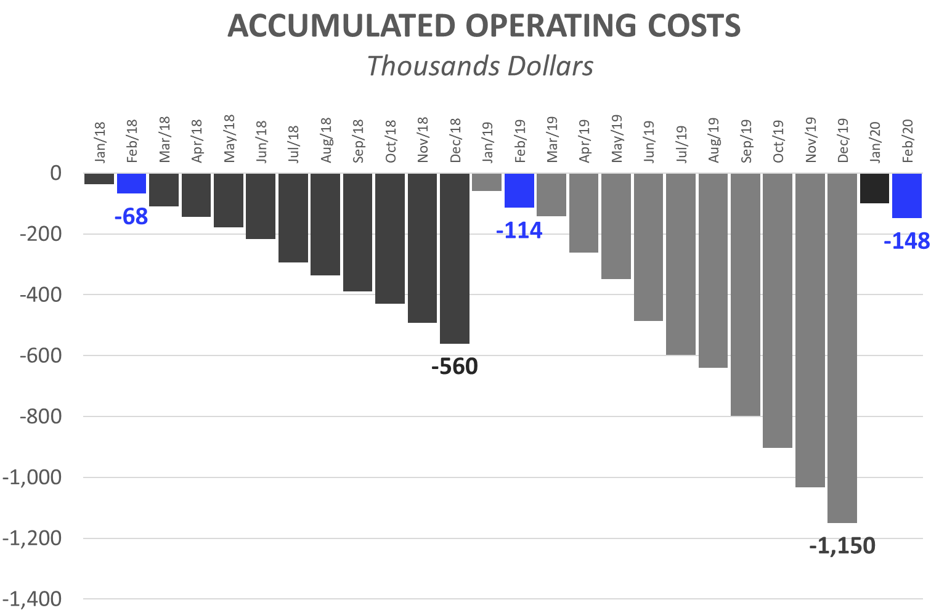
Income Statement: 2 months of 2020
12
Operating Costs accumulated for calendar year
The accumulated expenses for the 12 months (12M) of 2019 represent 205% of total 2018 expenses. This reflects the increase in operating costs mentioned in the previous slide and is the result of research performed and preparations for our first commercial production.
First 2 Month (2M): Comparison 2020 vs. 2019:
While in the first 2M of 2019 we spent USD 113,626, in the first 2M of 2020 we reached USD 148.433. This growth in expenses is principally attributed to:
  First 2M of 2019, corporate expenses were USD 39,709. While, in the first 2M of 2019, USD 28,868 has been invested.
  First 2M of 2020: The monthly average of admin salaries increased: + USD 1,360 (compared to 2019). This is due to:
    Increase in new other staff.
  First 2M of 2020: Professional Fees reached USD 18,101, while in 2019 (2M) they were USD 12,375.
  First 2M of 2020: Plant Salaries rose (2M 2020: USD 26,857 vs. First 2M 2019: USD 16,426). As of Feb/19 an Auxiliary Corp was hired. As of Sep/19 a second Auxiliary Corp was hired. As of Dec/19 a third and fourth Auxiliary Corp were hired.
  At the same time, the raise in salaries increased contributions required by law (BPS), in 2020/19 with respect to 2017.

Slide 13
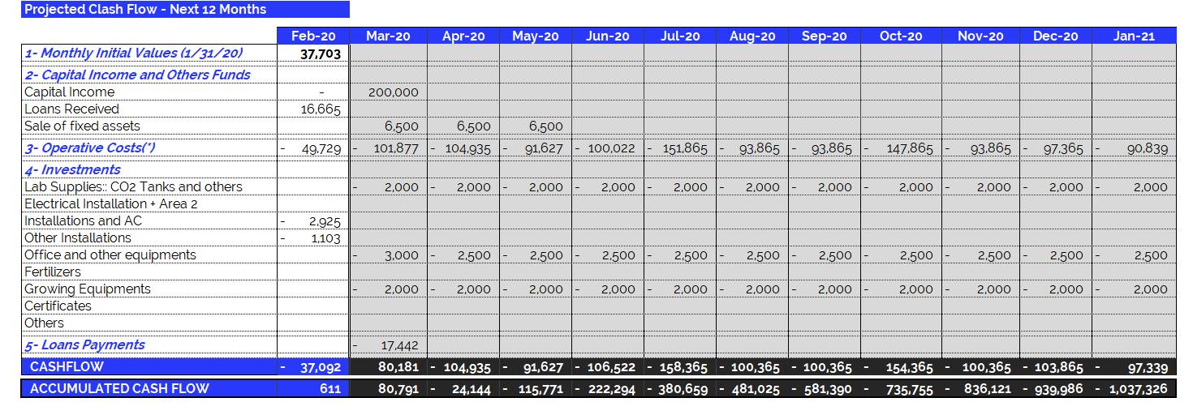
Feb 2020 – Projected Cash Flow for next 12 months
14
(*) Operating Expenses include 100% of the company's operating costs: salaries, professional fees, rent, etc. THE MONTHLY AVERAGE OF OPERATING EXPENSES does not include investments in equipment and labor. See the following item.

