Slide 1

BUREY SA –
Grunelabs.com
Feb 2020 presentation
Montevideo, February 10, 2020

Slide 2

INDEX
Cash flow available data
Management tools
  Balance Sheet
  Income Statement
Next steps

Slide 3
INDEX
Cash flow available data
Management tools
  Balance Sheet
  Income Statement
Next steps

Slide 4
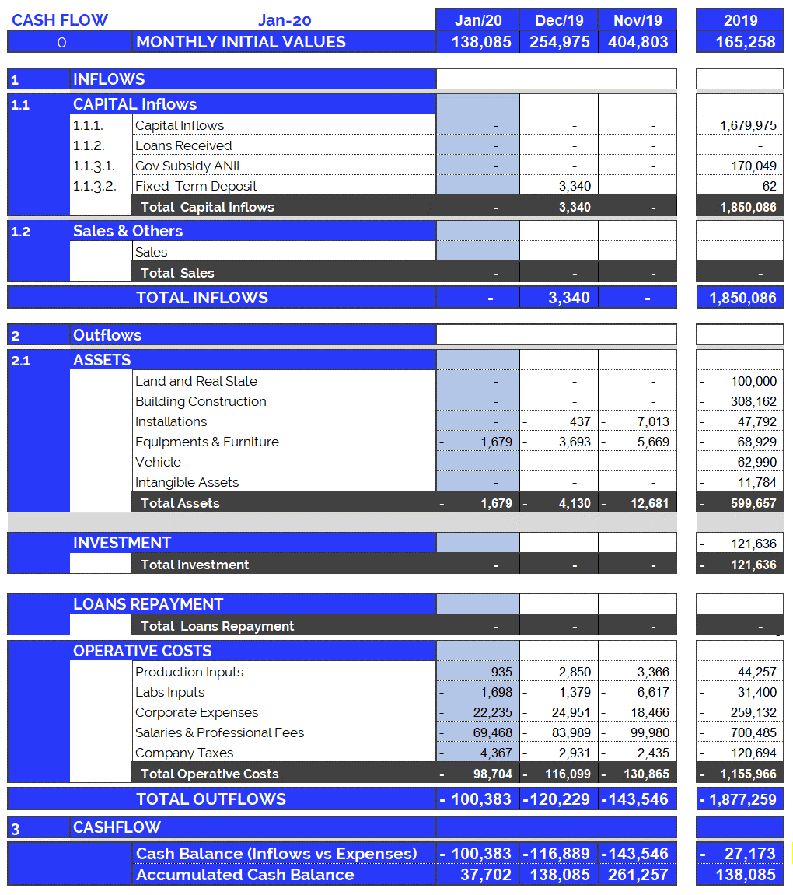
Cash Flow available data: Jan. 2020
4
Accumulated cash balance at the end of 2019:
USD 138,086.
  Opening balance 2019 (end of 2018): USD 165,258
  Inflows 2019: USD 1,850,086 (partner contributions and others)
  Outflows 2019: USD (-) 1,877,259.
  Final accumulated cash balance 2019: USD 138,086.
Accumulated cash balance at the end of Jan. 2020: USD 37,703.
  Opening balance (end of Dec/19): (+) USD 138,086.
  Capital Income Jan/20 : (+) USD 0
  Fixed Assets Jan/20 : (-) USD 1,679.
  Operating Expenses Jan/20 : (-) USD 98,704.
  Final accumulated cash balance Jan 2010 : USD 37,703.
  Cash outflows for Jan/20 (USD 100,383) are composed of: 98% Operating Expenses, 2% Equipment and Structure.
  January operating costs were within the average (last 12 months).
New partner contributions and Loans: Jan. 2020
  Contribution of partners: USD 0.

Slide 5
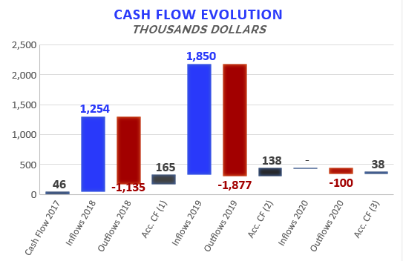

Accumulated Cash Flow – Jan 2020
5
Final Cash Balance 2016: USD 39 thousand
Final Cash Balance 2017: USD 46 thousand
Final Cash Balance 2018: USD 165 thousand
Final Cash Balance 2019: USD 138 thousand
Final Cash Balance 2020: USD 38 thousand
  January 2020: USD (-) 100.3 thousand.
Accumulated 2020
Acc. CF (1) – Accumulated Cash Flow (2016 - 2018)
Acc. CF (2) – Accumulated Cash Flow (2016 - December 2019)
Acc. CF (3) – Accumulated Cash Flow (2016 – Jan 2020)

Slide 6
INDEX
Cash flow available data
Management tools
  Balance Sheet
  Income Statement
Next steps

Slide 7
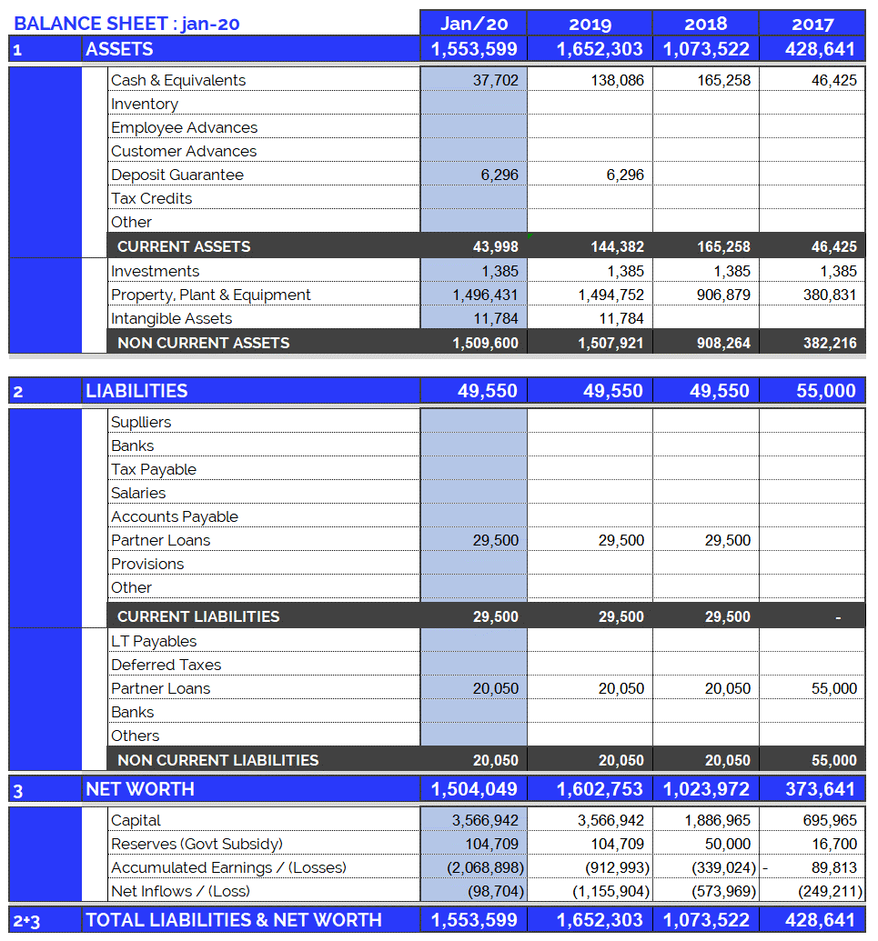
Balance Sheet: Jan. 2020
7
Continuous growth of plant and equipment
  Property, Plant & Equipment growth in 2017: 200%
  Property, Plant & Equipment growth in 2018: 138%
  Property, Plant & Equipment growth in 2019: 65%
  Property, Plant & Equipment growth in 2020: 0,1%
  (Investments include Value Added Taxes: Tax Credit)
Fixed assets totally funded by capital injections and Government Subsidy.

Slide 8
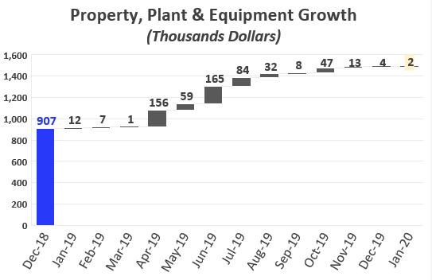
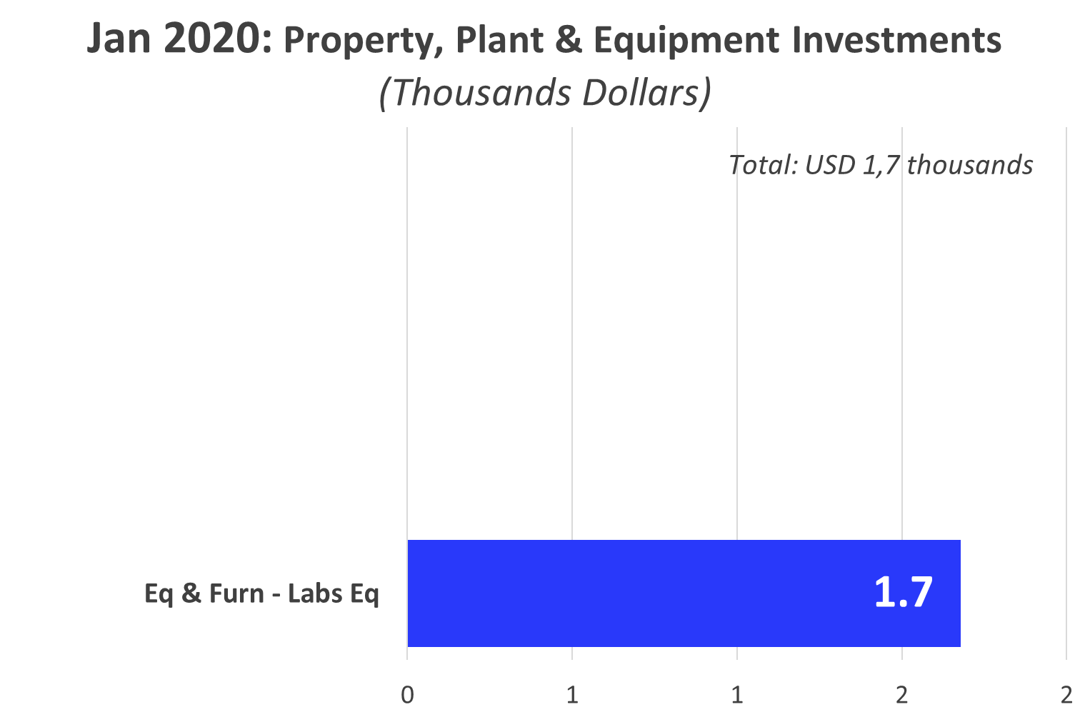
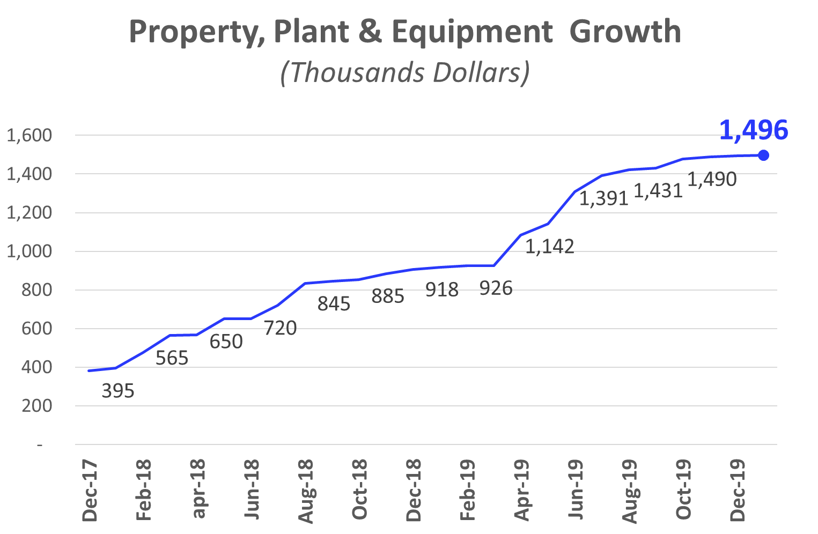
Investments_ Property, Plant & Eq.: Jan 2020
8

Slide 9
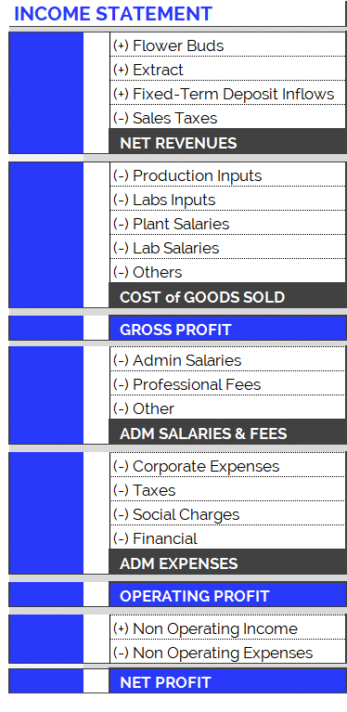
Income Statement: Change in Expenses
9
New Accounting Classification System for Operating Costs, since June 2019
In order to adequately present the company's areas of expense, the operating costs have been arranged according to item and category, as can be seen in the table on the right. Therefore:
  Cost of Goods Sold
    Shows direct costs of the production process: raw materials, tools, other materials and salaries of plant and laboratory employees.
  Adm Salaries & Fees
    Shows indirect costs of the production process: administrative salaries and professional fees.
  Administration Expenses
    Overhead and other expenses relating to the company’s structure.
The new accounting item classifications have generated small differences in the historical accumulated balances (in the new version of the Chart of Accounts compared to the previous one): for example, in the previous month's report (apr-19), differences can be observed in the accumulated flows of Cost of Good Sold. This is because all the accounts have been reclassified and, in order to maintain the same criteria, this generated variations in the historical presentation of the items. However, it should be kept in mind that the historical total expenditures remain unchanged, since the new order simply reorganizes the items for the purpose of better financial statements.

Slide 10
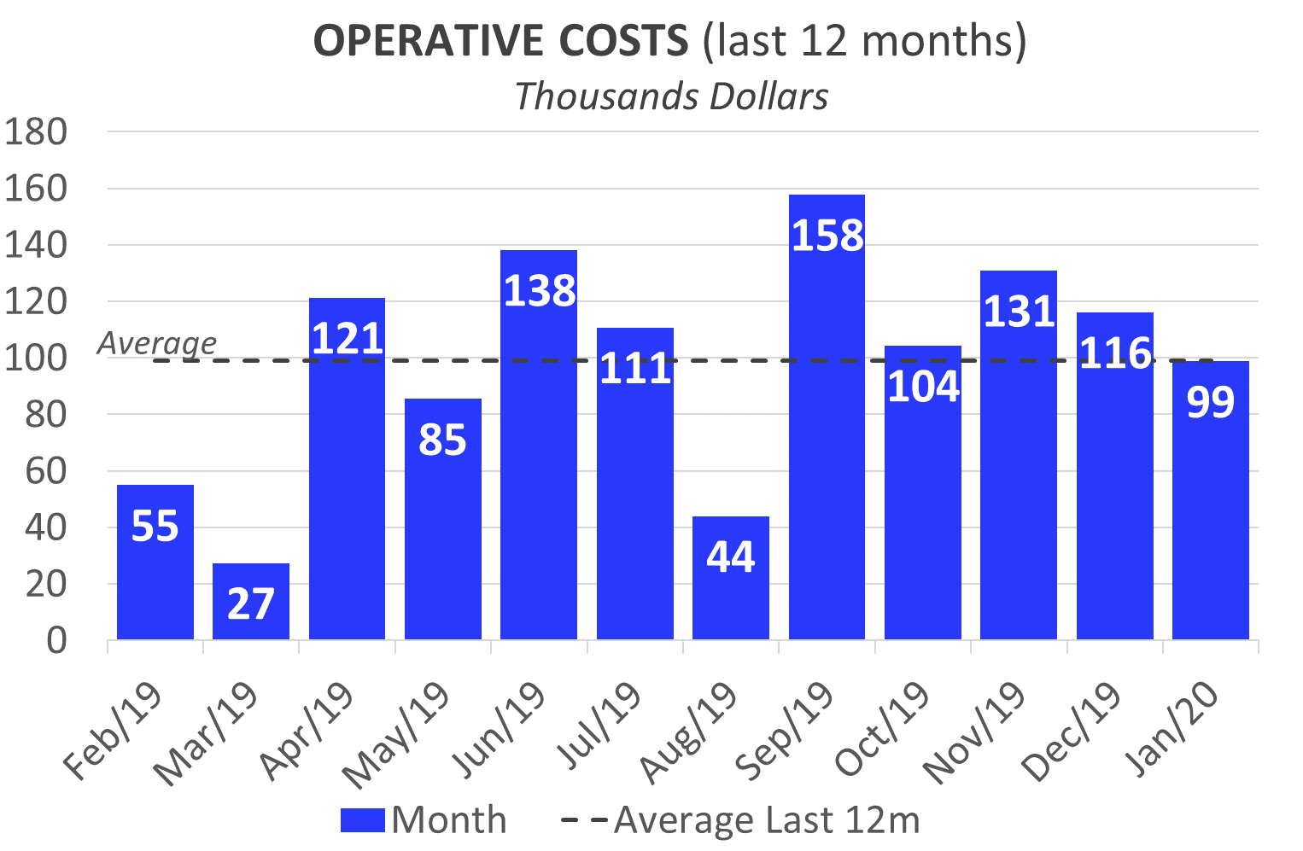
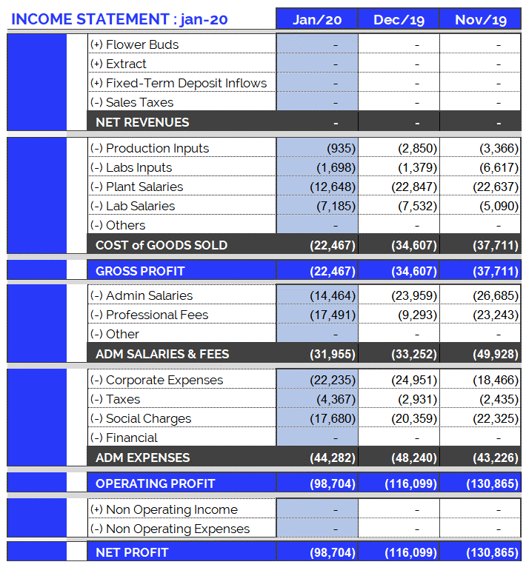
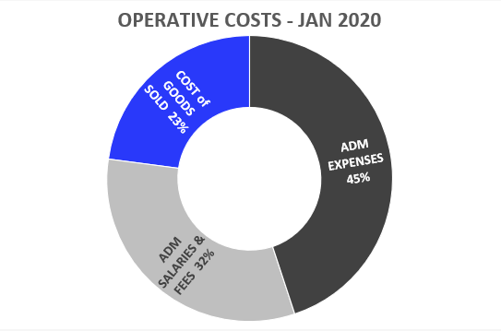
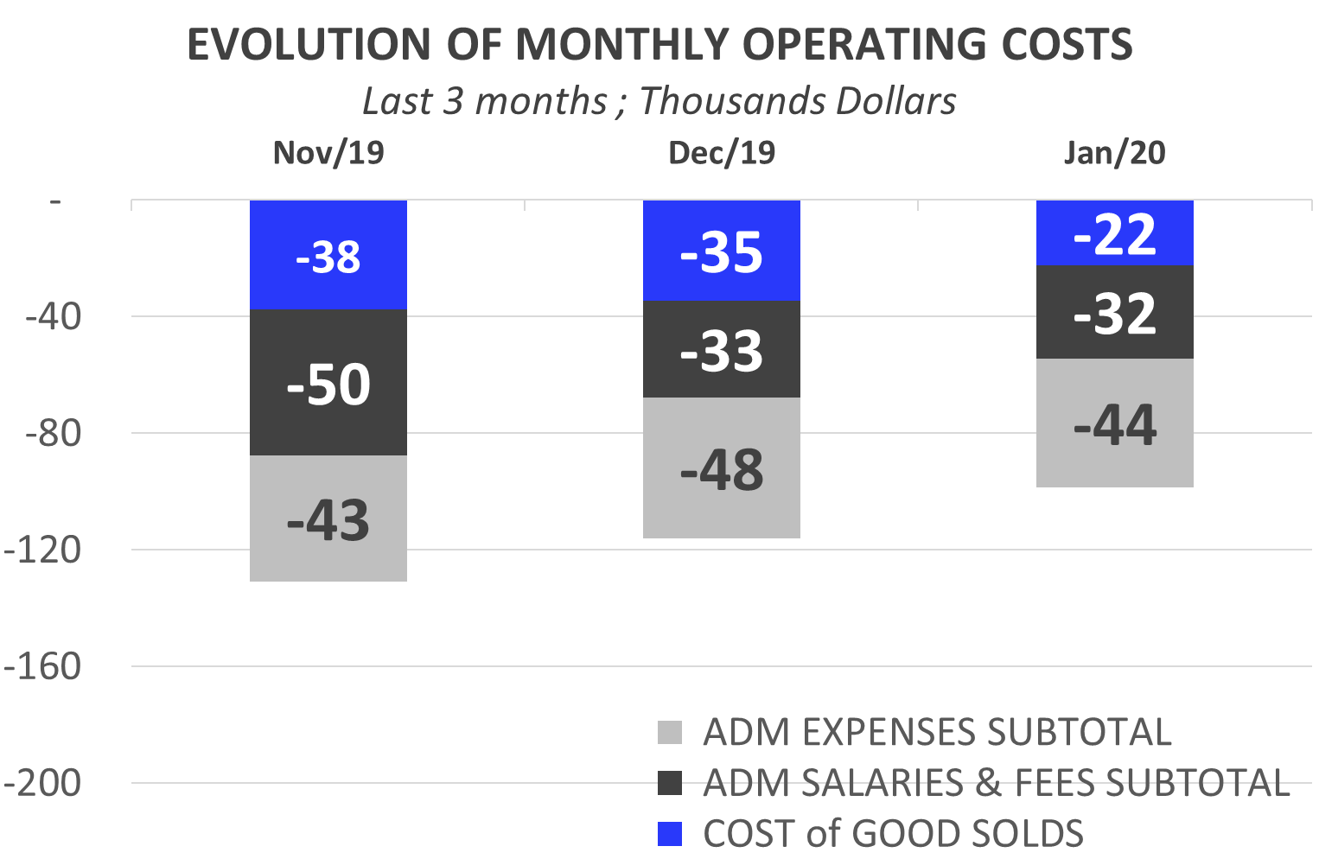
Income Statement: Jan. 2020
10
Highlights of Jan. 2020 Expenses:
USD 98.704.
Total operating costs for January are within the average (last 12 months).
  Costs of Goods Sold: USD 22,467.
  Corporate Expenses : USD 22,235.
    Electricity (UTE): USD 6,785.
    UdelaR: USD 6,458.
    Extra Corp Exp - travel: USD 1,944.
    Maintenance Car: USD 1,630.
  Admin Salaries: USD 14,464.
  Professional Fees: USD 17,491.
  Taxes and Employer Contributions: USD 4,367.

Slide 11
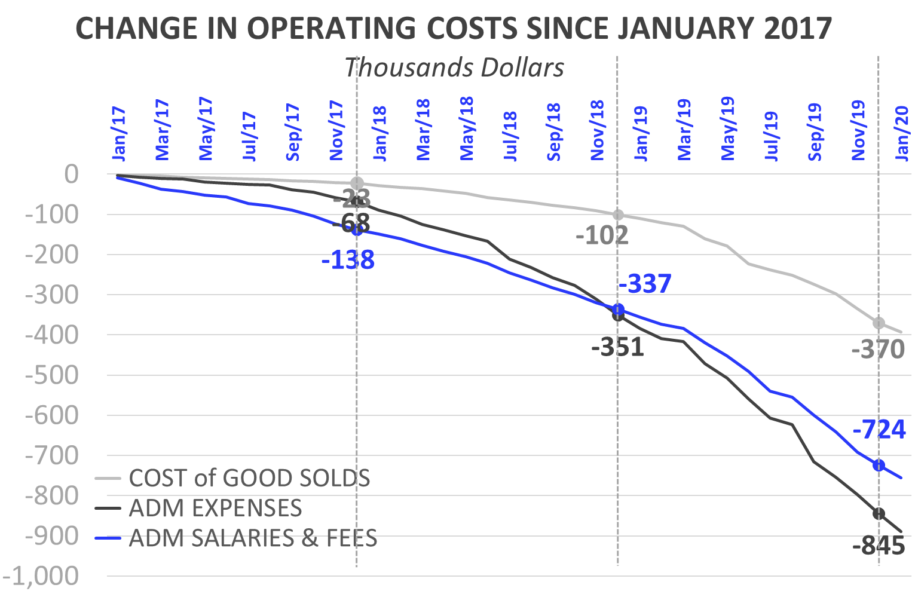
Income Statement: Change in Expenses
11
Burey’s operations have increased compared to 2017. This can be observed in the change of Operating Costs since Jan/17.
Cost of Goods Sold
  In 2019 (compared to the accumulated amount for 2018) the Cost of Goods Sold increased 242%: between Jan/19 and Dec/19 USD 268,173 was spent. Mainly this is due to: increase in plant salaries and labs inputs.
  In 2020, Cost of Goods Sold amounted to USD 22,467 (composed of 56% Plant Salaries, 32% Lab Salaries, 8% Labs Inputs and 4% Production Inputs).
Administrative Salaries & Fees
  In 2019 (compared to the accumulated amount for 2018) Administrative Salaries & Fees increased 95%: between Jan/19 and Dec/19 USD 387,507 was spent. Mainly this is due to: increase in Adm Salaries.
  In 2020, Administrative Salaries & Fees amounted to USD 31,955 (composed of 55% Professional Fees and 45% Adm. Salaries).
Administrative Expenses
  In 2019 (compared to the accumulated amount for 2018) Administrative Expenses increased 74%: between Jan/19 and Dec/19 USD 494,004 was spent.
  In 2020, Administrative Expenses amounted to USD 44,282 (composed of 50% Corporate Expenses, 40% Social Charges and 10% Taxes).

Slide 12
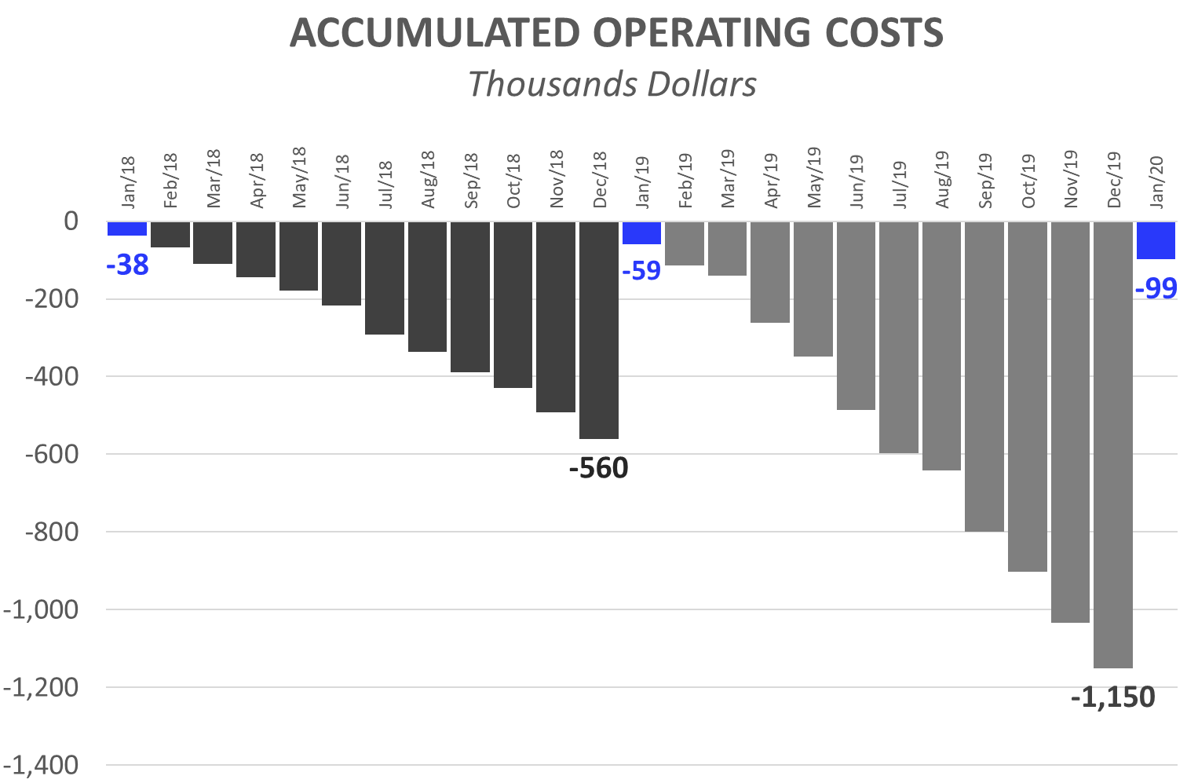
Income Statement: 1 month of 2020
12
Operating Costs accumulated for calendar year
The accumulated expenses for the 12 months (12M) of 2019 represent 205% of total 2018 expenses. This reflects the increase in operating costs mentioned in the previous slide and is the result of research performed and preparations for our first commercial production.
First 1 Month (1M): Comparison 2020 vs. 2019:
While in the first 1M of 2019 we spent USD 58,638, in the first 1M of 2020 we reached USD 98.704. This growth in expenses is principally attributed to:
  First 1M of 2019, corporate expenses were USD 22,372. While, in the first 1M of 2019, USD 22,235 has been invested.
  First 1M of 2020: The monthly average of admin salaries increased: + USD 1,991 (compared to 2019). This is due to:
    Increase in new other staff.
  First 1M of 2020: Professional Fees reached USD 17,491, while in 2019 (1M) they were USD 5,834.
  First 1M of 2020: Plant Salaries rose (1M 2020: USD 12,648 vs. First 1M 2019: USD 6,314). As of Feb/19 an Auxiliary Corp was hired. As of Sep/19 a second Auxiliary Corp was hired. As of Dec/19 a third and fourth Auxiliary Corp were hired.
  At the same time, the raise in salaries increased contributions required by law (BPS), in 2020/19 with respect to 2017.

Slide 13
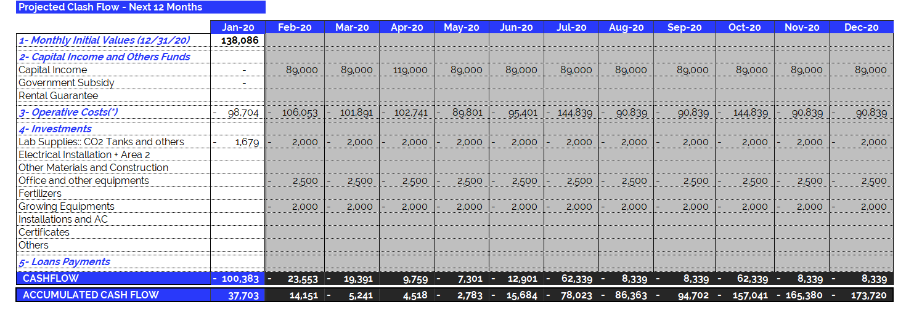
Jan 2020 – Projected Cash Flow for next 12 months
14
(*) Operating Expenses include 100% of the company's operating costs: salaries, professional fees, rent, etc. THE MONTHLY AVERAGE OF OPERATING EXPENSES does not include investments in equipment and labor. See the following item.

