Slide 1

BUREY SA –
Grunelabs.com
Jul 2019 presentation
Montevideo, August 10, 2019

Slide 2
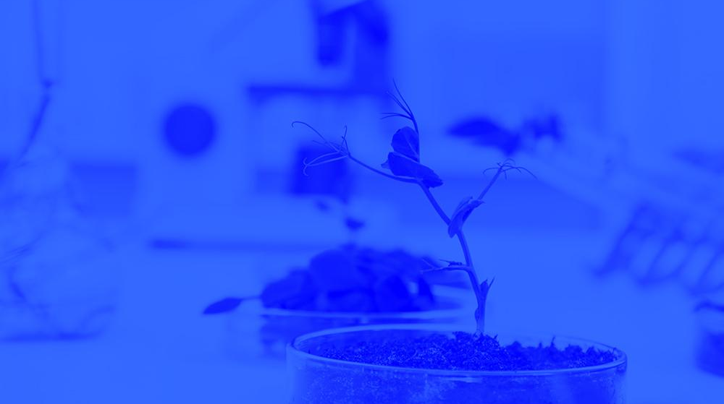
INDEX
Cash flow available data
Management tools
  Balance Sheet
  Income Statement
Next steps

Slide 3
INDEX
Cash flow available data
Management tools
  Balance Sheet
  Income Statement
Next steps

Slide 4
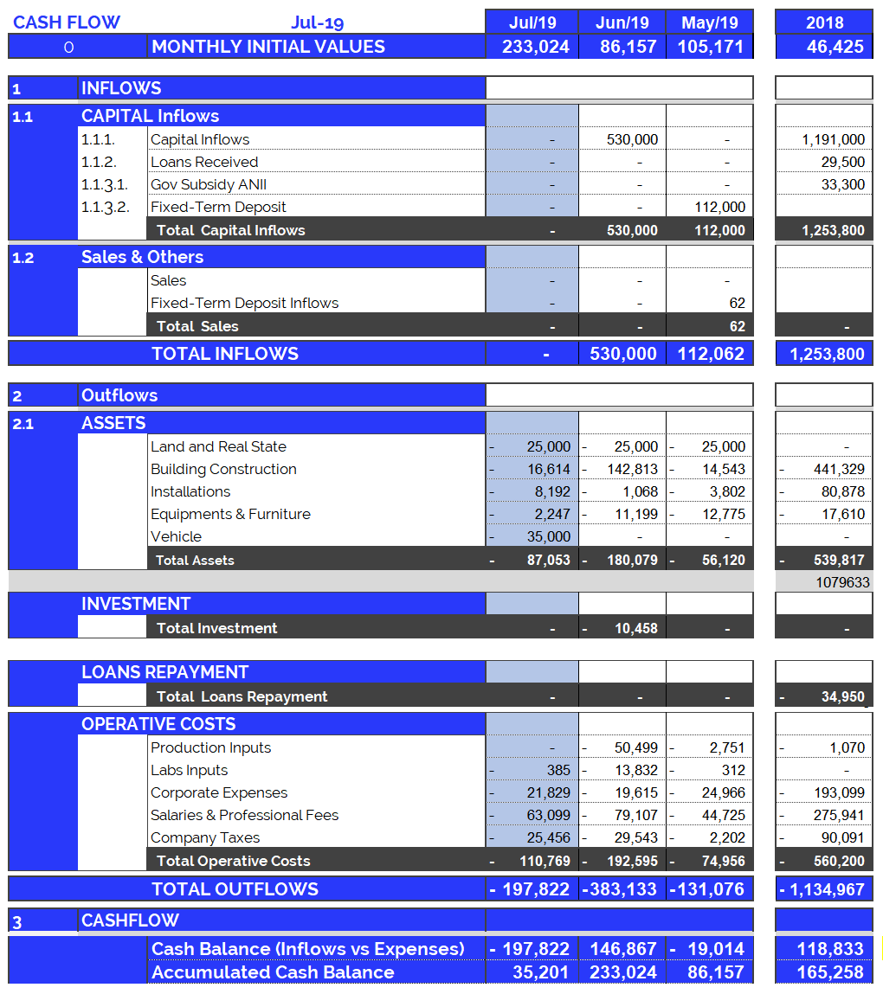
Cash Flow available data: Jul 2019
4
Accumulated cash balance at the end of 2018:
USD 165,258.
  Opening balance 2018 (end of 2017): USD 46,425
  Income 2018: USD 1,253,800 (partner contributions and loans)
  Expenses 2018: USD (-) 1,134,967.
  Final accumulated cash balance 2018: USD 165,258
Accumulated cash balance at the end of Jul 2019: USD 35,202.
  Opening balance (end of Jun/19): (+) USD 233,024
  Capital Income Jul/19 : (-) USD 0
  Building Construction Jul/19 : (-) USD 87,053
  Operating Expenses Jul/19 : (-) USD 110,769
  Final accumulated cash balance Jul 2019 : USD 35,201.
  Cash outflows for Jul/19 (USD 197,822) are composed of: 56% Operating Expenses, 44% Investment in Vehicles, Equipment and Structure.
  July operating costs were +46% more than the monthly average (last 12 months).
New partner contributions and Loans: Jul 2019
  Contribution of partners: USD 0.

Slide 5
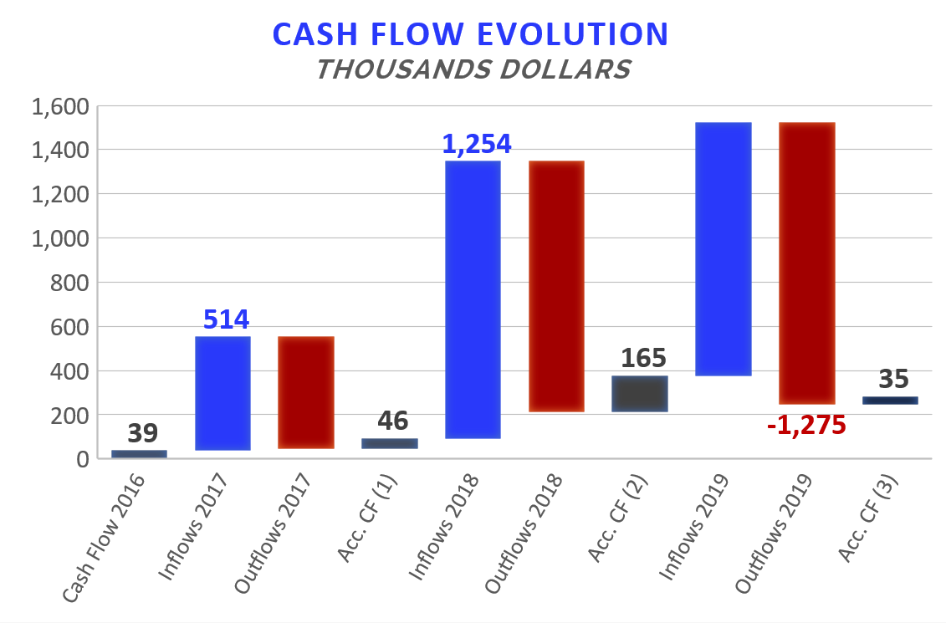

Accumulated Cash Flow – Jul 2019
5
Final Cash Balance 2016: USD 39 thousand
Final Cash Balance 2017: USD 46 thousand
Final Cash Balance 2018: USD 165 thousand
Final Cash Balance 2019: USD 35 thousand
  January 2019: USD (-) 67.7 thousand.
  February 2019: USD (-) 61.5 thousand.
  March 2019: USD (-) 28.8 thousand.
  April 2019: USD (+) 105.2 thousand.
  May 2019: USD (-) 26.1 thousand.
  Jun 2019: USD (+) 146.8 thousand.
  Jul 2019: USD (-) 197.8 thousand.
Accumulated 2019
1.145
-506
-1.135
Acc. CF (1) – Accumulated Cash Flow (2016 - 2017)
Acc. CF (2) – Accumulated Cash Flow (2016 - December 2018)
Acc. CF (3) – Accumulated Cash Flow (2016 – Jun 2019)

Slide 6
INDEX
Cash flow available data
Management tools
  Balance Sheet
  Income Statement
Next steps

Slide 7
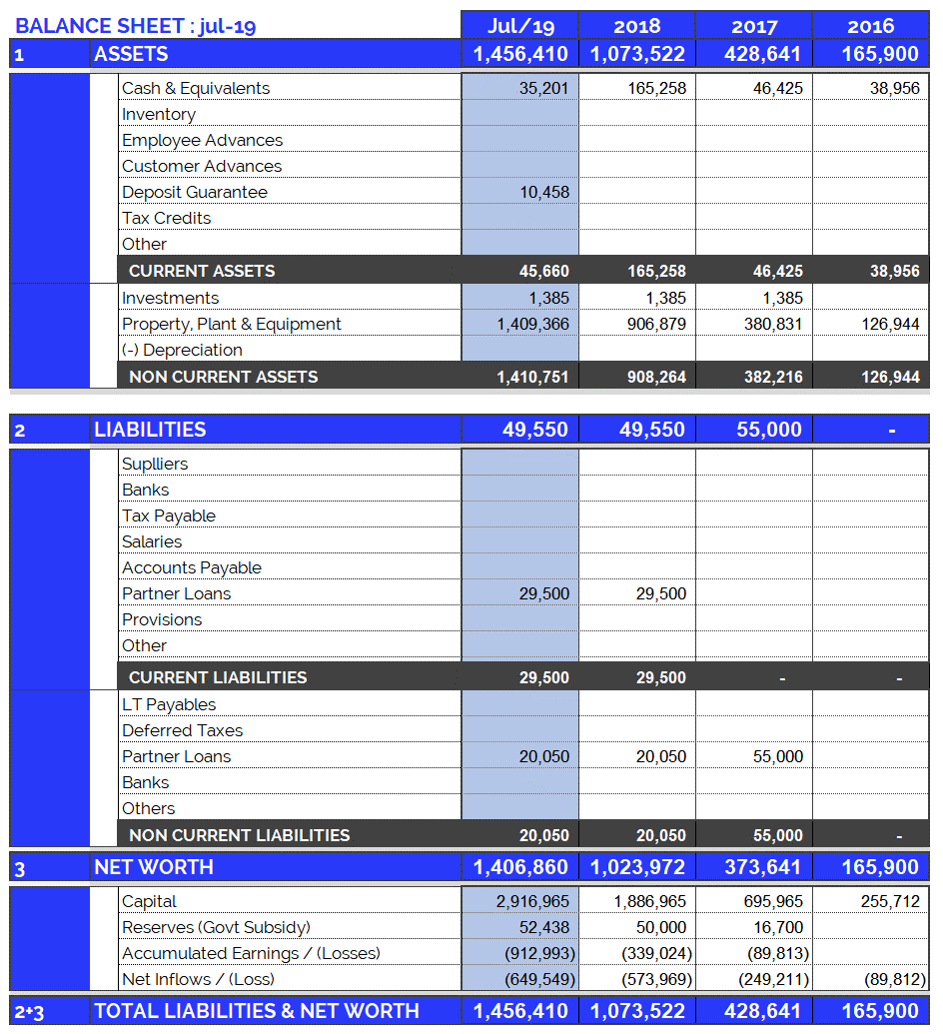
Balance Sheet: Jul 2019
7
Continuous growth of plant and equipment
  Property, Plant & Equipment growth in 2017: 200%
  Property, Plant & Equipment growth in 2018: 138%
  Property, Plant & Equipment growth in 2019: 55%
  (Investments include Value Added Taxes: Tax Credit)
Fixed assets totally funded by capital injections and Government Subsidy.

Slide 8
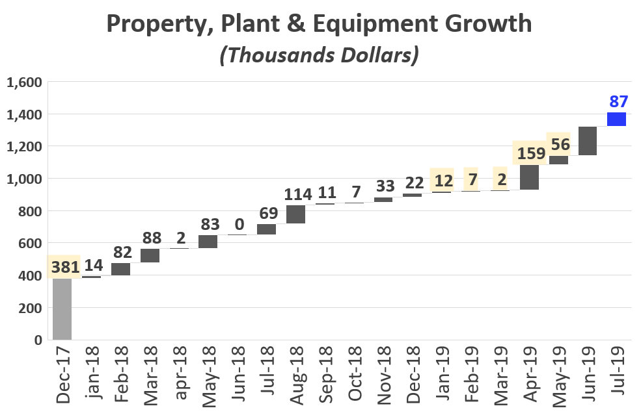
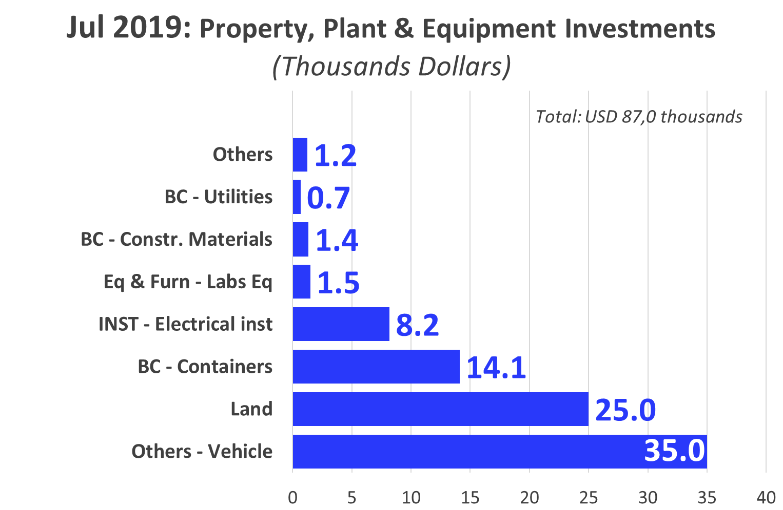

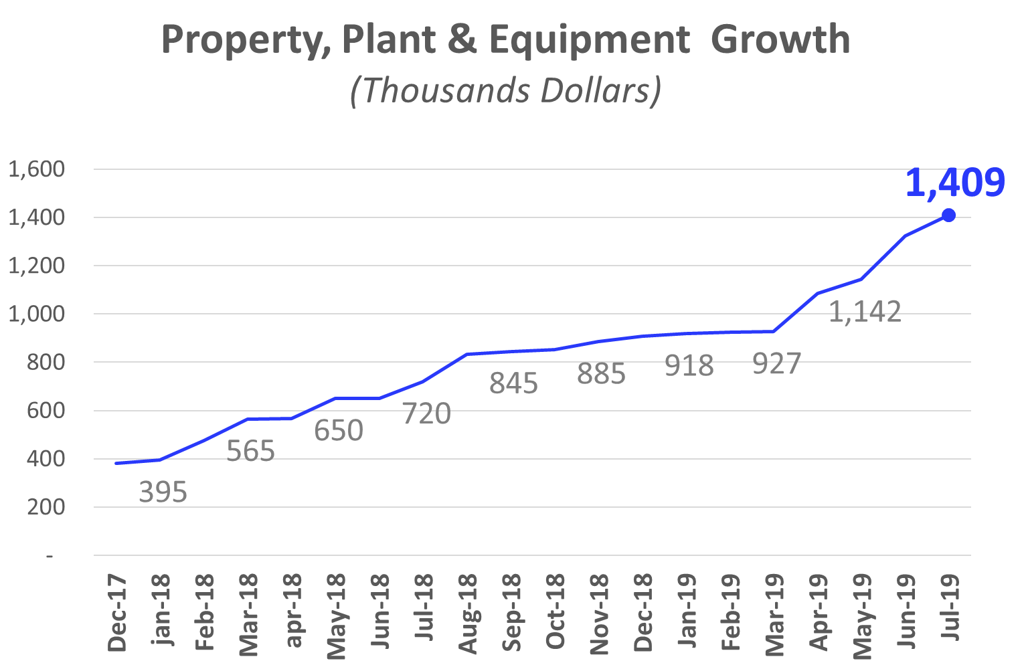
Investments_ Property, Plant & Eq.: Jul 2019
8
Vehicle: Pickup Truck
Land: External Land Acquisition (3/4)
BC – Containers (2)

Slide 9
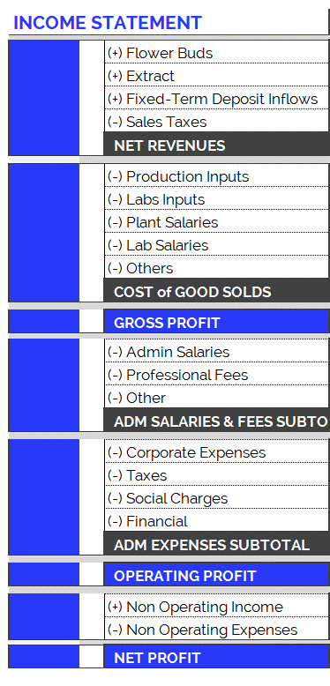
Income Statement: Change in Expenses
10
New Accounting Classification System for Operating Costs, since June 2019
In order to adequately present the company's areas of expense, the operating costs have been arranged according to item and category, as can be seen in the table on the right. Therefore:
  Cost of Good Solds
    Shows direct costs of the production process: raw materials, tools, other materials and salaries of plant and laboratory employees.
  Adm Salaries & Fees
    Shows indirect costs of the production process: administrative salaries and professional fees.
  Administration Expenses
    Overhead and other expenses relating to the company’s structure.
The new accounting item classifications have generated small differences in the historical accumulated balances (in the new version of the Chart of Accounts compared to the previous one): for example, in the previous month's report (apr-19), differences can be observed in the accumulated flows of Cost of Good Sold. This is because all the accounts have been reclassified and, in order to maintain the same criteria, this generated variations in the historical presentation of the items. However, it should be kept in mind that the historical total expenditures remain unchanged, since the new order simply reorganizes the items for the purpose of better financial statements.

Slide 10
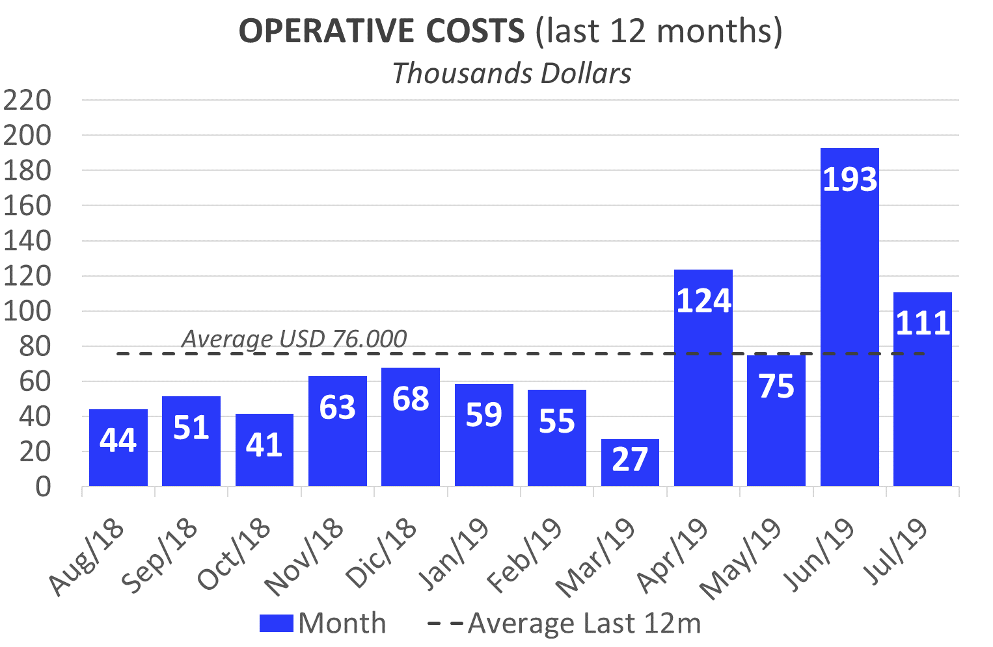
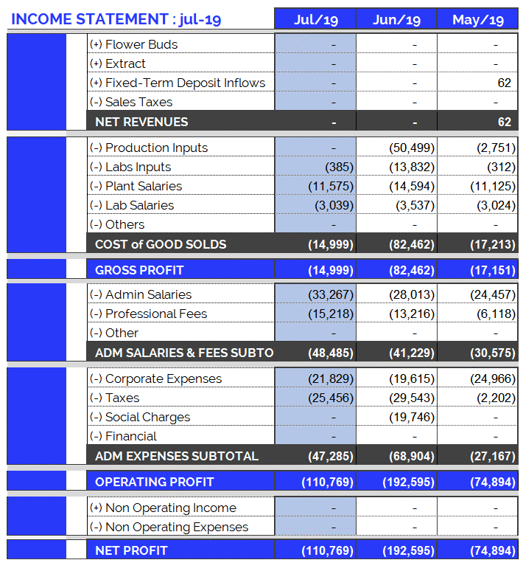
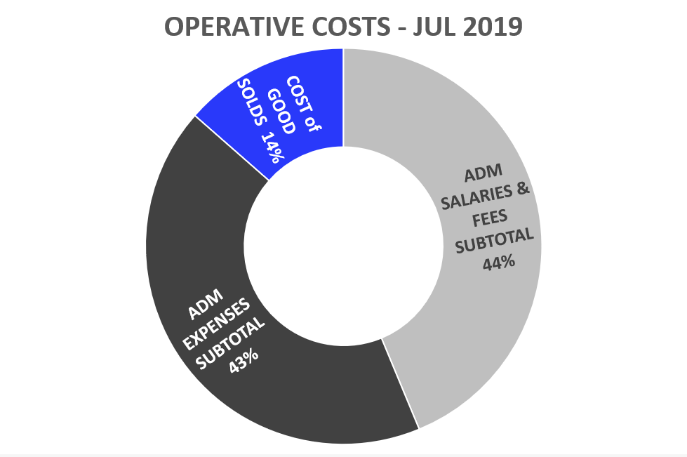
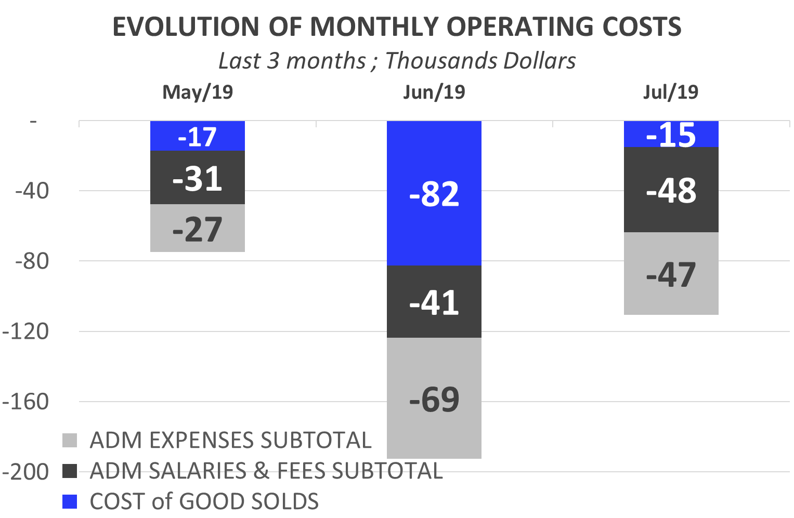
Income Statement: Jul 2019
9
Highlights of July 2019 Expenses: USD 110,769.
Total operating costs for July are more than the average for the last 12 months:
  Costs of Goods Sold: USD 14,999.
  Corporate Expenses : USD 21,829.
    Extra Corp. Exp. Viatics: USD 5,979.
    PCTP Land Rent: USD 3,966.
    Apt. Rentals and Others: USD 2,843.
    Employee Insurance: USD 1,074.
  Admin Salaries: USD 33,267.
    Joao: USD 13,925; includes 2 salaries.
    Frank: USD 8,597 (July salary + final payment)
  Professional Fees: USD 15,218.
    Extra expenses: Lawyer USD 6,983, Architect USD 2,623.
  Taxes and Employer Contributions: USD 25,456.

Slide 11
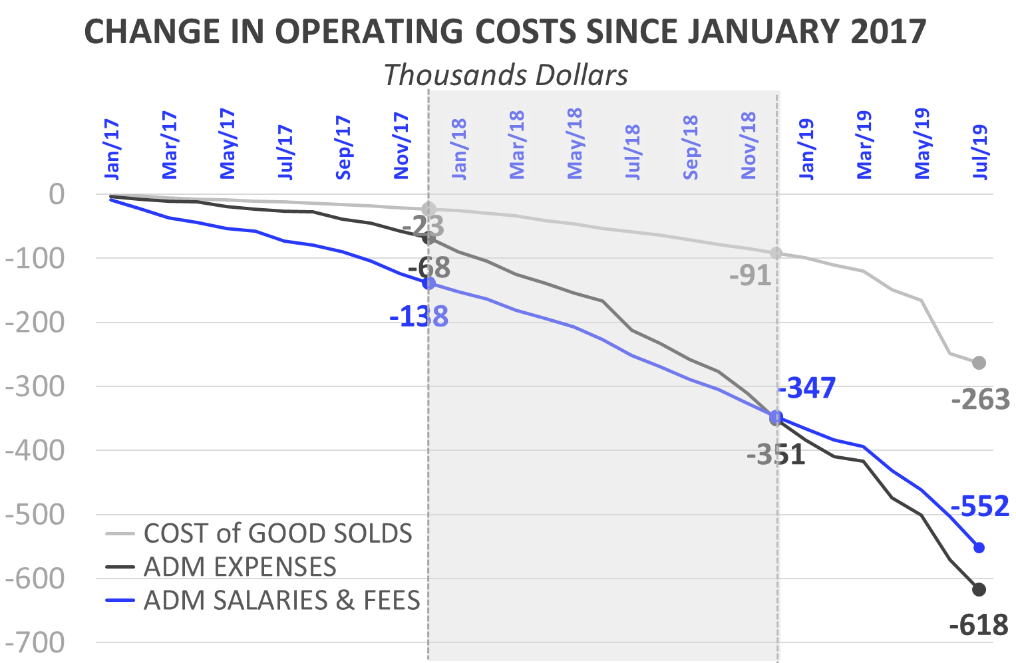
Income Statement: Change in Expenses
10
Burey’s operations have increased compared to 2017. This can be observed in the change of Operating Costs since Jan/17.
Cost of Goods Sold
  In 2018 (compared to the accumulated amount for 2017) the Cost of Goods Sold increased 292%: between Jan/18 and Dec/18 USD 68,019 was spent. Mainly this is due to: increase in plant salaries.
  In Jul/19, Cost of Goods Solds amounted to USD 14,999 (composed of 77% Plant Salaries).
Administrative Salaries & Fees
  In 2018 (compared to the accumulated amount for 2017) Administrative Salaries & Fees increased 151%: between Jan/18 and Dec/18 USD 208,992 was spent.
  In Jul/19, Administrative Salaries & Fees amounted to USD 48,485 (+2.8 times more was spent than Jul/18)
Administrative Expenses
  In 2018 (compared to the accumulated amount for 2017) Administrative Expenses increased 416%: between Jan/18 and Dec/18 USD 283,190 was spent.
  In Jul/19, Administrative Expenses amounted to USD 47,285 (equal to Jul/18).

Slide 12
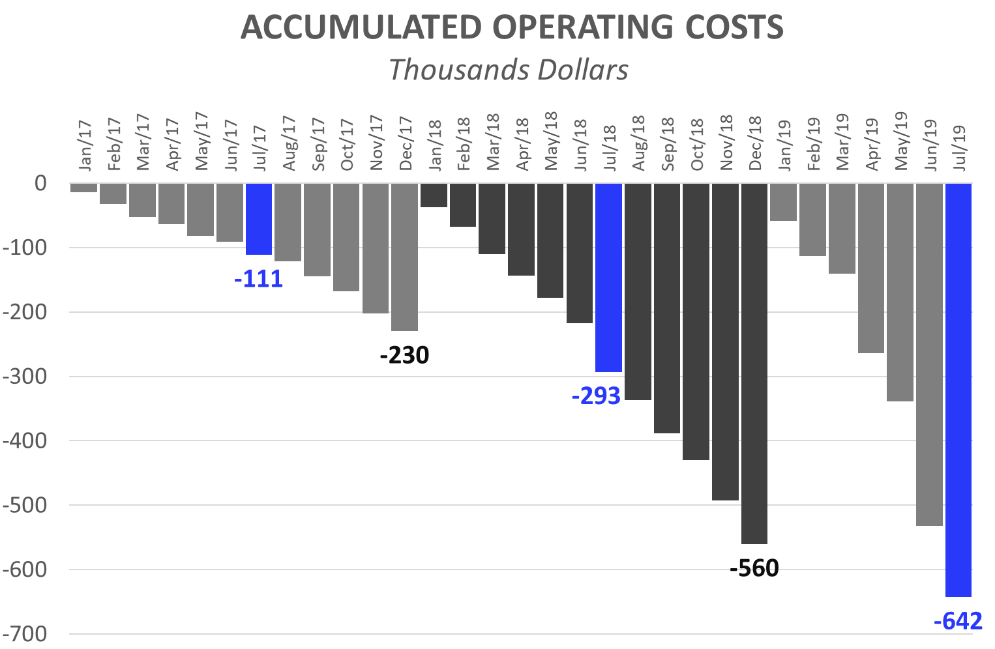
Income Statement: 7 months of 2019
11
Operating Costs accumulated for calendar year
The accumulated expenses for the 12 months (12M) of 2018 represent 243% of total 2017 expenses. This reflects the increase in operating costs mentioned in the previous slide and is the result of research performed and preparations for our first commercial production. Operating costs accrued as of July 2019 (7M), represent 115% of those for 2018 (12M).
First 7 Months (7M): Comparison 2019 vs. 2018:
While in the first 7M 2018 we spent USD 292,806, in the first 7M of 2019 we reached USD 642,487. This growth in expenses is principally attributed to:
  First 7M of 2018, corporate expenses were USD 99,483. While, in the first 7M of 2019, USD 148,897 has been invested.
  First 7M 2019: The monthly average of admin salaries increased: + USD 10,106 (compared to first 7M 2018). This is due to:
    Increase in compensation for Sergio, Joao, Sonia (Secretary) and Frank.
  First 7M 2019: Professional Fees reached USD 58,397, while in 2018 (7M) they were USD 38,202.
  First 7M 2019: Plant Salaries rose (First 7M 2019: USD 74,102 vs. First 7M 2018: USD 31,723). As of Feb/18 a Janitor and Auxiliary Corp were hired. As of Jan/19 a Maintenance Manager and Second Auxiliary Corp were hired.
  At the same time, the raise in salaries increased contributions required by law (BPS), in 2019/2018 with respect to 2017.

Slide 13
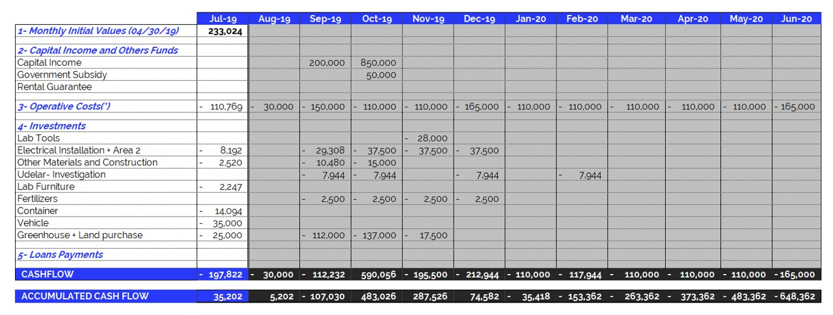
Jul 2019 – Projected Cash Flow for next 12 months
14
In August 2019 we had problems depositing partner contributions at the bank. Therefore, August expenses have been postponed until September. At the time of publication, expenditure forecasts for the next several months are being reviewed. We will provide an update in the next report.
(*) Operating Expenses include 100% of the company's operating costs: salaries, professional fees, rent, etc. THE MONTHLY AVERAGE OF OPERATING EXPENSES does not include investments in equipment and labor. See the following item.

