Slide 1

BUREY SA –
Grunelabs.com
Jun 2019 presentation
Montevideo, Jul 10, 2019

Slide 2
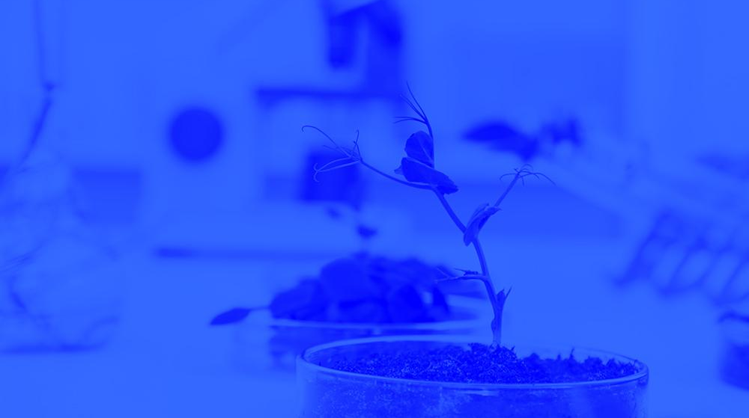
INDEX
Cash flow available data
Management tools
  Balance Sheet
  Income Statement
Next steps

Slide 3
INDEX
Cash flow available data
Management tools
  Balance Sheet
  Income Statement
Next steps

Slide 4
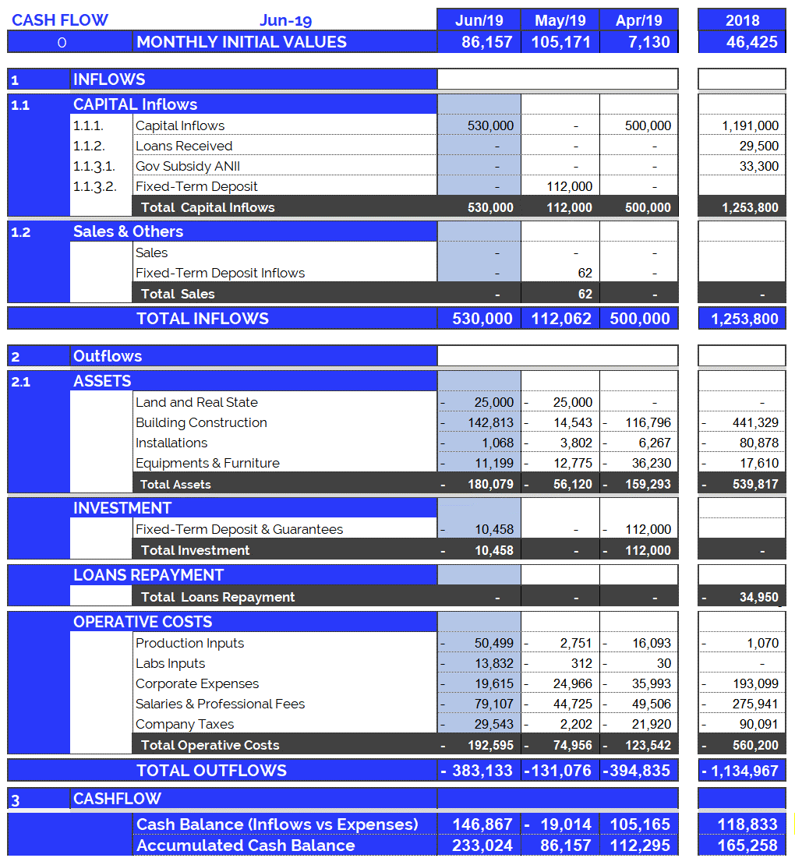
Cash Flow available data: Jun 2019
4
Accumulated cash balance at the end of 2018:
USD 165,258.
  Opening balance 2018 (end of 2017): USD 46,425
  Income 2018: USD 1,253,800 (partner contributions and loans)
  Expenses 2018: USD (-) 1,134,967.
  Final accumulated cash balance 2018: USD 165,258
Accumulated cash balance at the end of Jun 2019: USD 233,025.
  Opening balance (end of May/19): (+) USD 86,157
  Capital Income Jun/19 : (+) USD 530,000
  Rental Guarantee Jun/19 : (-) USD 10,458
  Building Construction Jun/19 : (-) USD 180,079
  Operating Expenses Jun/19 : (-) USD 192,595
  Final accumulated cash balance Jun 2019 : USD 233,025.
  Cash outflows for Jun/19 (USD 383,133) are composed of: 50% Operating Expenses, 47% Investment in Equipment and Structure and 3% Rental Guarantee.
  June operating costs were +2.6 times more than the monthly average (last 12 months): additional one-time expenses.
New partner contributions and Loans: Jun 2019
  Contribution of partners: USD 530,000

Slide 5
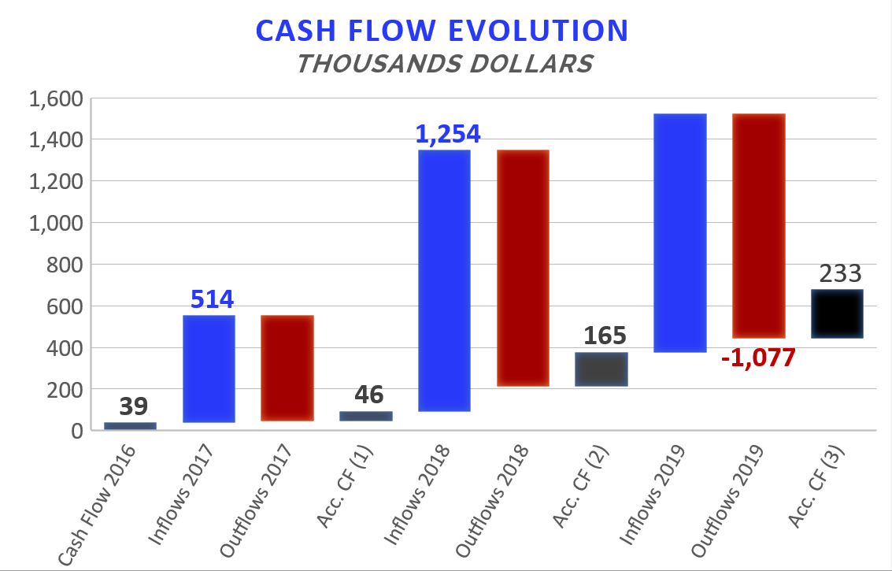

Accumulated Cash Flow – Jun 2019
5
Final Cash Balance 2016: USD 39 thousand
Final Cash Balance 2017: USD 46 thousand
Final Cash Balance 2018: USD 165 thousand
Final Cash Balance 2019: USD 233 thousand
  January 2019: USD (-) 67.7 thousand.
  February 2019: USD (-) 61.5 thousand.
  March 2019: USD (-) 28.8 thousand.
  April 2019: USD (+) 105.2 thousand.
  May 2019: USD (-) 26.1 thousand.
  Jun 2019: USD (+) 147.0 thousand.
Accumulated 2019
1.144
-506
-1.135
Acc. CF (1) – Accumulated Cash Flow (2016 - 2017)
Acc. CF (2) – Accumulated Cash Flow (2016 - December 2018)
Acc. CF (3) – Accumulated Cash Flow (2016 – Jun 2019)

Slide 6
INDEX
Cash flow available data
Management tools
  Balance Sheet
  Income Statement
Next steps

Slide 7
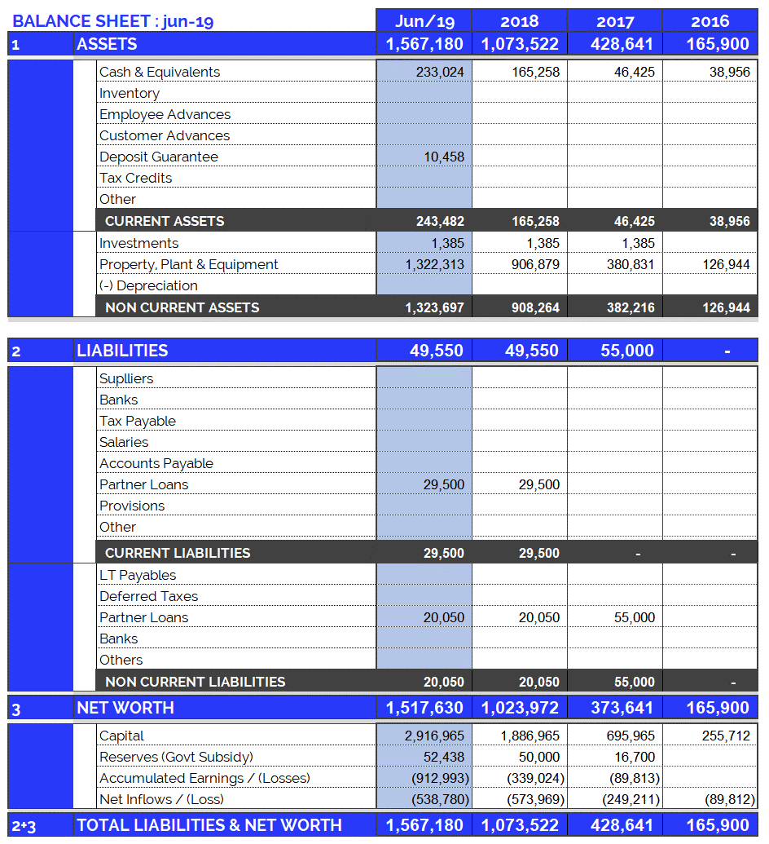
Balance Sheet: Jun 2019
7
Continuous growth of plant and equipment
  Property, Plant & Equipment growth in 2017: 200%
  Property, Plant & Equipment growth in 2018: 138%
  Property, Plant & Equipment growth in 2019: 46%
  (Investments include Value Added Taxes: Tax Credit)
Jun 2019: A Rental Guarantee of USD 10,458 was made with Hipotecario Bank of Uruguay for two apartments.
Fixed assets totally funded by capital injections and Government Subsidy.

Slide 8
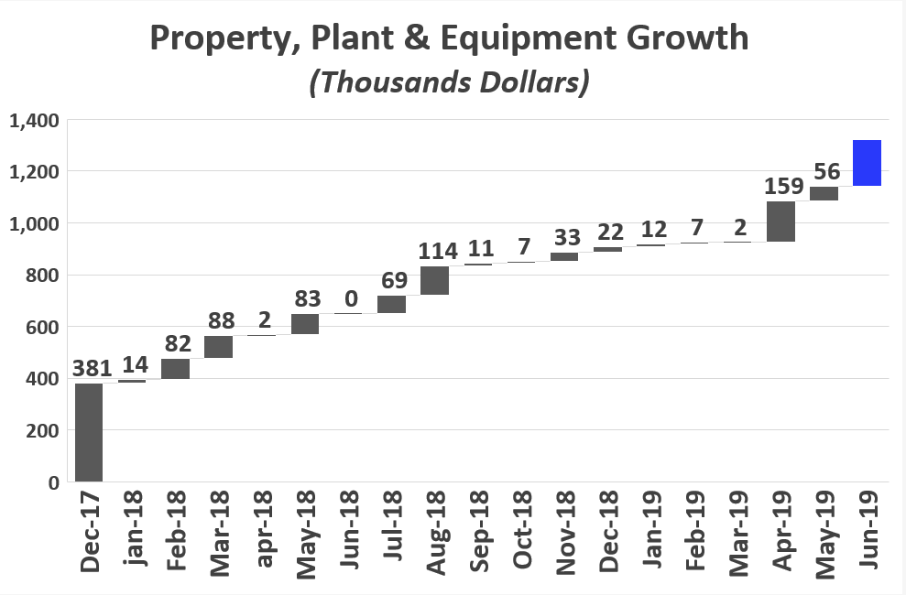
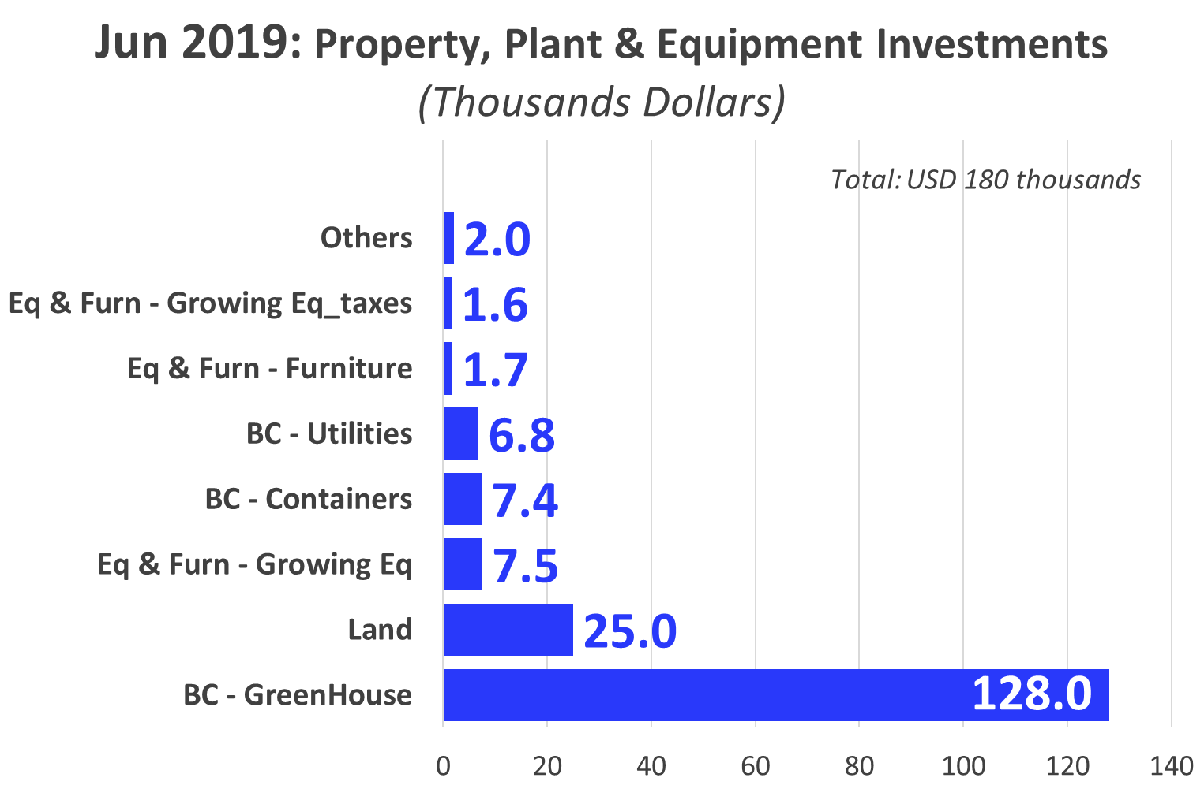
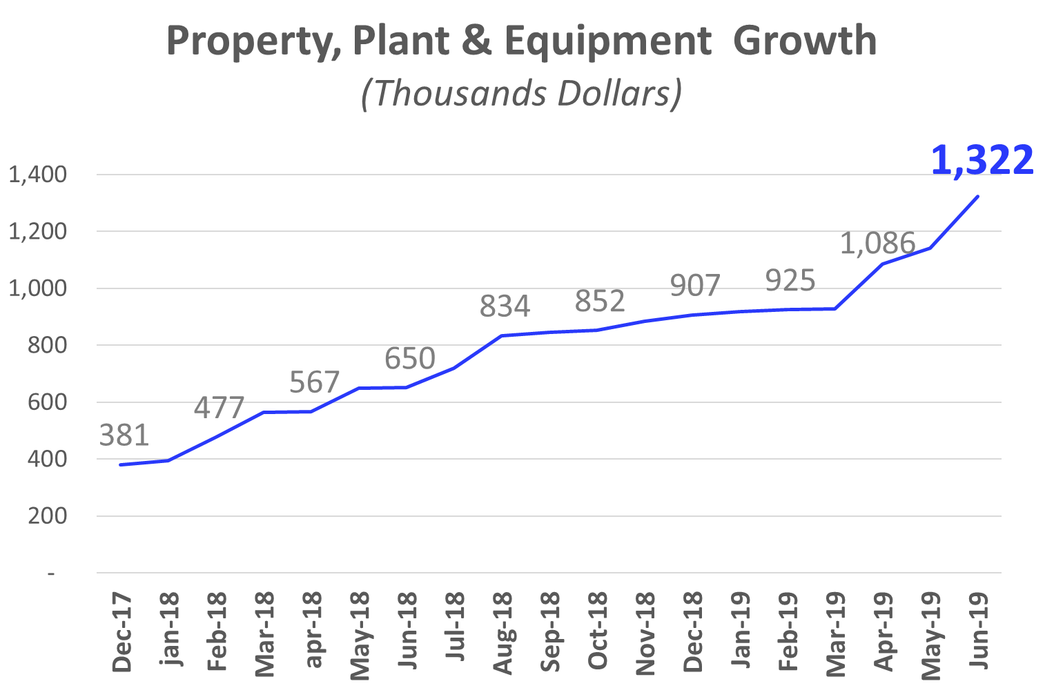
Investments_ Property, Plant & Eq.: Jun 2019
8
180
Building Construction – Green House (2/4)
Land: External Land Acquisition (2/4)
Eq & Furn – Growing Eq : Tracking System (2/2)

Slide 9
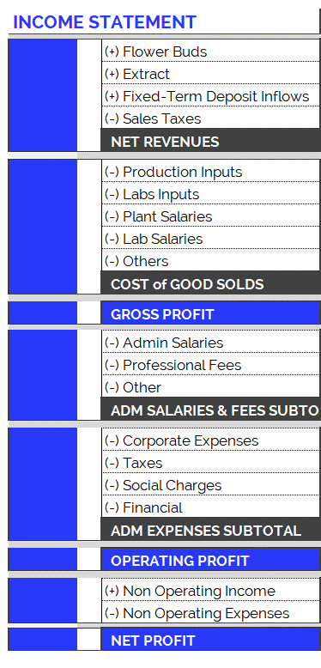
Income Statement: Change in Expenses
10
New Accounting Classification System for Operating Costs, since June 2019
In order to adequately present the company's areas of expense, the operating costs have been arranged according to item and category, as can be seen in the table on the right. Therefore:
  Cost of Good Solds
    Shows direct costs of the production process: raw materials, tools, other materials and salaries of plant and laboratory employees.
  Adm Salaries & Fees
    Shows indirect costs of the production process: administrative salaries and professional fees.
  Administration Expenses
    Overhead and other expenses relating to the company’s structure.
The new accounting item classifications have generated small differences in the historical accumulated balances (in the new version of the Chart of Accounts compared to the previous one): for example, in the previous month's report (apr-19), differences can be observed in the accumulated flows of Cost of Good Sold. This is because all the accounts have been reclassified and, in order to maintain the same criteria, this generated variations in the historical presentation of the items. However, it should be kept in mind that the historical total expenditures remain unchanged, since the new order simply reorganizes the items for the purpose of better financial statements..

Slide 10
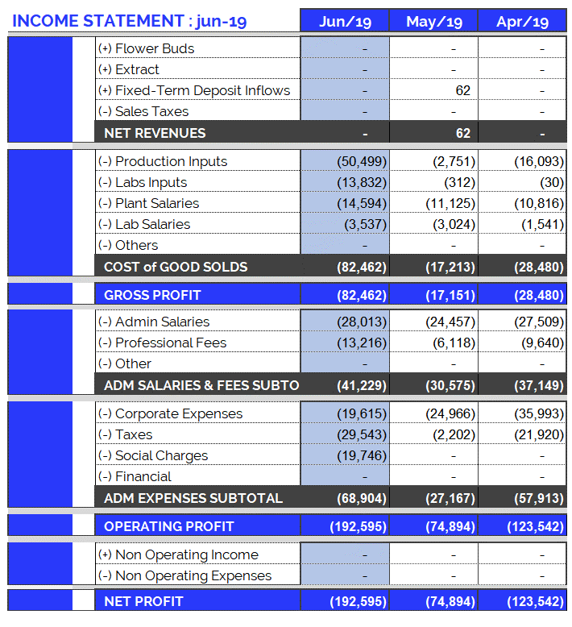
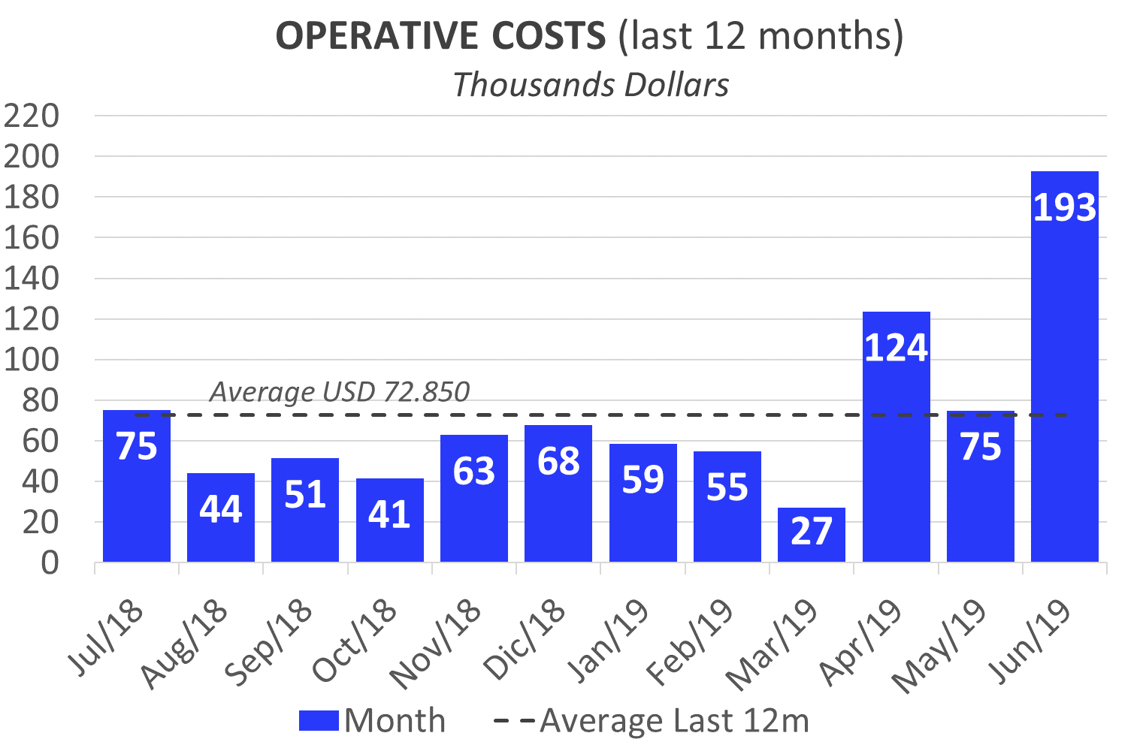
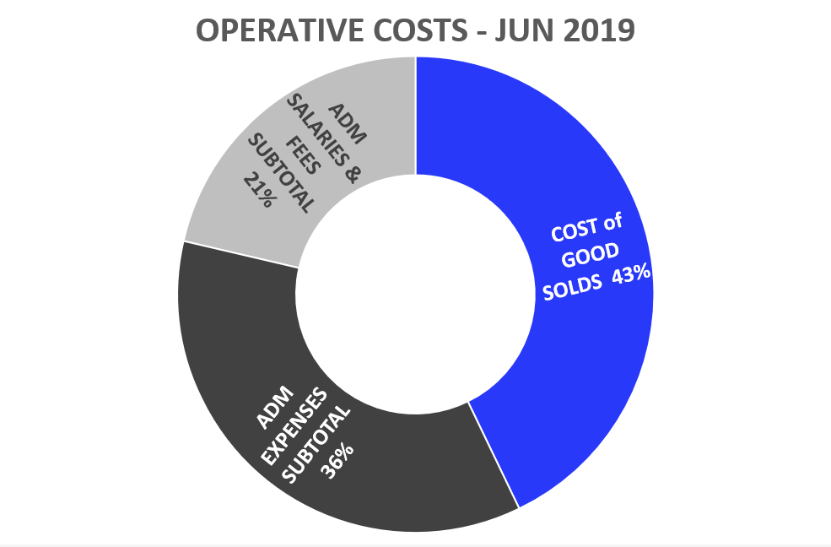
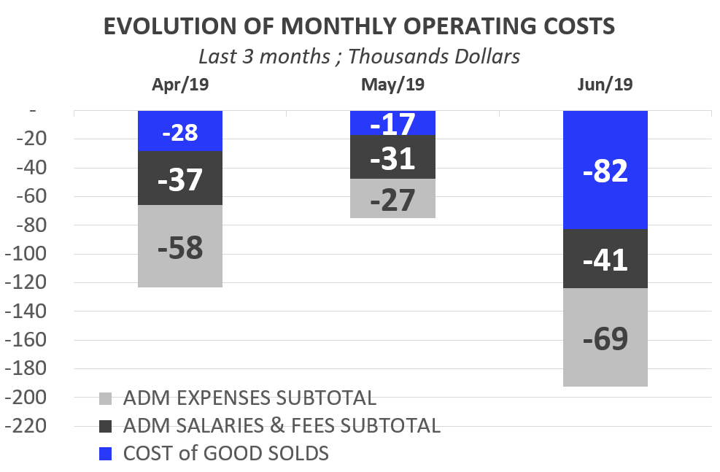
Income Statement: Jun 2019
9
Highlights of June 2019 Expenses: USD 192,595
Total operating costs for June were more than the last 12 months average: + 2.6 times. While operating expenses were within the average level, there were additional expenses (USD 93,474):
    Filters and Glasses: USD 19,493
    Fertilizer: USD 13,773.
    Coconut Fiber: USD 13,733.
    Personal Contributions BPS (includes past due of previous months): USD 12,133.
    Bonuses: USD 11,856.
    Pharm Supplies: USD 10,125.
    IRPF Salaries: USD 7,414.
    PH Plants: USD 2,885.
    PH Tools: USD 2,335.
As a result, the remaining expenses were USD 99,121: + 36% than the last 12 months average.
    Adm. Salaries: USD 28,013
    Corp. Expenses: USD 19,615

Slide 11
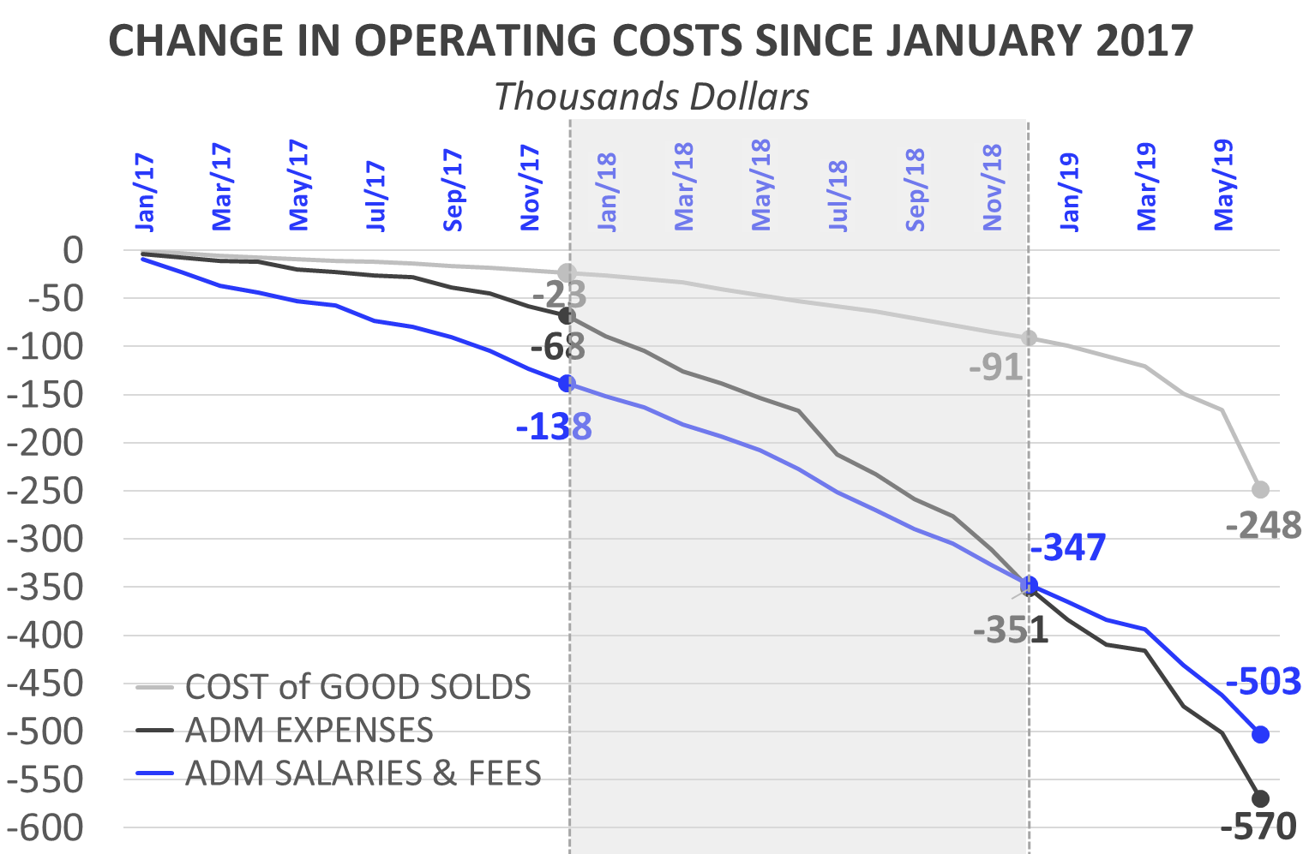
Income Statement: Change in Expenses
10
Burey’s operations have increased compared to 2017. This can be observed in the change of Operating Costs since Jan/17.
Cost of Goods Sold
  In 2018 (compared to the accumulated amount for 2017) the Cost of Goods Sold increased 292%: between Jan/18 and Dec/18 USD 68,019 was spent. Mainly this is due to: increase in plant salaries.
  In Jun/19, Cost of Goods Solds amounted to USD 82,462 (In June purchases were made for operations: Garden Tools, Fertilizers, Coconut Fiber, Pharmaceutical Supplies and others). In addition, legally required bonuses were paid to plant officials.
Administrative Salaries & Fees
  In 2018 (compared to the accumulated amount for 2017) Administrative Salaries & Fees increased 151%: between Jan/18 and Dec/18 USD 208,992 was spent.
  In Jun/19, Administrative Salaries & Fees amounted to USD 41,229 (+2.1 times more was spent than Jun/18); including bonuses.
Administrative Expenses
  In 2018 (compared to the accumulated amount for 2017) Administrative Expenses increased 416%: between Jan/18 and Dec/18 USD 283,190 was spent.
  In Jun/19, Administrative Expenses amounted to USD 68,904 (+5.2 times compared to Jun/18) . Esto se explicó por el pago atrasado de Social Charges : Personal and Employer Contributions

Slide 12
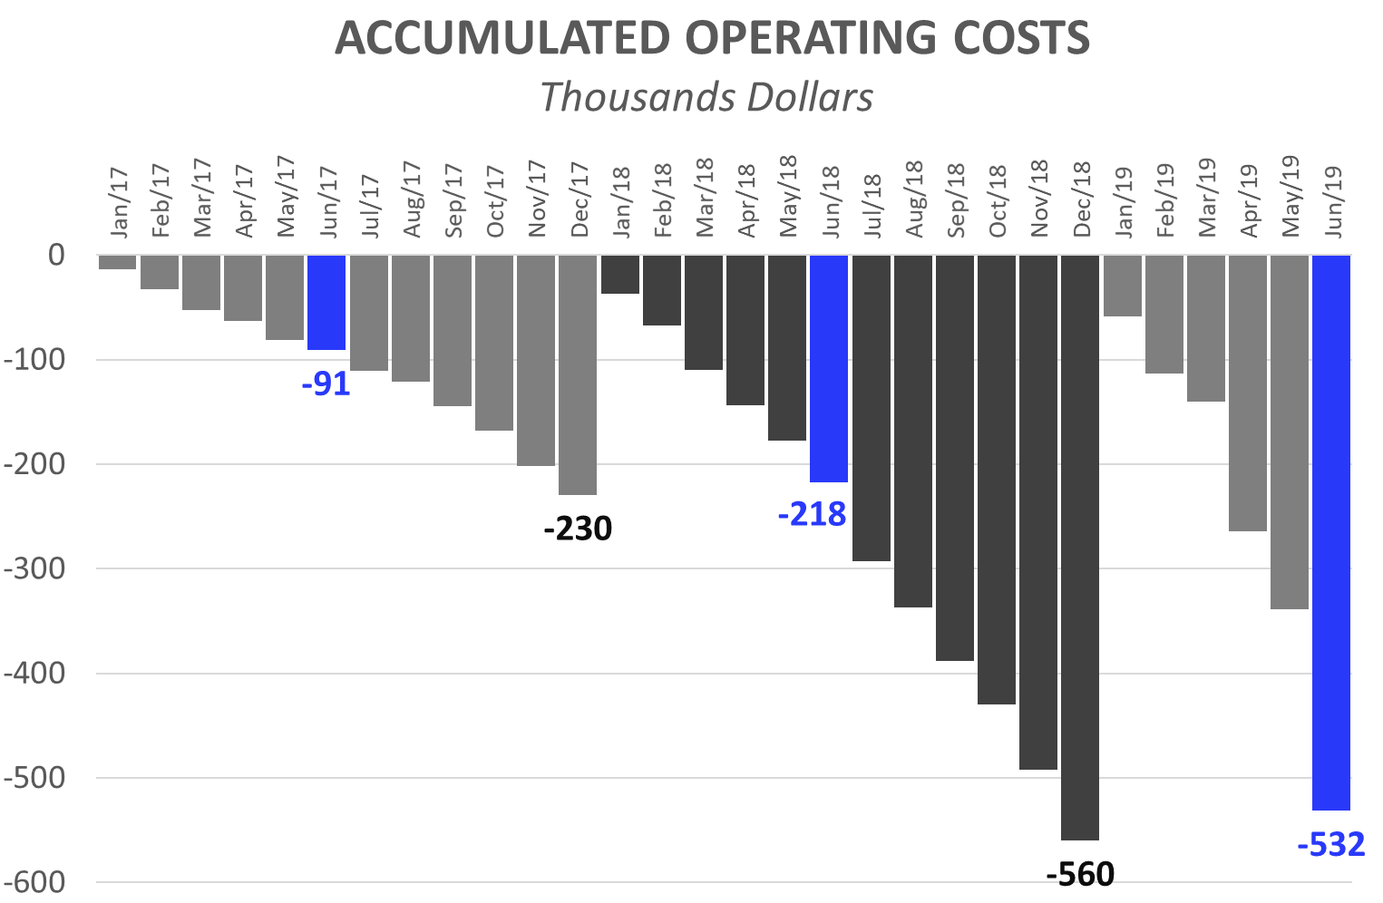
Income Statement: 6 months of 2019
11
Operating Costs accumulated for calendar year
The accumulated expenses for the 12 months (12M) of 2018 represent 243% of total 2017 expenses. This reflects the increase in operating costs mentioned in the previous slide and is the result of research performed and preparations for our first commercial production. Operating costs accrued as of June 2019 (6M) accounted for 95% of 2018 (12M).
First 6 Months (6M): Comparison 2019 vs. 2018:
While in the first 6M 2019 we spent USD 217,657, in the first 6M of 2019 we reached USD 531,718. This growth in expenses is principally attributed to:
  First 6M of 2018, corporate expenses were USD 74,233. While, in the first 6M of 2019, USD 127,068 has been invested.
  First 6M 2019: The monthly average of admin salaries increased: + USD 9,625 (compared to first 6M 2018). This is due to:
    Increase in compensation for Sergio, Joao, Sonia (Secretary) and Frank.
  First 6M 2019: Professional Fees reached USD 43,179, while in 2018 (6M) they were USD 33,936.
  First 6M 2019: Plant Salaries rose (First 6M 2019: USD 62,527 vs. First 6M 2018: USD 26,892). As of Feb/18 a Janitor and Auxiliary Corp were hired. As of Jan/19 a Maintenance Manager and Second Auxiliary Corp were hired.
  At the same time, the raise in salaries increased contributions required by law (BPS), in 2019/2018 with respect to 2017.

Slide 13
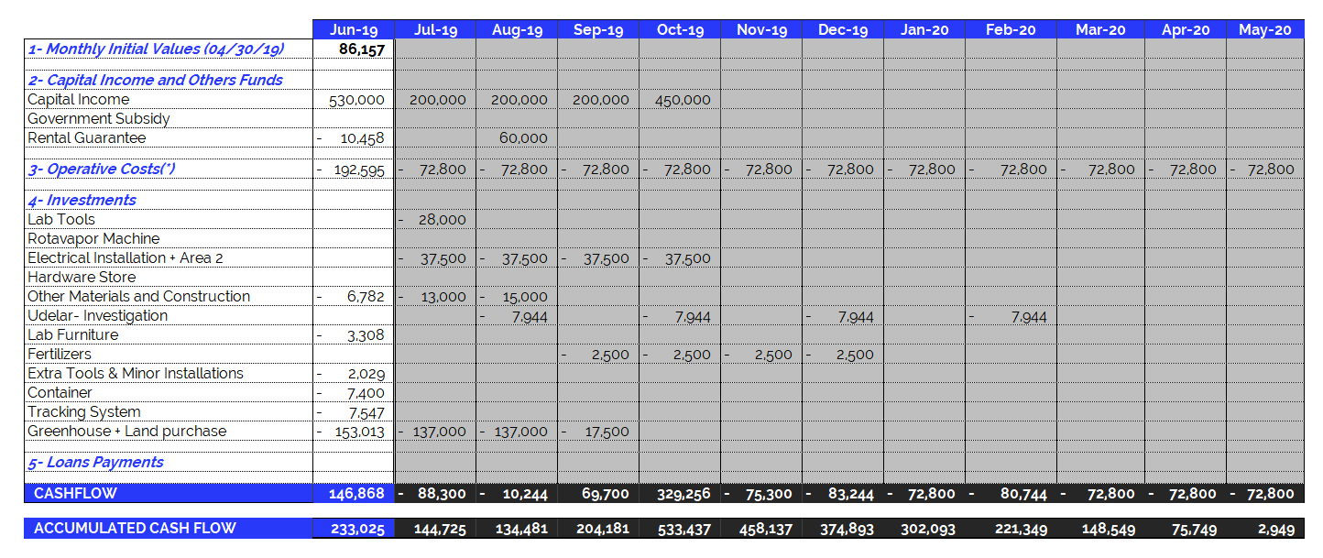
Jun 2019 – Projected Cash Flow for next 12 months
14
(*) Operating Expenses include 100% of the company's operating costs: salaries, professional fees, rent, etc. THE MONTHLY AVERAGE OF OPERATING EXPENSES does not include investments in equipment and labor. See the following item.

