Slide 1

BUREY SA – Grunelabs.com May 2019 presentation
Montevideo, Jun 10, 2019

Slide 2

INDEX
Cash flow available data
Management tools
Balance Sheet
Income Statement
Next steps

Slide 3
Clarifications:
In June 2019, the company implemented a new chart of accounts format for internal management accounting.
This was done in order to adjust the financial statements (Cash Flow) to the current state of the company.
This means that Cash Flow items, as of May 2019, will have a new classification and arrangement. In any case, the historical data was saved and adapted to the new Chart of Accounts in order to standardize the statistics.
In conclusion, some items belonging to Property, Plant & Equipment and Operating Costs have small differences (compared to previous months) due to the re-classification of accounting items. These are not considerable differences and only affect the presentation of financial statements, not the total balances.

Slide 4
INDEX
Cash flow available data
Management tools
Balance Sheet
Income Statement
Next steps

Slide 5
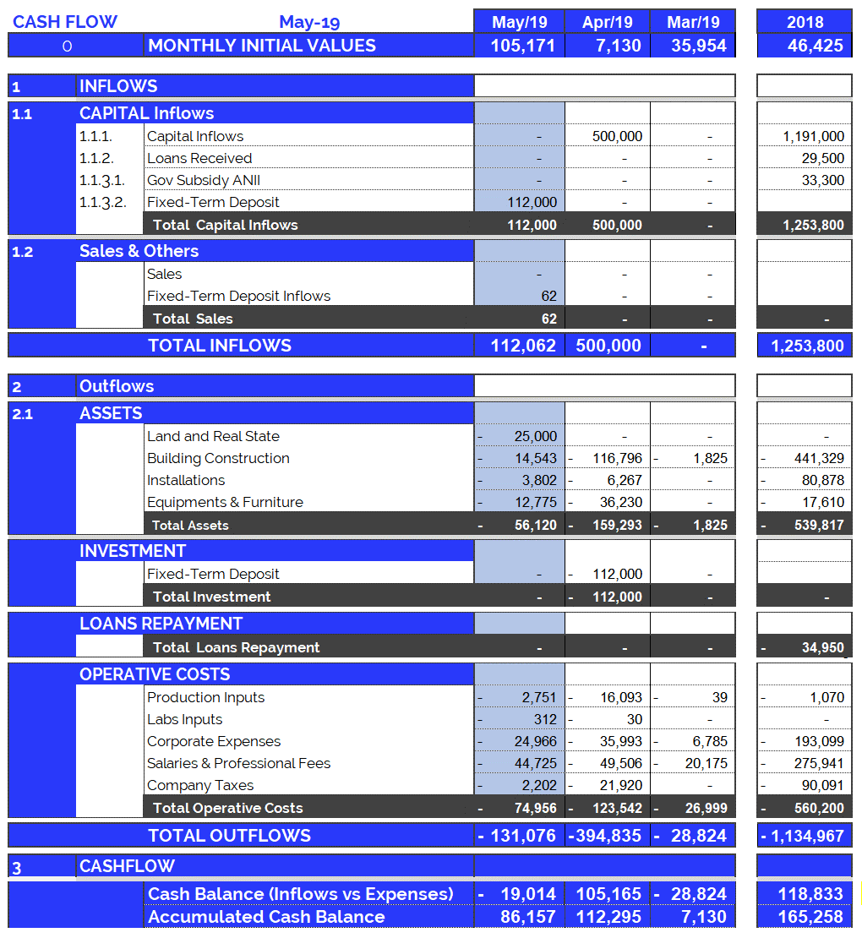
Cash Flow available data: May 2019
4
Accumulated cash balance at the end of 2018: USD 165,258.
Opening balance 2018 (end of 2017): USD 46,425
Income 2018: USD 1,253,800 (partner contributions and loans)
Expenses 2018: USD (-) 1,134,967.
Final accumulated cash balance 2018: USD 165,258
Accumulated cash balance at the end of May 2019: USD 86,157.
Opening balance (end of Apr/19): (+) USD 112,295.
Bank Account Adjustment Apr/19: (-) USD 7,124.
Fixed-Term Deposit May/19: (+) 112,062
Building Construction May/19: (-) USD 56,120
Operating Expenses May/19: (-) USD 74,956
Final accumulated cash balance May 2019 : USD 86,157.
Cash outflows for May/19 (USD 131,076) are composed of: 43% Investment in Equipment and Structure and 57% Operating Expenses.
May operating costs were 25% more than the monthly average (last 12 months).
New partner contributions and Loans: May 2019
Contribution of partners: USD 0
Short term loan: USD 0

Slide 6
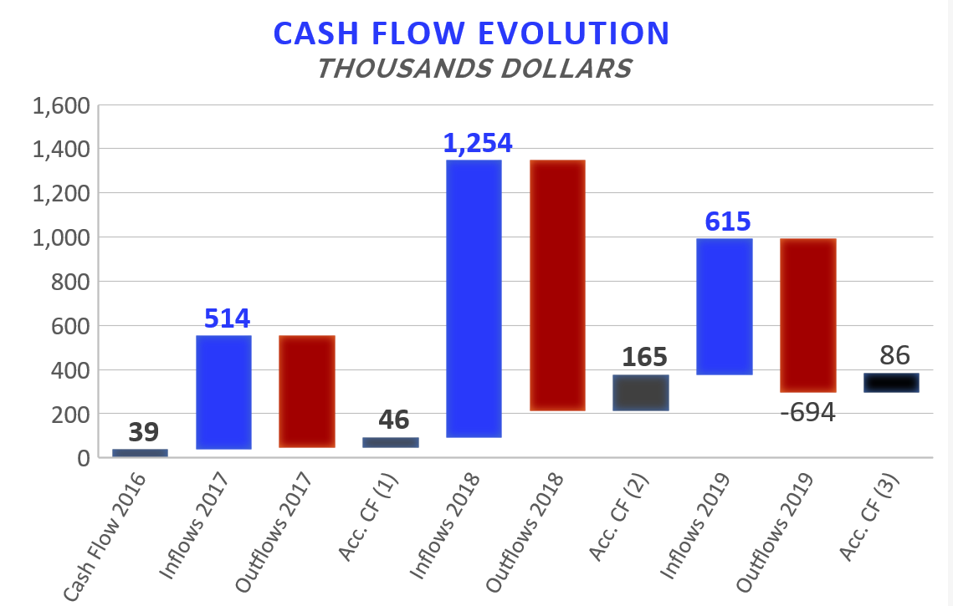

Accumulated Cash Flow – May 2019
5
Final Cash Balance 2016: USD 39 thousand
Final Cash Balance 2017: USD 46 thousand
Final Cash Balance 2018: USD 165 thousand
Final Cash Balance 2019: USD 86 thousand
January 2019: USD (-) 67.7 thousand.
February 2019: USD (-) 61.5 thousand.
March 2019: USD (-) 28.8 thousand.
April 2019: USD (+) 105.2 thousand.
May 2019: USD (-) 26.1 thousand.
Accumulated 2019
-506
-1.135
Acc. CF (1) – Accumulated Cash Flow (2016 - 2017)
Acc. CF (2) – Accumulated Cash Flow (2016 - December 2018)
Acc. CF (3) – Accumulated Cash Flow (2016 – May 2019)

Slide 7
INDEX
Cash flow available data
Management tools
Balance Sheet
Income Statement
Next steps

Slide 8
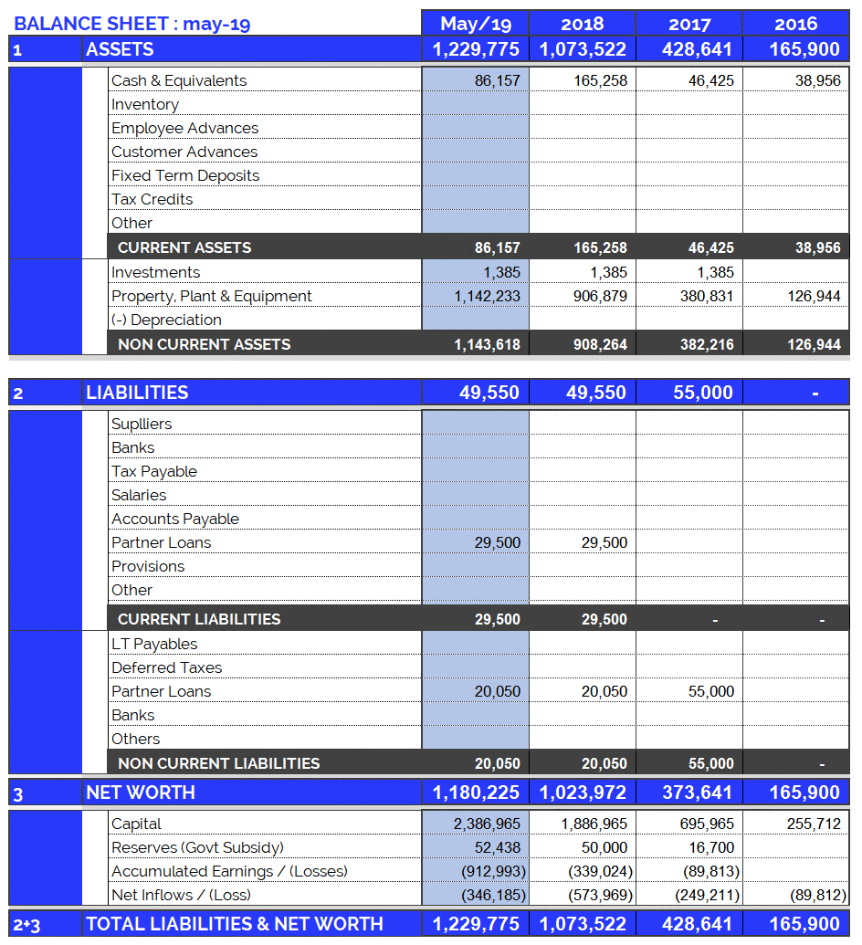
Balance Sheet: May 2019
7
Continuous growth of plant and equipment
Property, Plant & Equipment growth in 2017: 200%
Property, Plant & Equipment growth in 2018: 138%
Property, Plant & Equipment growth in 2019: 26%
(Investments include Value Added Taxes: Tax Credit)
No loan payments were made in May 2019.
May 2019: The Fixed Term Deposit (made in April 2019) was collected for USD 112,000 + USD 62 of interest earned.
Fixed assets totally funded by capital injections and Government Subsidy.

Slide 9
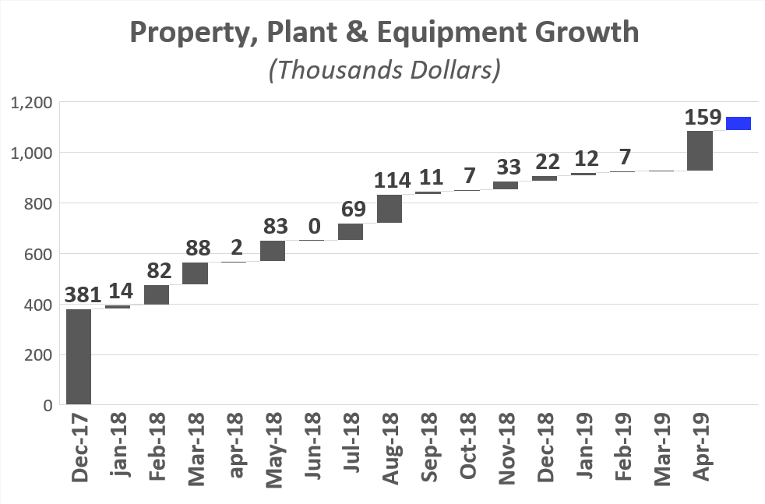
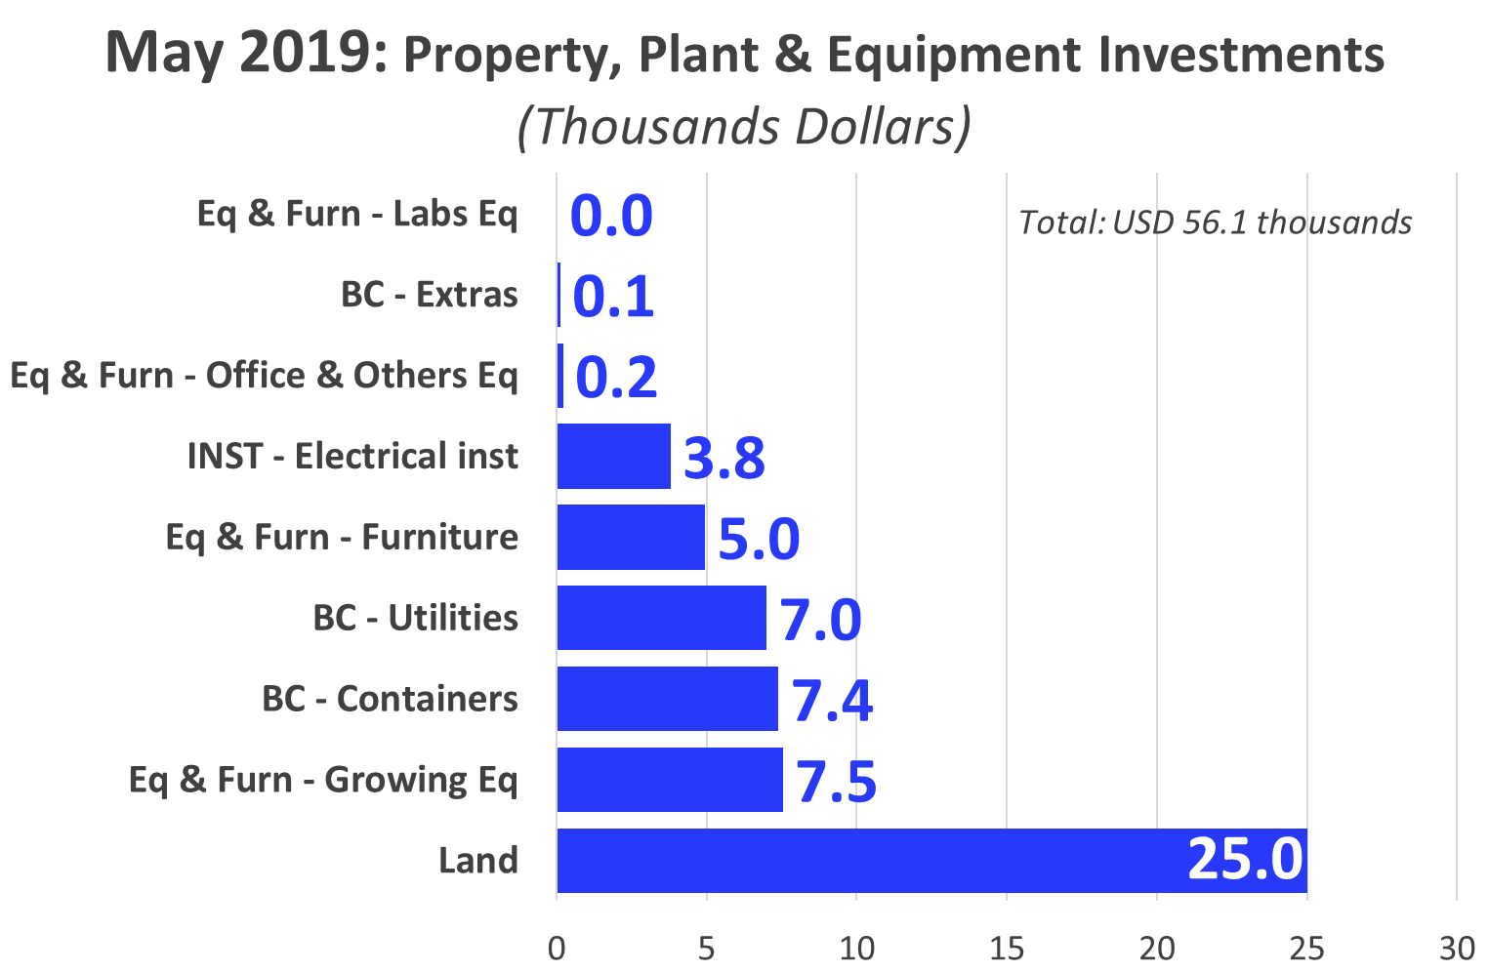
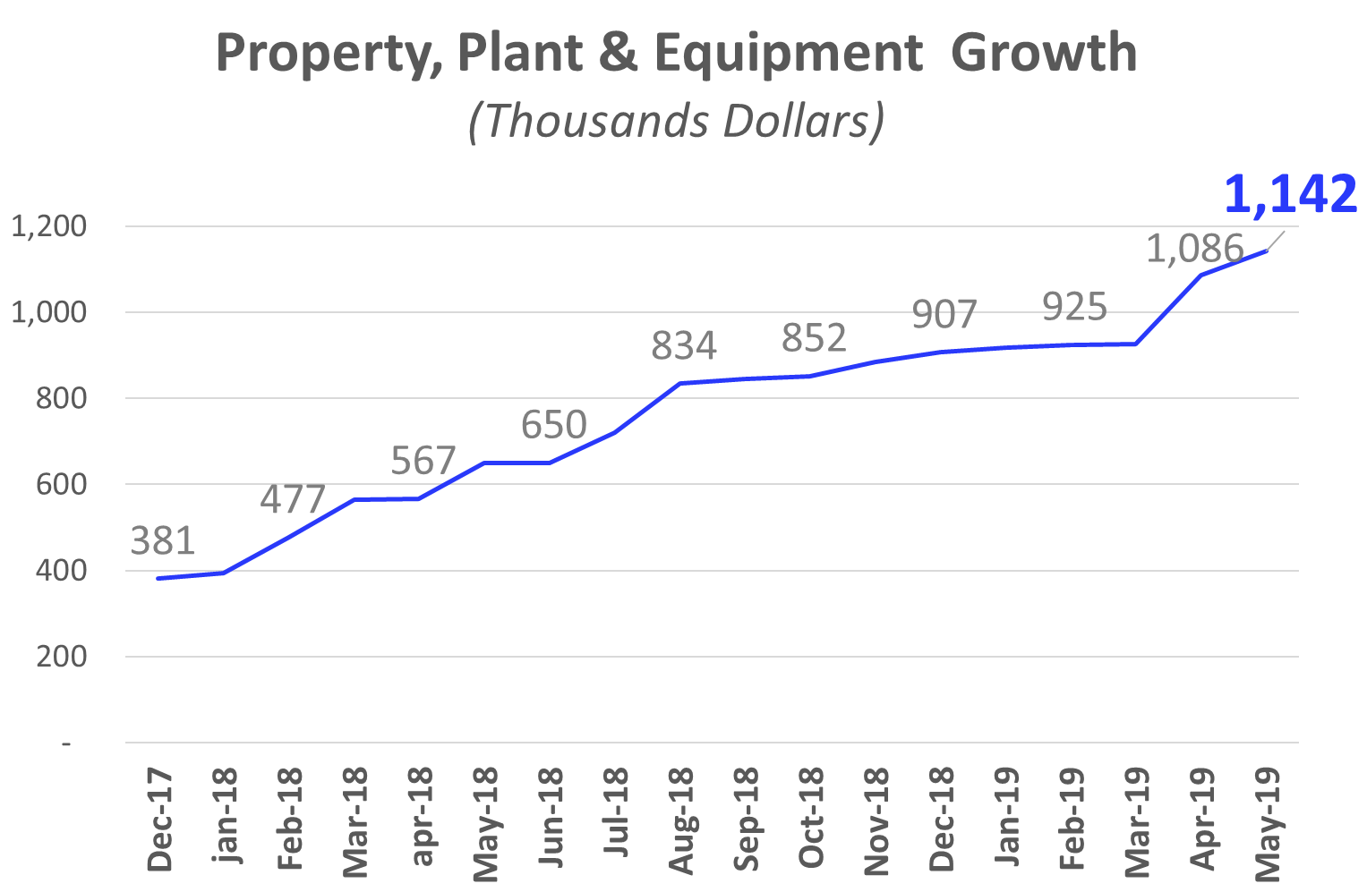
Investments_ Property, Plant & Eq.: May 2019
8
56
2
Land: First purchase installment..
Eq & Furn – Growing Equipment: Tracking System installment ½
Building Construction – Utilities : Materials for the Irrigation System
Office & Other Eq: Fire Extinguishers

Slide 10
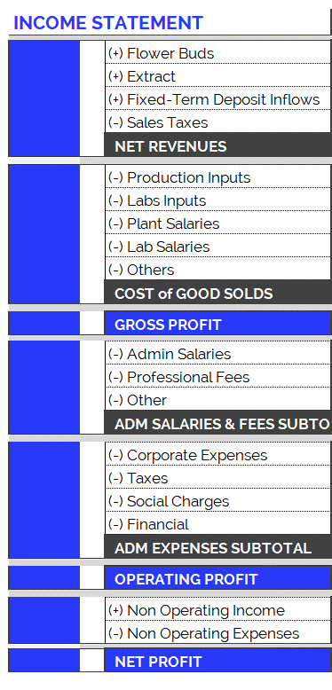
Income Statement: Change in Expenses
10
New Accounting Classification System for Operating Costs.
In order to adequately present the company's areas of expense, the operating costs have been arranged according to item and category, as can be seen in the table on the right. Therefore:
Cost of Good Solds
Shows direct costs of the production process: raw materials, tools, other materials and salaries of plant and laboratory employees.
Adm Salaries & Fees
Shows indirect costs of the production process: administrative salaries and professional fees.
Administration Expenses
Overhead and other expenses relating to the company’s structure.
The new accounting item classifications have generated small differences in the historical accumulated balances (in the new version of the Chart of Accounts compared to the previous one): for example, in the previous month's report, differences can be observed in the accumulated flows of Cost of Good Sold. This is because all the accounts have been reclassified and, in order to maintain the same criteria, this generated variations in the historical presentation of the items. However, it should be kept in mind that the historical total expenditures remain unchanged, since the new order simply reorganizes the items for the purpose of better financial statements..

Slide 11
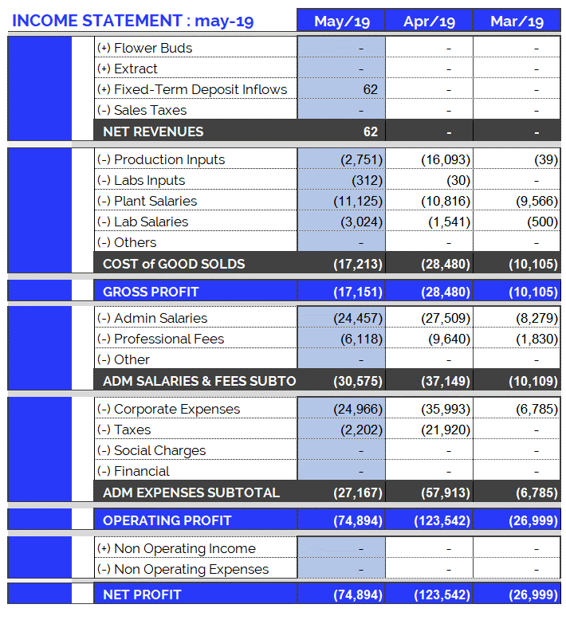
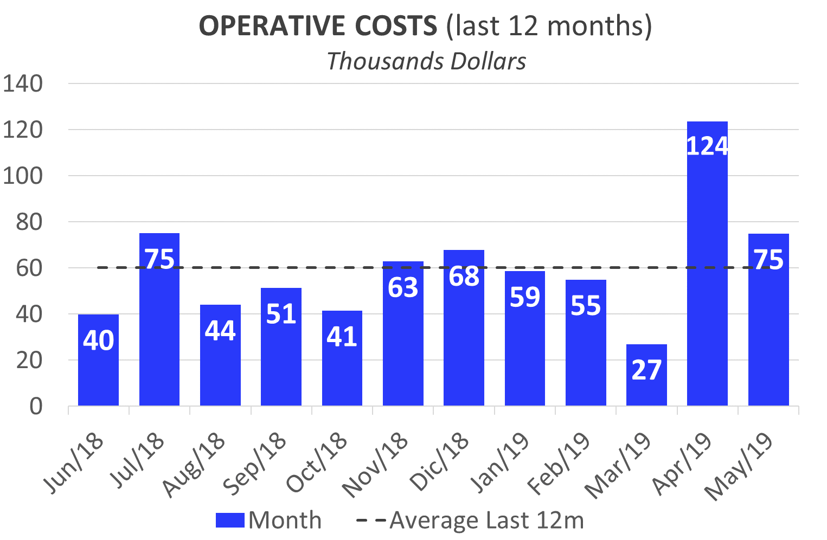
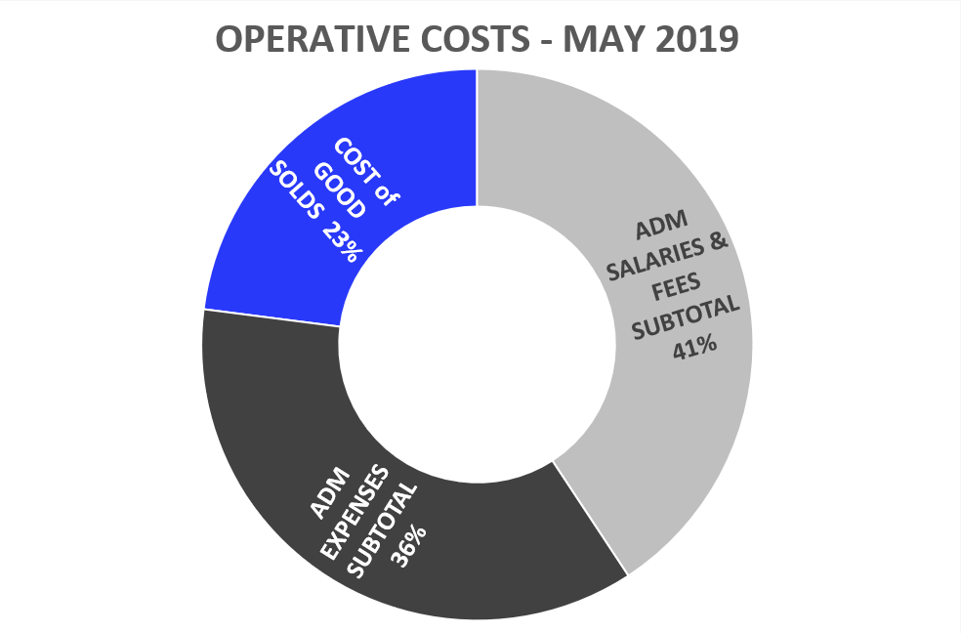
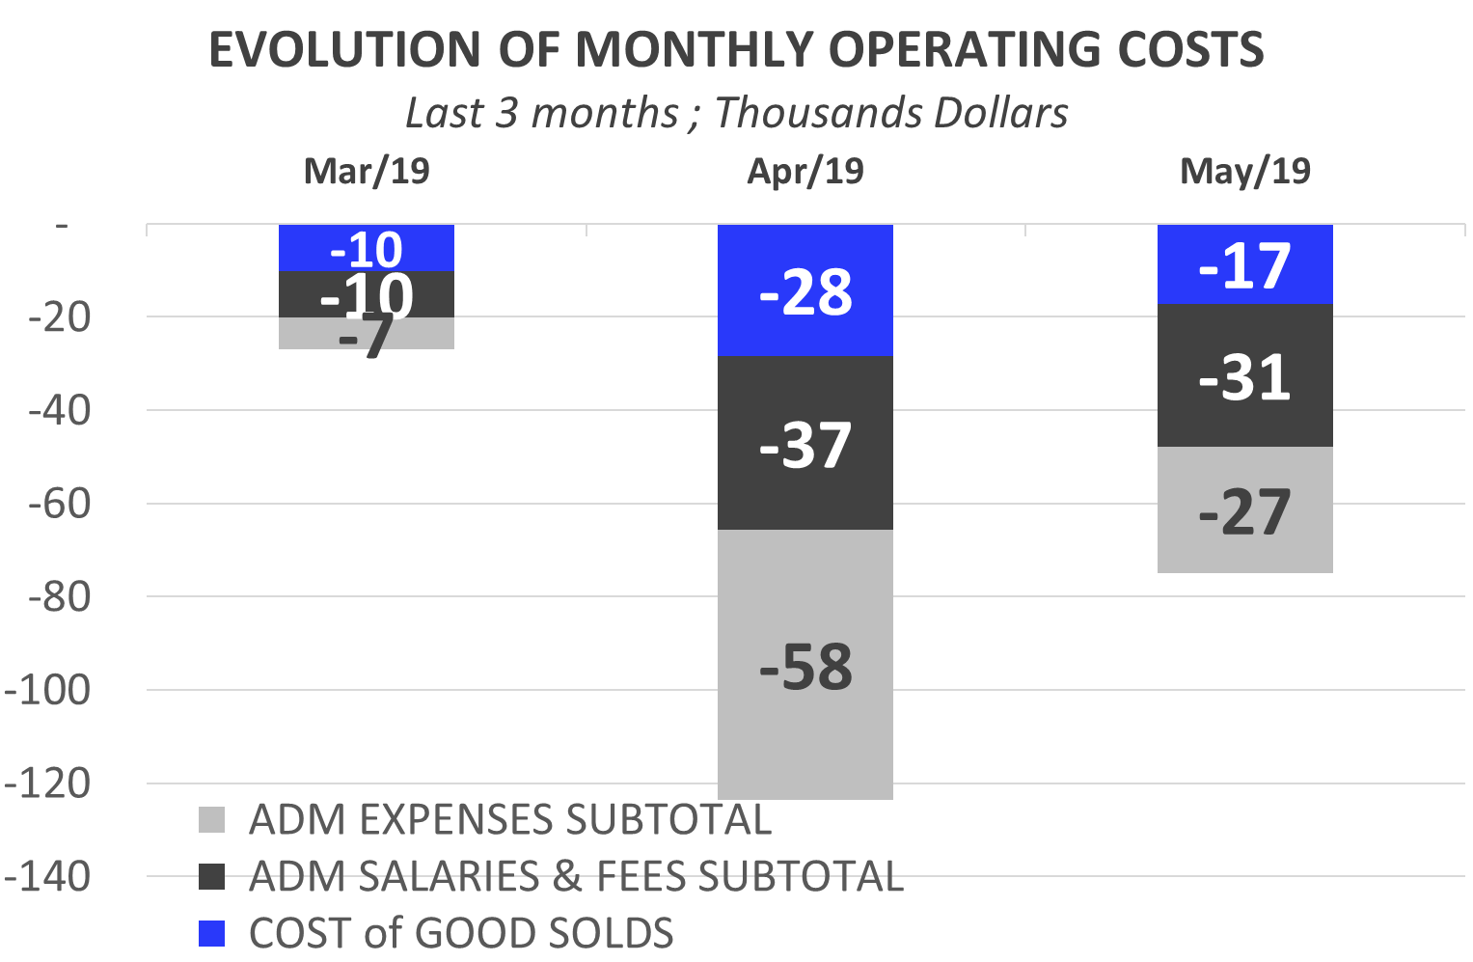
Income Statement: May 2019
9
Highlights of May 2019 Expenses: USD 74,956
Total operating costs for May were more than the last 12 months average
Corporate Expenses : USD 24,966
Credit Card Deposit Guarantee: USD 6,000.
Scientific Tech Park Land Rent: USD 3,979.
Electricity (UTE): USD 2,904.
Associates Travel: USD 2,207.
Web Page and Translations: USD 1,273.
Admin Salaries: USD 24,457.
Taxes: USD 2, 202.

Slide 12
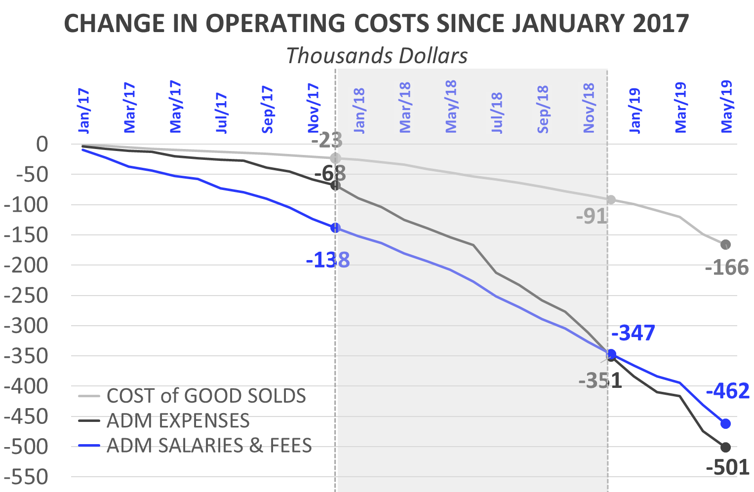
Income Statement: Change in Expenses
10
Burey’s operations have increased compared to 2017. This can be observed in the change of Operating Costs since Jan/17.
Cost of Goods Sold
In 2018 (compared to the accumulated amount for 2017) the Cost of Goods Sold increased 292%: between Jan/18 and Dec/18 USD 68,019 was spent. Mainly this is due to: increase in plant salaries.
In May/19, Cost of Goods Solds amounted to USD 17,213 (+3 times more was spent than May/18).
Administrative Salaries & Fees
In 2018 (compared to the accumulated amount for 2017) Administrative Salaries & Fees increased 151%: between Jan/18 and Dec/18 USD 208,992 was spent.
In May/19, Administrative Salaries & Fees amounted to USD 30,575 (+2.2 times more was spent than May/18).
Administrative Expenses
In 2018 (compared to the accumulated amount for 2017) Administrative Expenses increased 416%: between Jan/18 and Dec/18 USD 283,190 was spent.
In May/19, Administrative Expenses amounted to USD 27,167 (+1.8 times compared to May/18)
May/19: Taxes and social security payments (BPS): USD 2,202.

Slide 13
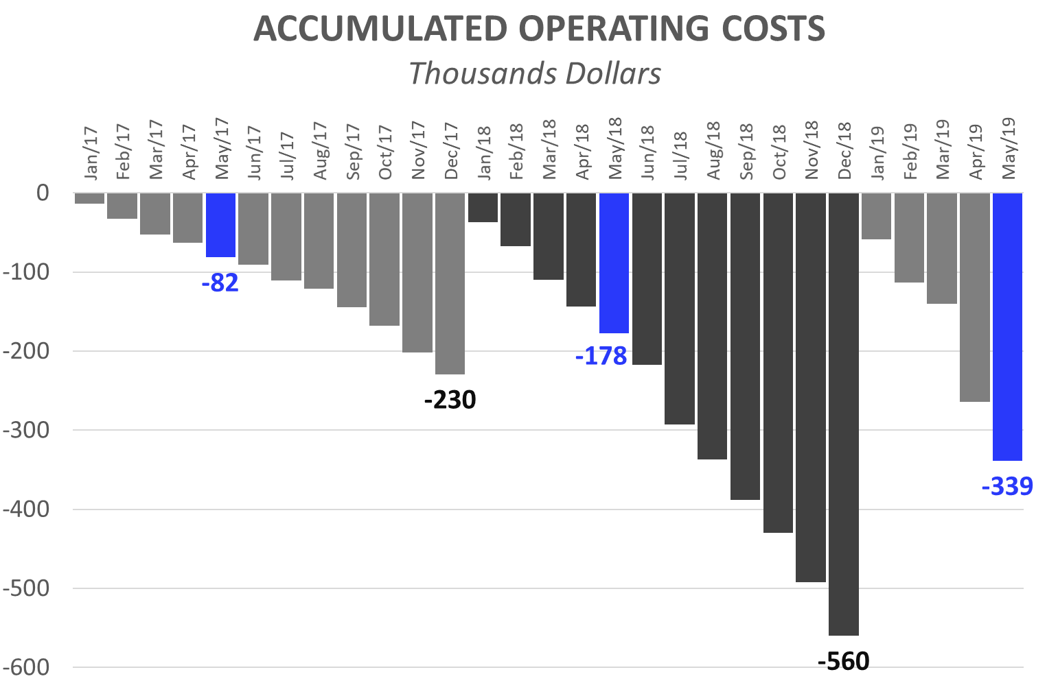
Income Statement: 5 months of 2019
11
Operating Costs accumulated for calendar year
The accumulated expenses for the 12 months (12M) of 2018 represent 243% of total 2017 expenses. This reflects the increase in operating costs mentioned in the previous slide and is the result of research performed and preparations for our first commercial production. By 2019, this trend is expected to continue, driven by production and sales.
First 5 Months (5M): Comparison 2019 vs. 2018:
While in the first 5M 2018 we spent USD 177,815, in the first 5M of 2019 we reached USD 339,123. This growth in expenses is principally attributed to:
First 5M of 2018, corporate expenses were USD 60,970. While, in the first 5M of 2019, USD 107,453 has been invested. (See Corporate Expenses in the previous slide).
First 5M 2019: The monthly average of admin salaries increased: + USD 8,748 (compared to first 5M 2018). This is due to:
Increase in compensation for Sergio, Joao, Sonia (Secretary) and Frank.
First 5M 2019: Professional Fees reached USD 29,963, while in 2018 (5M) they were USD 28,132.
First 5M 2019: Plant Salaries rose (First 5M 2019: USD 47,933 vs. First 5M 2018: USD 20,620). As of Feb/18 a Janitor and Auxiliary Corp were hired. As of Jan/19 a Maintenance Manager and Second Auxiliary Corp were hired.
At the same time, the raise in salaries increased contributions required by law (BPS), in 2019/2018 with respect to 2017.

Slide 14
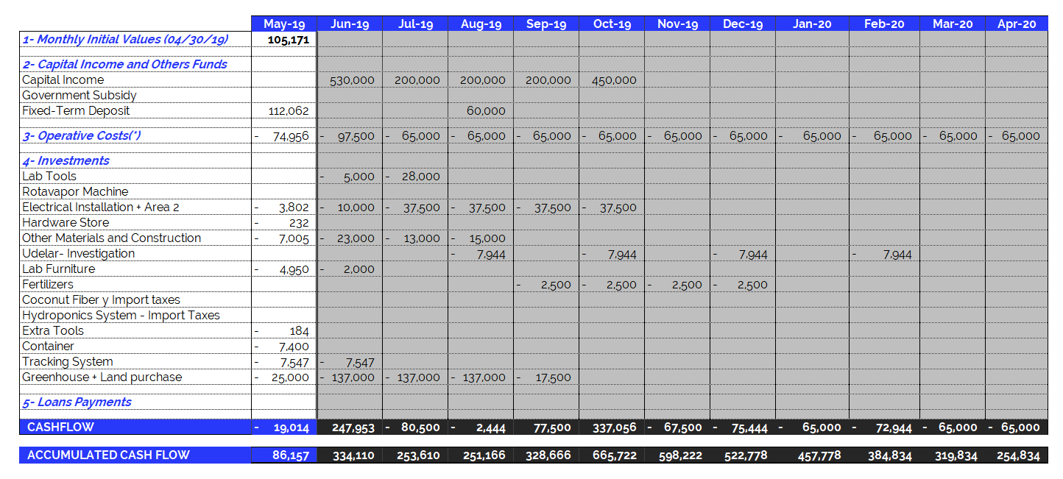
May 2019 – Projected Cash Flow for next 12 months
14
(*) Operating Expenses include 100% of the company's operating costs: salaries, professional fees, rent, etc. THE MONTHLY AVERAGE OF OPERATING EXPENSES does not include investments in equipment and labor. See the following item.

