Slide 1

BUREY SA – Grunelabs.com June 2020 presentation
Montevideo, June 4, 2020

Slide 2
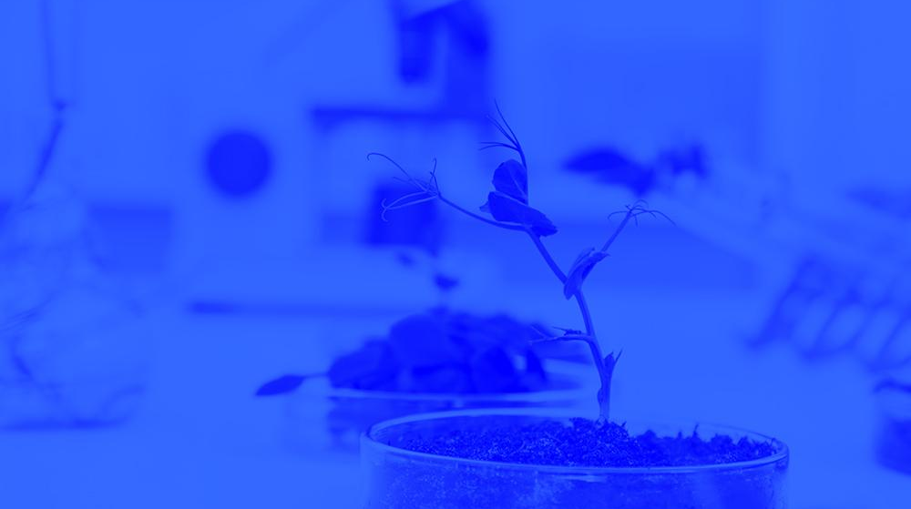
INDEX
Cash flow available data
Management tools
Balance Sheet
Income Statement
Next steps

Slide 3
INDEX
Cash flow available data
Management tools
Balance Sheet
Income Statement
Next steps

Slide 4
Cash Flow available data: May 2020
4
Accumulated cash balance at the end of 2019: USD 138,086.
Opening balance 2019 (end of 2018): USD 165,258
Inflows 2019: USD 1,850,086 (partner contributions and others)
Outflows 2019: USD (-) 1,877,259.
Final accumulated cash balance 2019: USD 138,086.
Accumulated cash balance at the end of May. 2020: USD 95,130.
Opening balance (end of Apr/20): (+) USD 47,108.
Capital Income May/20 : (+) USD 115,000.
Vehicle Sale ‘Fee 3/3’ May/20: (+) USD 6,650.
Loan repayment May/20: (-) USD 5,500.
Loan GruneLabs Portugal: (-) USD 4,000.
Fixed AssetsMay/20 : (-) USD 1087.
Operating Expenses Apr/20 : (-) USD 72,591.
Final accumulated cash balance May 2020 : USD 95,130.
New partner contributions and Loans: May. 2020
Contribution of partners: USD 115,000.

Slide 5

Accumulated Cash Flow – May 2020
5
Final Cash Balance 2016: USD 39 thousand
Final Cash Balance 2017: USD 46 thousand
Final Cash Balance 2018: USD 165 thousand
Final Cash Balance 2019: USD 138 thousand
Final Cash Balance 2020: USD 95 thousand
January 2020: USD (-) 100.3 thousand.
February 2020: USD (-) 37.1 thousand.
March 2020: USD (+) 53.8
April 2020: USD (-) 7.3
May 2020: USD (+) 48
Accumulated 2020
Acc. CF (1) – Accumulated Cash Flow (2016 - 2018)
Acc. CF (2) – Accumulated Cash Flow (2016 - December 2019)
Acc. CF (3) – Accumulated Cash Flow (2016 – May 2020)

Slide 6
INDEX
Cash flow available data
Management tools
Balance Sheet
Income Statement
Next steps

Slide 7
Balance Sheet: May. 2020
7
Continuous growth of plant and equipment
Property, Plant & Equipment growth in 2017: 200%
Property, Plant & Equipment growth in 2018: 138%
Property, Plant & Equipment growth in 2019: 65%
Property, Plant & Equipment growth in 2020: -1,6%
(Investments include Value Added Taxes: Tax Credit)
Fixed assets totally funded by capital injections and Government Subsidy.
2020: Vehicle sale (1 unit)

Slide 8
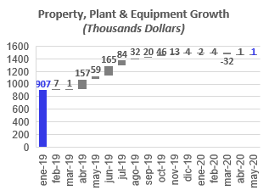
Investments_ Property, Plant & Eq.: May 2020
8

Slide 9
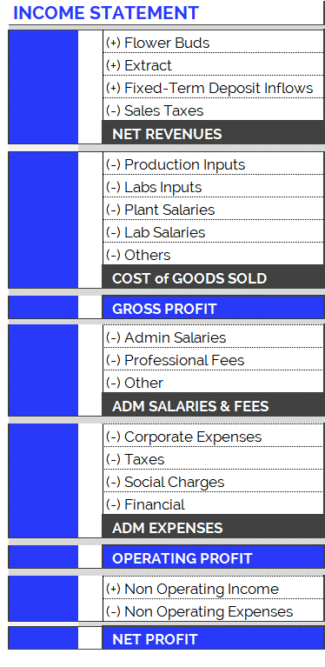
Income Statement: Change in Expenses
9
New Accounting Classification System for Operating Costs, since June 2019
In order to adequately present the company's areas of expense, the operating costs have been arranged according to item and category, as can be seen in the table on the right. Therefore:
Cost of Goods Sold
Shows direct costs of the production process: raw materials, tools, other materials and salaries of plant and laboratory employees.
Adm Salaries & Fees
Shows indirect costs of the production process: administrative salaries and professional fees.
Administration Expenses
Overhead and other expenses relating to the company’s structure.
The new accounting item classifications have generated small differences in the historical accumulated balances (in the new version of the Chart of Accounts compared to the previous one): for example, in the previous month's report (apr-19), differences can be observed in the accumulated flows of Cost of Good Sold. This is because all the accounts have been reclassified and, in order to maintain the same criteria, this generated variations in the historical presentation of the items. However, it should be kept in mind that the historical total expenditures remain unchanged, since the new order simply reorganizes the items for the purpose of better financial statements.

Slide 10
Income Statement: May. 2020
10
Highlights of May. 2020 Operative Costs:
USD 72,591.
Total operating costs for May are below the average (last 12 months) (*).
Costs of Goods Sold: USD 21,357.
Admin Salaries: USD 11,129.
Professional Fees: USD 12,260
Corporate Expenses : USD18,634
Social Charges: USD 5,811

Slide 11
Income Statement: Change in Expenses
11
Burey’s operations have increased compared to 2017. This can be observed in the change of Operating Costs since Jan/17.
Cost of Goods Sold
In 2019 (compared to the accumulated amount for 2018) the Cost of Goods Sold increased 242%: between Jan/19 and Dec/19 USD 268,173 was spent. Mainly this is due to: increase in plant salaries and labs inputs.
In 2020, Cost of Goods Sold amounted to USD 111,482 (composed of 60% Plant Salaries, 27% Lab Salaries, 7% Production Inputs and 6% Labs Inputs).
Administrative Salaries & Fees
In 2019 (compared to the accumulated amount for 2018) Administrative Salaries & Fees increased 95%: between Jan/19 and Dec/19 USD 387,507 was spent. Mainly this is due to: increase in Adm Salaries.
In 2020, Administrative Salaries & Fees amounted to USD 130,428 (composed of 56% Adm. Salaries and 44% Prof. Fees).
Administrative Expenses
In 2019 (compared to the accumulated amount for 2018) Administrative Expenses increased 74%: between Jan/19 and Dec/19 USD 494,004 was spent.
In 2020, Administrative Expenses amounted to USD 167,738 (composed of 57% Corporate Expenses, 36% Social Charges and 7% Taxes).

Slide 12
Operative Costs: 5 months of 2020
12
Operating Costs accumulated for calendar year
The accumulated expenses for the 12 months (12M) of 2019 represent 205% of total 2018 expenses. This reflects the increase in operating costs mentioned in the previous slide and is the result of research performed and preparations for our first commercial production.
First 5 Months (5M): Comparison 2020 vs. 2019:
While in the first 5M of 2019 we had operative costs for USD 339,123, in the first 5M of 2020 we reached USD 409.642. This growth in expenses is principally attributed to:
First 5M of 2019, corporate expenses were USD 107,453. While, in the first 5M of 2020, USD 103,482 , has been invested.
First 5M of 2020: The monthly average of admin salaries remains constant, compared to 2019. This is due to:
Although, first 5M of 2019 there was no Head of Accounting and Management and new other staff, in 2020, CEO Joao Rocha was transferred to Portugal.
First 5M of 2020: Professional Fees reached USD 58,026, while in 2019 (5M) they were USD 29,963.
First 5M of 2020: Plant Salaries rose (5M 2020: USD 66,371 vs. First 5M 2019: USD 47,933).
At the same time, the raise in salaries increased contributions required by law (BPS), in 2020/19 with respect to 2018.

