Slide 1

BUREY SA –
Grunelabs.com
Nov 2019 presentation
Montevideo, October 10, 2019

Slide 2

INDEX
Cash flow available data
Management tools
  Balance Sheet
  Income Statement
Next steps

Slide 3
INDEX
Cash flow available data
Management tools
  Balance Sheet
  Income Statement
Next steps

Slide 4
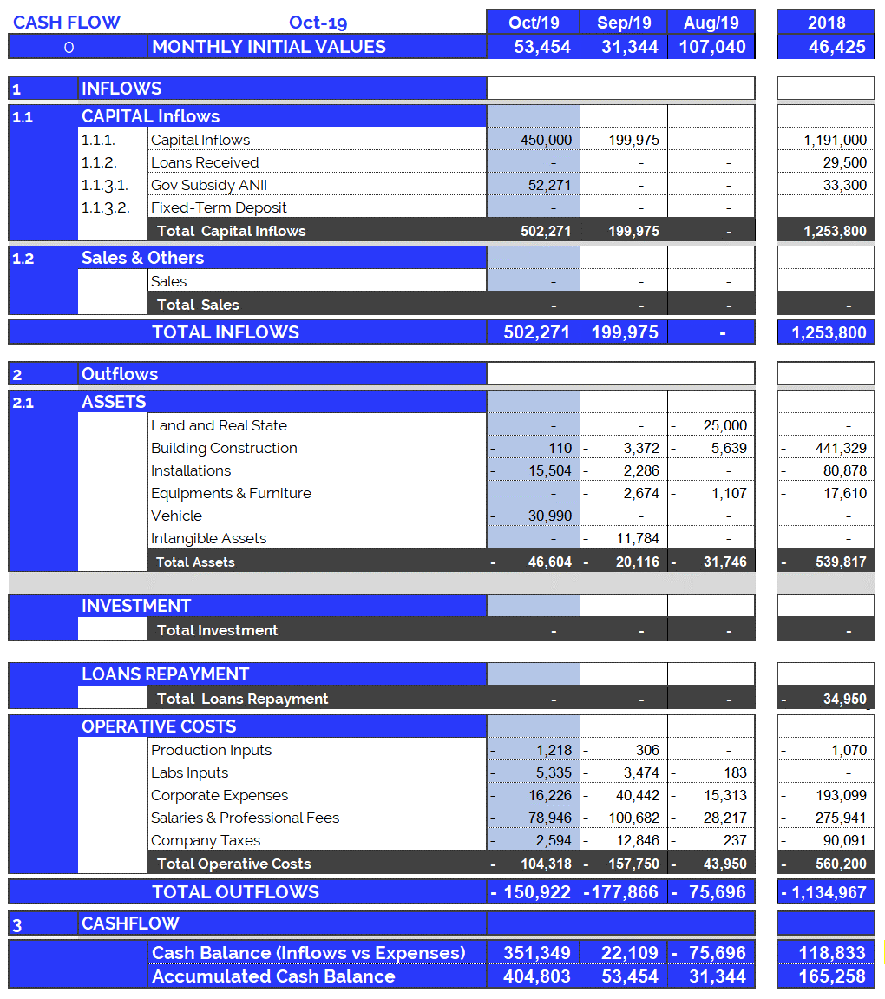
Cash Flow available data: Oct. 2019
4
Accumulated cash balance at the end of 2018:
USD 165,258.
  Opening balance 2018 (end of 2017): USD 46,425
  Income 2018: USD 1,253,800 (partner contributions and loans)
  Expenses 2018: USD (-) 1,134,967.
  Final accumulated cash balance 2018: USD 165,258
Accumulated cash balance at the end of Oct. 2019: USD 404,803.
  Opening balance (end of Sept/19): (+) USD 53,454
  Capital Income Oct/19 : (+) USD 450,000
  Gov. Subsidy Oct/19: (+) USD 52,271
  Fixed Assets Oct/19 : (-) USD 46,604.
  Operating Expenses Oct/19 : (-) USD 104,318.
  Final accumulated cash balance Oct 2019 : USD 404,803.
  Cash outflows for Oct/19 (USD 150,922) are composed of: 69% Operating Expenses, and 31% Equipment and Structure.
  October operating costs were +21% more than the monthly average (last 12 months).
New partner contributions and Loans: Oct. 2019
  Contribution of partners: USD 450,000.

Slide 5
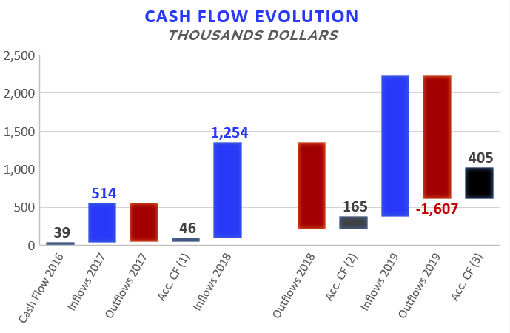

Accumulated Cash Flow – Oct 2019
5
Final Cash Balance 2016: USD 39 thousand
Final Cash Balance 2017: USD 46 thousand
Final Cash Balance 2018: USD 165 thousand
Final Cash Balance 2019: USD 404 thousand
  January 2019: USD (-) 67.7 thousand.
  February 2019: USD (-) 61.5 thousand.
  March 2019: USD (-) 28.8 thousand.
  April 2019: USD (+) 107.3 thousand.
  May 2019: USD (-) 32.7 thousand.
  Jun 2019: USD (+) 219.7 thousand.
  Jul 2019: USD (-) 194.3 thousand.
  Aug 2019: USD (-) 75.7 thousand.
  Sep 2019: USD (+) 22.1 thousand.
  Oct 2019: USD (+) 351,3 thousand.
Accumulated 2019
1.145
-506
-1.135
Acc. CF (1) – Accumulated Cash Flow (2016 - 2017)
Acc. CF (2) – Accumulated Cash Flow (2016 - December 2018)
Acc. CF (3) – Accumulated Cash Flow (2016 – Oct 2019)

Slide 6
INDEX
Cash flow available data
Management tools
  Balance Sheet
  Income Statement
Next steps

Slide 7
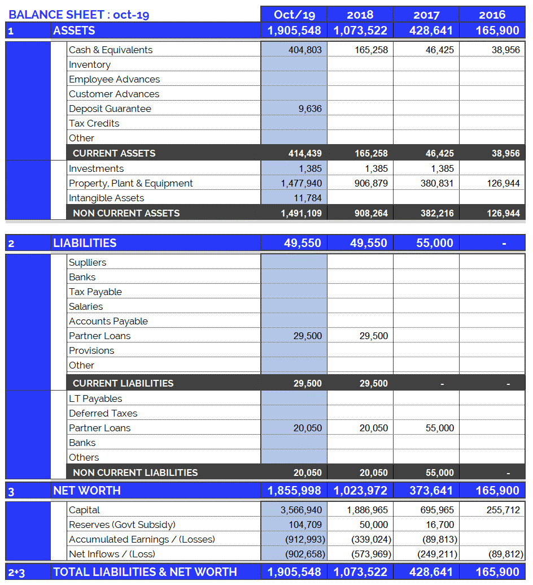
Balance Sheet: Oct. 2019
7
Continuous growth of plant and equipment
  Property, Plant & Equipment growth in 2017: 200%
  Property, Plant & Equipment growth in 2018: 138%
  Property, Plant & Equipment growth in 2019: 63%
  (Investments include Value Added Taxes: Tax Credit)
Fixed assets totally funded by capital injections and Government Subsidy.

Slide 8
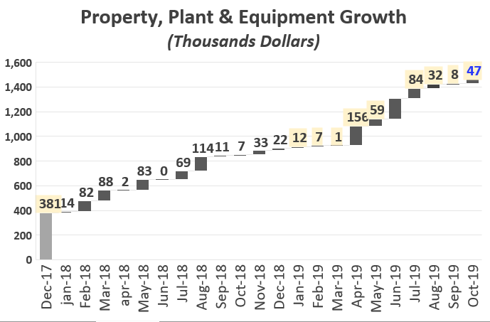
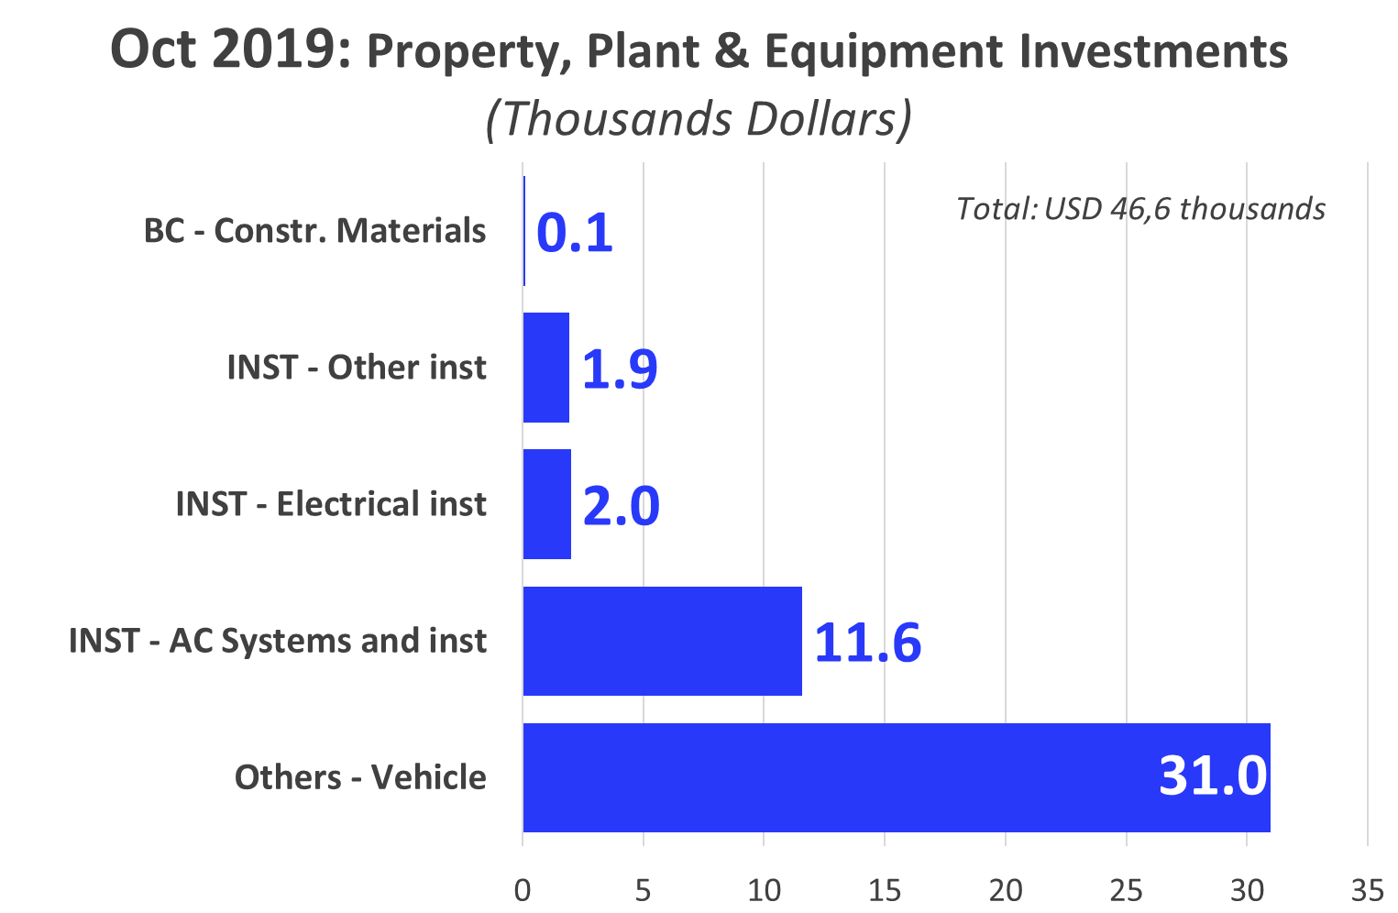

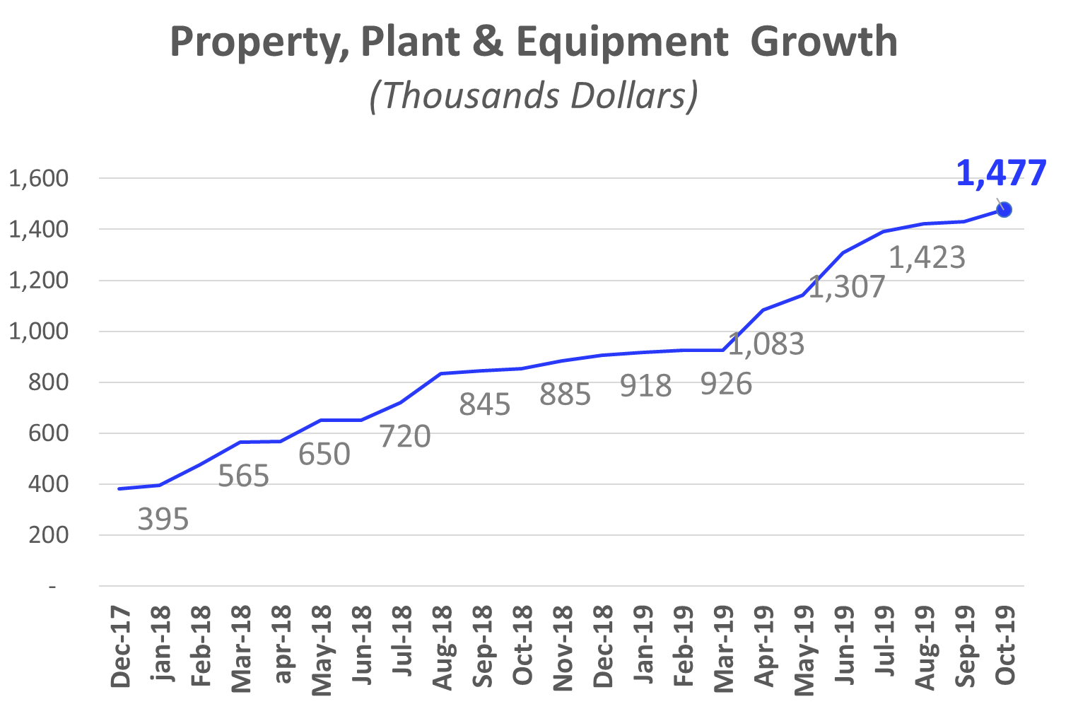
Investments_ Property, Plant & Eq.: Oct 2019
8
165

Slide 9
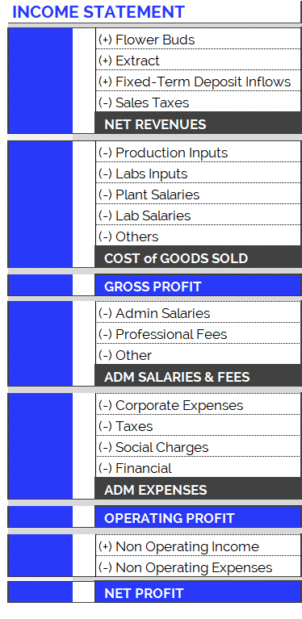
Income Statement: Change in Expenses
9
New Accounting Classification System for Operating Costs, since June 2019
In order to adequately present the company's areas of expense, the operating costs have been arranged according to item and category, as can be seen in the table on the right. Therefore:
  Cost of Goods Sold
    Shows direct costs of the production process: raw materials, tools, other materials and salaries of plant and laboratory employees.
  Adm Salaries & Fees
    Shows indirect costs of the production process: administrative salaries and professional fees.
  Administration Expenses
    Overhead and other expenses relating to the company’s structure.
The new accounting item classifications have generated small differences in the historical accumulated balances (in the new version of the Chart of Accounts compared to the previous one): for example, in the previous month's report (apr-19), differences can be observed in the accumulated flows of Cost of Good Sold. This is because all the accounts have been reclassified and, in order to maintain the same criteria, this generated variations in the historical presentation of the items. However, it should be kept in mind that the historical total expenditures remain unchanged, since the new order simply reorganizes the items for the purpose of better financial statements.

Slide 10
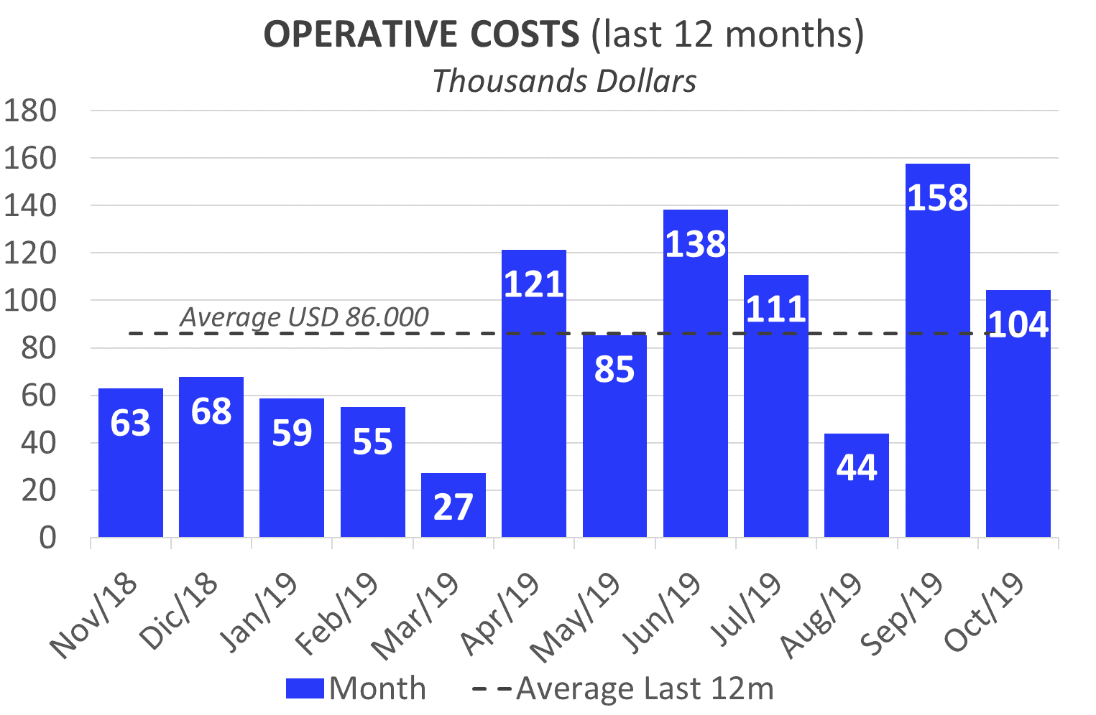
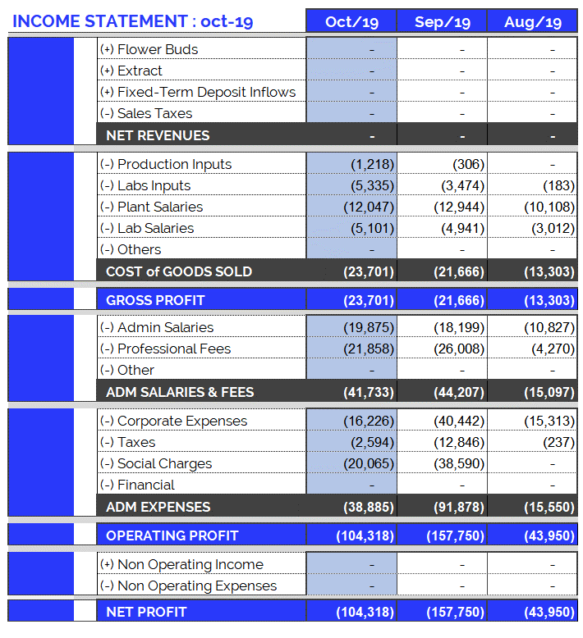
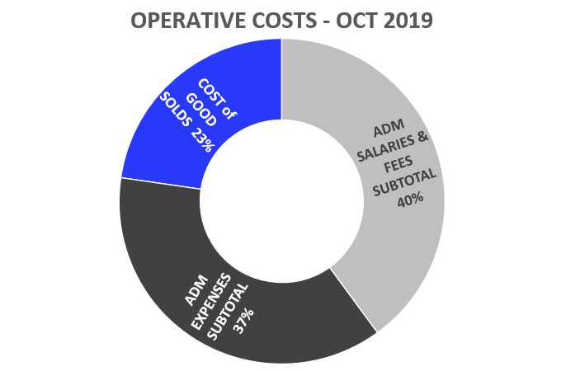
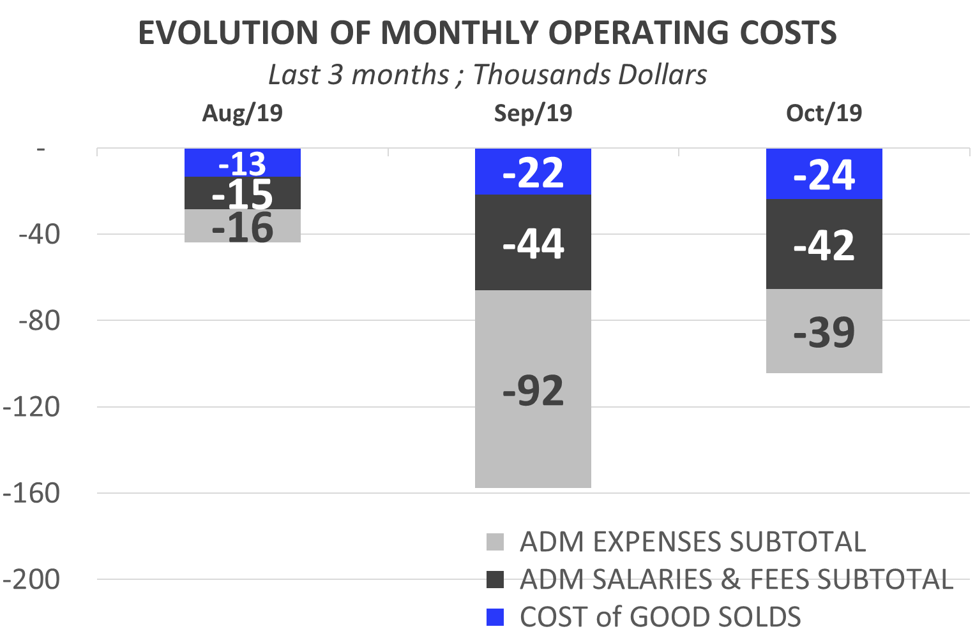
Income Statement: Oct. 2019
10
Highlights of Oct. 2019 Expenses:
USD 104,318.
Total operating costs for October are more than the average for the last 12 months (+21%).
  Costs of Goods Sold: USD 23,701.
  Corporate Expenses : USD 16,226.
    Travel Expenses: USD 3,181.
    Electricity (UTE): USD 2,484.
    Office Supplies: USD 1,030.
    Apt. Rentals and Others: USD 1,000.
  Admin Salaries: USD 19,875.
  Professional Fees: USD 21,858.
    Notary and Lawyer: USD 13,398.
  Taxes and Employer Contributions: USD 2,594.

Slide 11
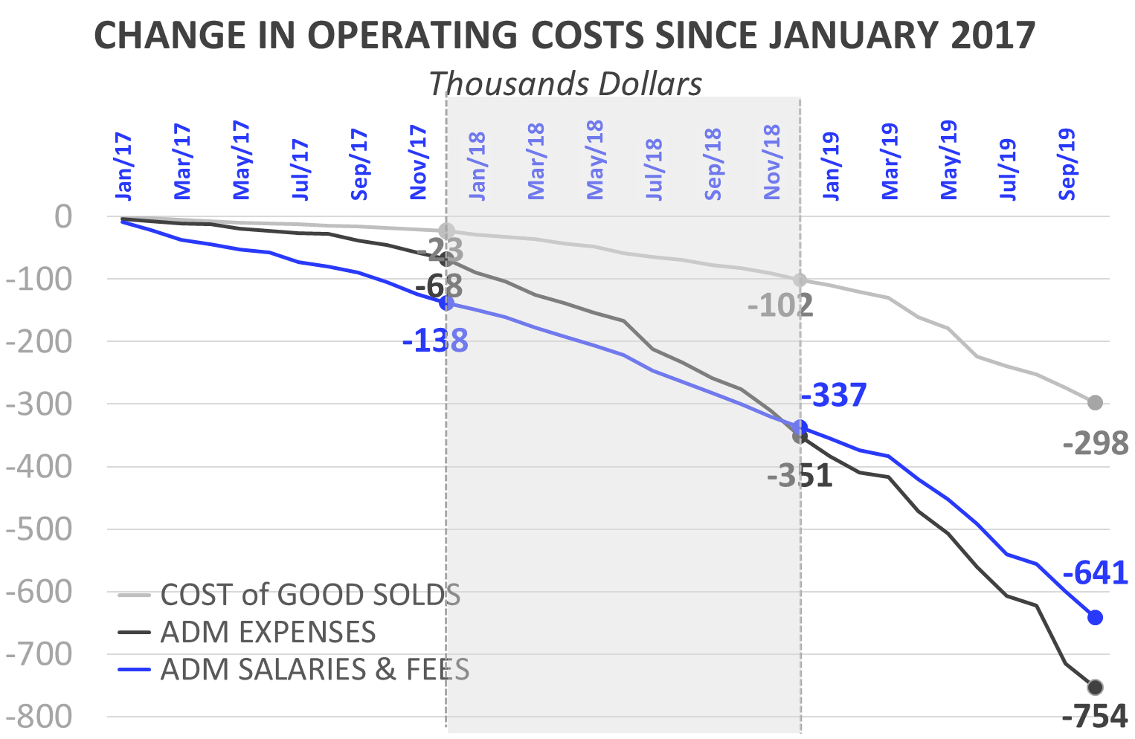
Income Statement: Change in Expenses
11
Burey’s operations have increased compared to 2017. This can be observed in the change of Operating Costs since Jan/17.
Cost of Goods Sold
  In 2018 (compared to the accumulated amount for 2017) the Cost of Goods Sold increased 292%: between Jan/18 and Dec/18 USD 68,019 was spent. Mainly this is due to: increase in plant salaries.
  In Oct/19, Cost of Goods Sold amounted to USD 23,701 (composed of 51% Plant Salaries).
Administrative Salaries & Fees
  In 2018 (compared to the accumulated amount for 2017) Administrative Salaries & Fees increased 151%: between Jan/18 and Dec/18 USD 208,992 was spent.
  In Oct/19, Administrative Salaries & Fees amounted to USD 41,733 (2.4 times compared to Oct/18)
Administrative Expenses
  In 2018 (compared to the accumulated amount for 2017) Administrative Expenses increased 416%: between Jan/18 and Dec/18 USD 283,190 was spent.
  In Oct/19, Administrative Expenses amounted to USD 38,885 (2.1 times compared to Oct/18)

Slide 12
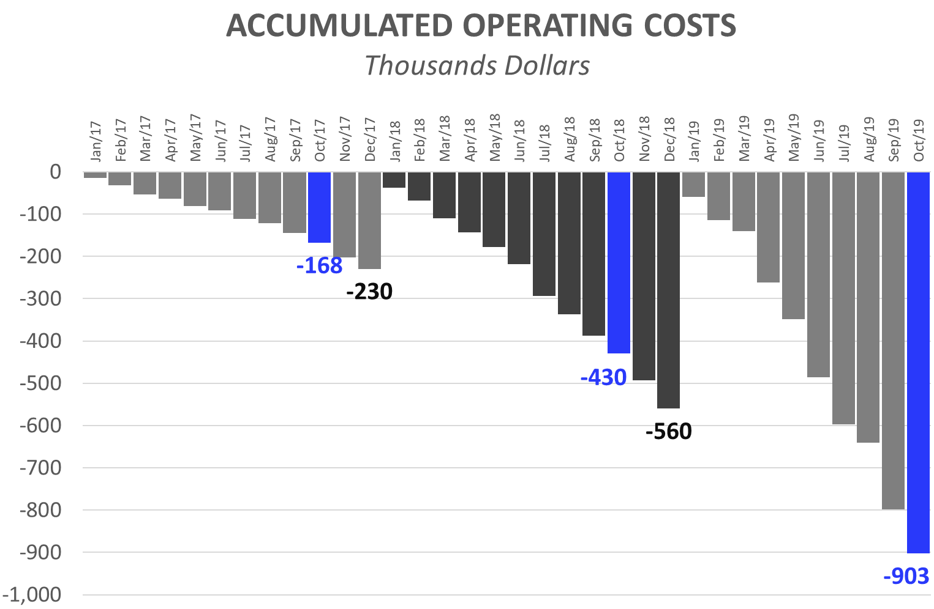
Income Statement: 10 months of 2019
12
Operating Costs accumulated for calendar year
The accumulated expenses for the 12 months (12M) of 2018 represent 243% of total 2017 expenses. This reflects the increase in operating costs mentioned in the previous slide and is the result of research performed and preparations for our first commercial production. Operating costs accrued as of October 2019 (10M), represent 162% of those for 2018 (12M).
First 9 Months (10M): Comparison 2019 vs. 2018:
While in the first 10M 2018 we spent USD 429,650, in the first 10M of 2019 we reached USD 902,720. This growth in expenses is principally attributed to:
  First 10M of 2018, corporate expenses were USD 138,160. While, in the first 10M of 2019, USD 209,433 has been invested.
  First 10M 2019: The monthly average of admin salaries increased: + USD 8,805 (compared to first 10M 2018). This is due to:
    Increase in compensation for Sergio, Joao, Sonia (Secretary) and other staff.
  First 10M 2019: Professional Fees reached USD 110,252, while in 2018 (10M) they were USD 55,381.
  First 10M 2019: Plant Salaries rose (First 10M 2019: USD 108,433 vs. First 10M 2018: USD 53,110). As of Feb/18 a Janitor and Auxiliary Corp were hired. As of Jan/19 a Maintenance Manager and Second Auxiliary Corp were hired.
  At the same time, the raise in salaries increased contributions required by law (BPS), in 2019/2018 with respect to 2017.

Slide 13
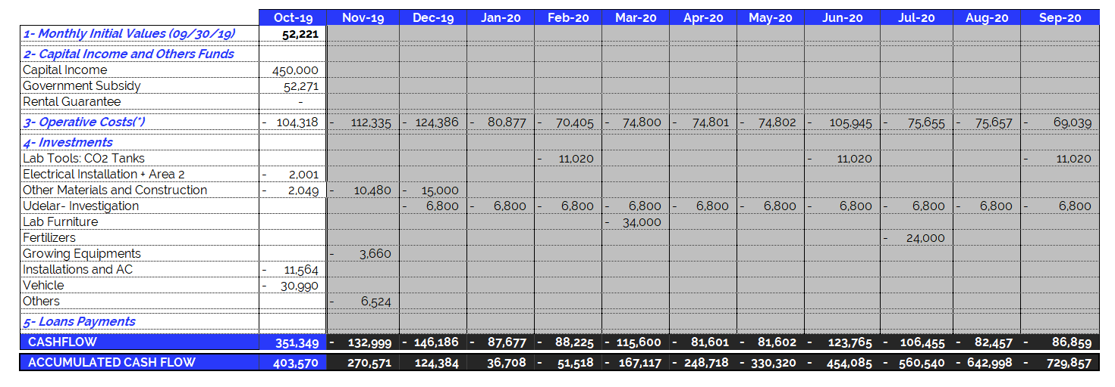
Oct 2019 – Projected Cash Flow for next 12 months
13
(*) Operating Expenses include 100% of the company's operating costs: salaries, professional fees, rent, etc. THE MONTHLY AVERAGE OF OPERATING EXPENSES does not include investments in equipment and labor. See the following item.

