Slide 1

BUREY SA –
Grunelabs.com
May 2020 presentation
Montevideo, May 10, 2020

Slide 2

INDEX
Cash flow available data
Management tools
  Balance Sheet
  Income Statement
Next steps

Slide 3
INDEX
Cash flow available data
Management tools
  Balance Sheet
  Income Statement
Next steps

Slide 4
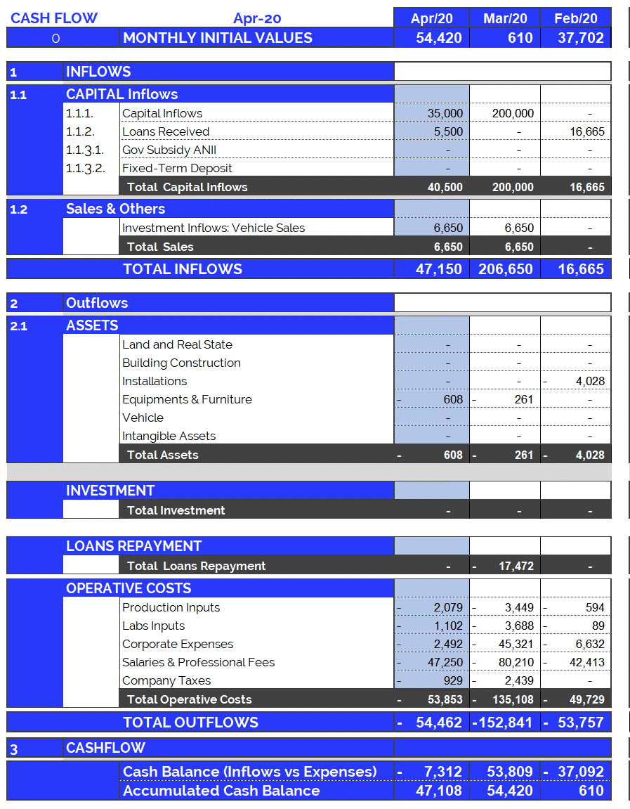
Cash Flow available data: Apr. 2020
4
Accumulated cash balance at the end of 2019:
USD 138,086.
  Opening balance 2019 (end of 2018): USD 165,258
  Inflows 2019: USD 1,850,086 (partner contributions and others)
  Outflows 2019: USD (-) 1,877,259.
  Final accumulated cash balance 2019: USD 138,086.
Accumulated cash balance at the end of Apr. 2020: USD 47,109.
  Opening balance (end of Mar/20): (+) USD 54,420.
  Capital Income Apr/20 : (+) USD 35,000
  Vehicle Sale ‘Fee 2/3’ Apr/20: (+) USD 6,650
  Loans Received Apr/20 : (+) USD 5,500.
  Fixed Assets Apr/20 : (-) USD 608.
  Operating Expenses Apr/20 : (-) USD 53,853.
  Final accumulated cash balance Apr 2020 : USD 47,109.
  Cash outflows for Apr/20 (USD 54,461) are composed of: 99% Operating Expenses and 1% Investement in P.P.& Eq.
  April operating costs were below the average (last 12 months).
New partner contributions and Loans: Apr. 2020
  Contribution of partners: USD 35.000.

Slide 5
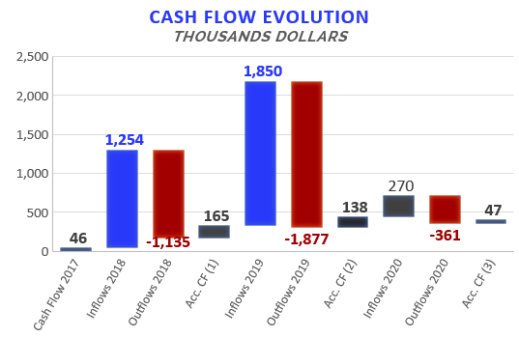

Accumulated Cash Flow – Apr 2020
5
Final Cash Balance 2016: USD 39 thousand
Final Cash Balance 2017: USD 46 thousand
Final Cash Balance 2018: USD 165 thousand
Final Cash Balance 2019: USD 138 thousand
Final Cash Balance 2020: USD 47 thousand
  January 2020: USD (-) 100.3 thousand.
  February 2020: USD (-) 37.1 thousand.
  March 2020: USD (+) 53.8
  April 2020: USD (-) 7.3
Accumulated 2020
Acc. CF (1) – Accumulated Cash Flow (2016 - 2018)
Acc. CF (2) – Accumulated Cash Flow (2016 - December 2019)
Acc. CF (3) – Accumulated Cash Flow (2016 – Apr 2020)

Slide 6
INDEX
Cash flow available data
Management tools
  Balance Sheet
  Income Statement
Next steps

Slide 7
Balance Sheet: Apr. 2020
7
Continuous growth of plant and equipment
  Property, Plant & Equipment growth in 2017: 200%
  Property, Plant & Equipment growth in 2018: 138%
  Property, Plant & Equipment growth in 2019: 65%
  Property, Plant & Equipment growth in 2020: -1,7%
  (Investments include Value Added Taxes: Tax Credit)
Fixed assets totally funded by capital injections and Government Subsidy.
2020: Vehicle sale (1 unit)

Slide 8
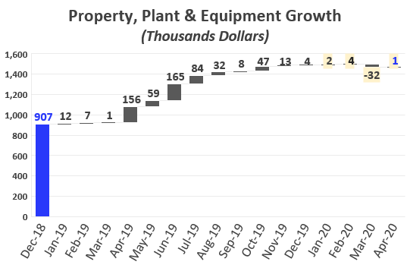
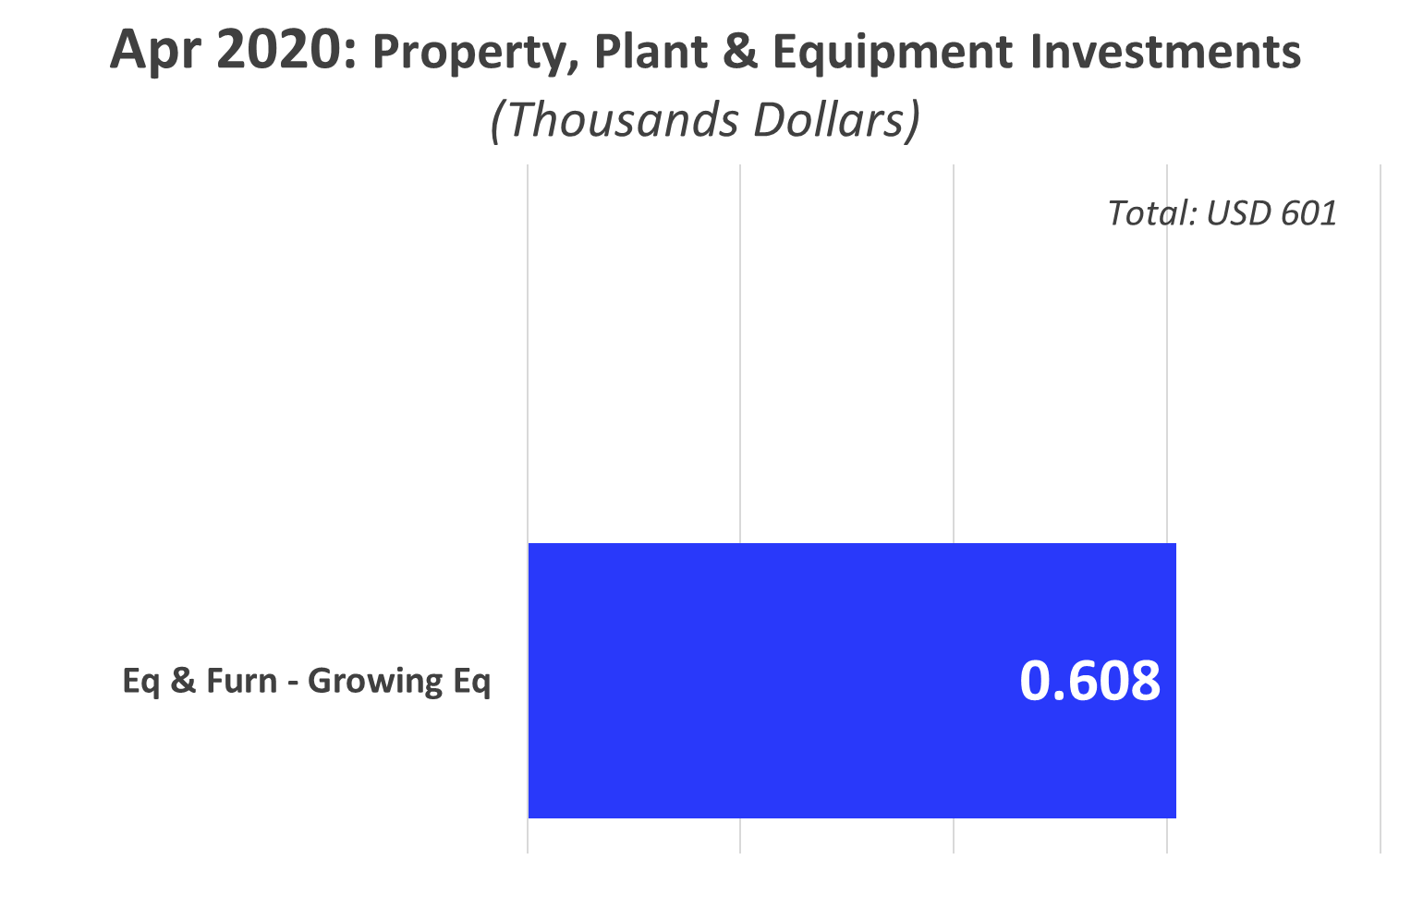
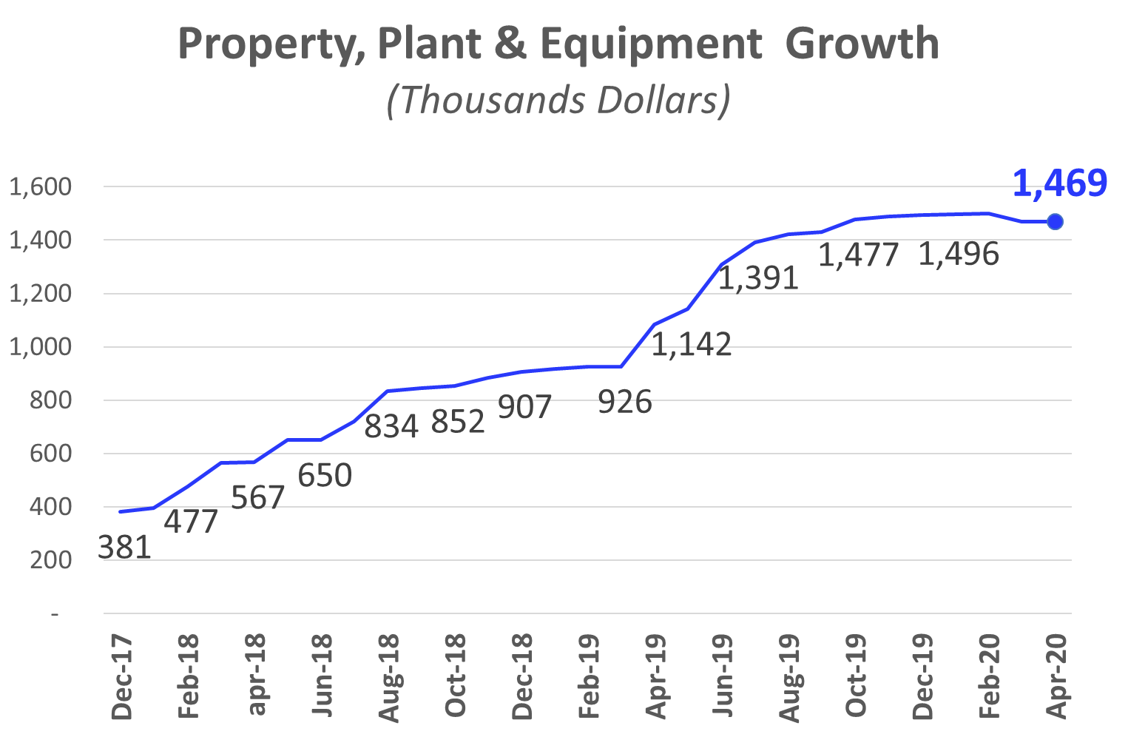
Investments_ Property, Plant & Eq.: Apr 2020
8

Slide 9
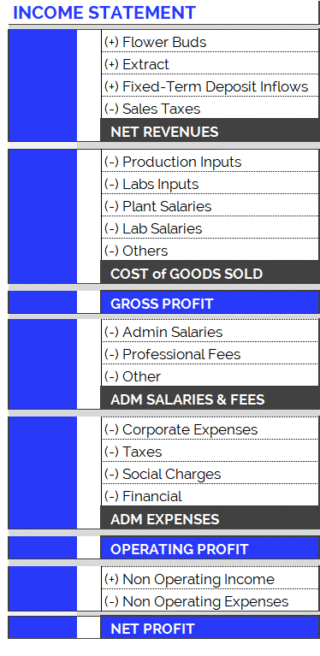
Income Statement: Change in Expenses
9
New Accounting Classification System for Operating Costs, since June 2019
In order to adequately present the company's areas of expense, the operating costs have been arranged according to item and category, as can be seen in the table on the right. Therefore:
  Cost of Goods Sold
    Shows direct costs of the production process: raw materials, tools, other materials and salaries of plant and laboratory employees.
  Adm Salaries & Fees
    Shows indirect costs of the production process: administrative salaries and professional fees.
  Administration Expenses
    Overhead and other expenses relating to the company’s structure.
The new accounting item classifications have generated small differences in the historical accumulated balances (in the new version of the Chart of Accounts compared to the previous one): for example, in the previous month's report (apr-19), differences can be observed in the accumulated flows of Cost of Good Sold. This is because all the accounts have been reclassified and, in order to maintain the same criteria, this generated variations in the historical presentation of the items. However, it should be kept in mind that the historical total expenditures remain unchanged, since the new order simply reorganizes the items for the purpose of better financial statements.

Slide 10
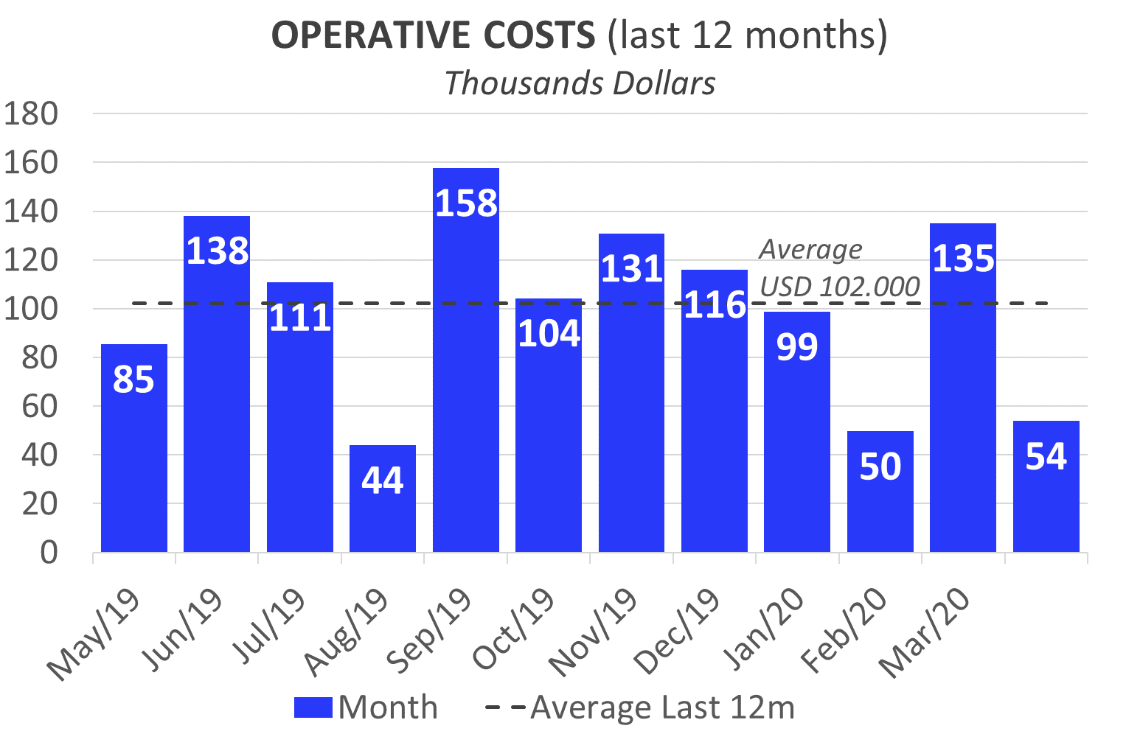
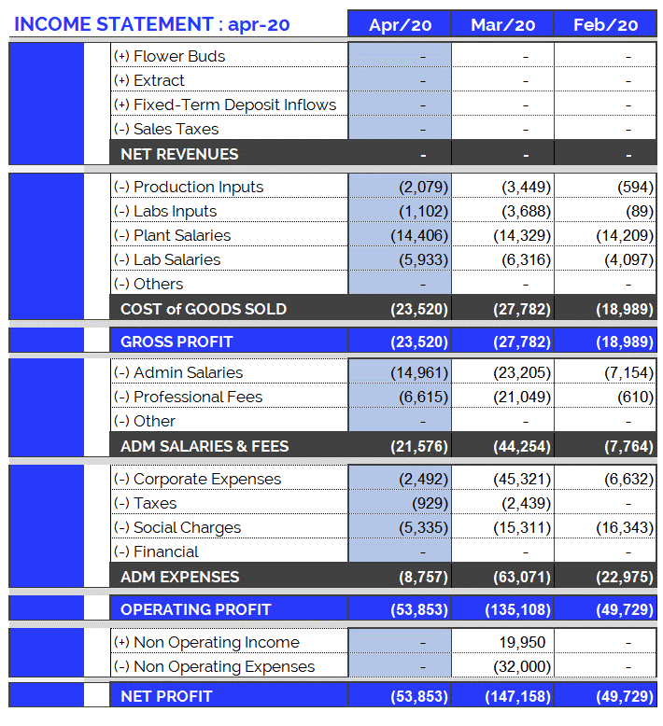
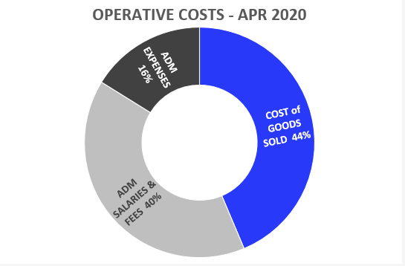
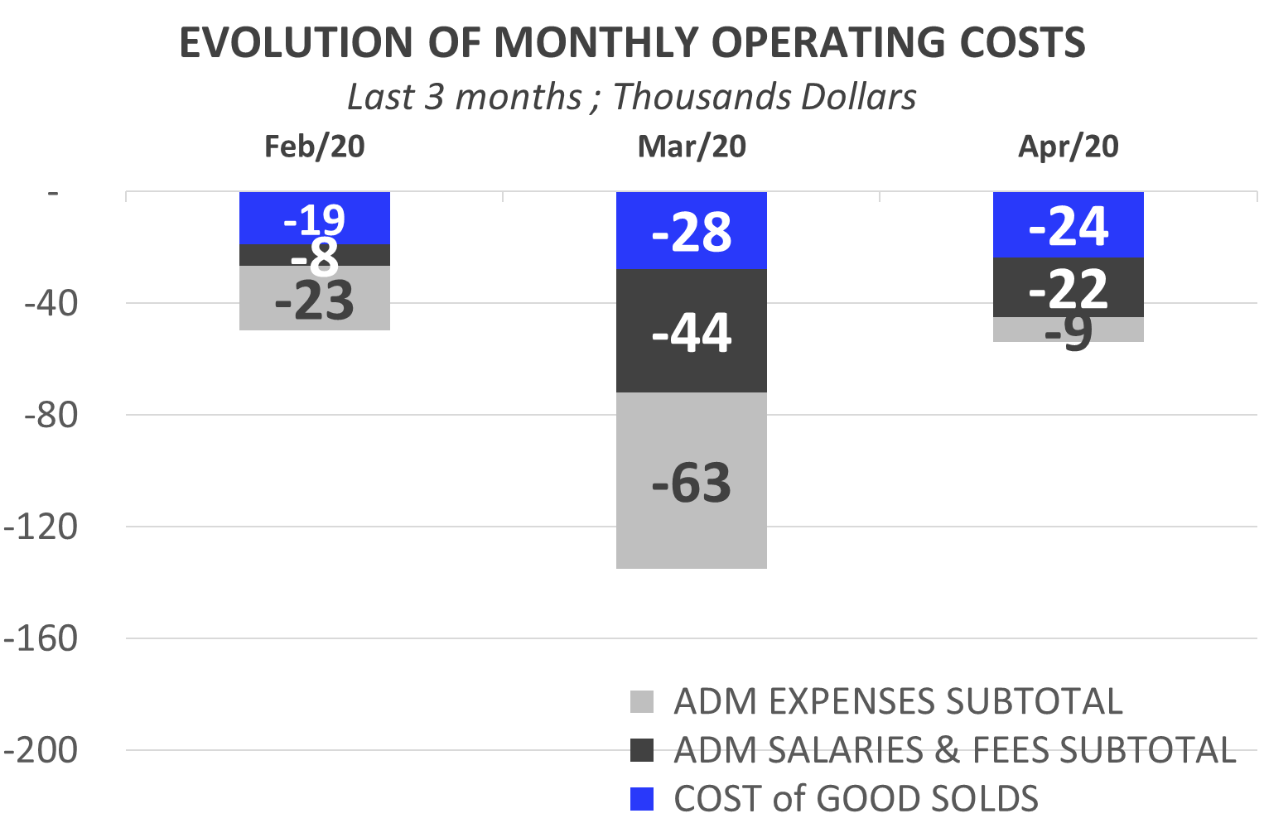
Income Statement: Apr. 2020
10
Highlights of Apr. 2020 Operative Costs:
USD 53,853.
Total operating costs for April are below the average (last 12 months) (*).
  Costs of Goods Sold: USD 23,520.
  Admin Salaries: USD 14.961.
  Professional Fees: USD 6,615. (*)
  Corporate Expenses : USD 2,492. (*)
  Social Charges: USD 5,335. (*)
  (*) In April, the payment of several expenses was postponed to the following month.

Slide 11
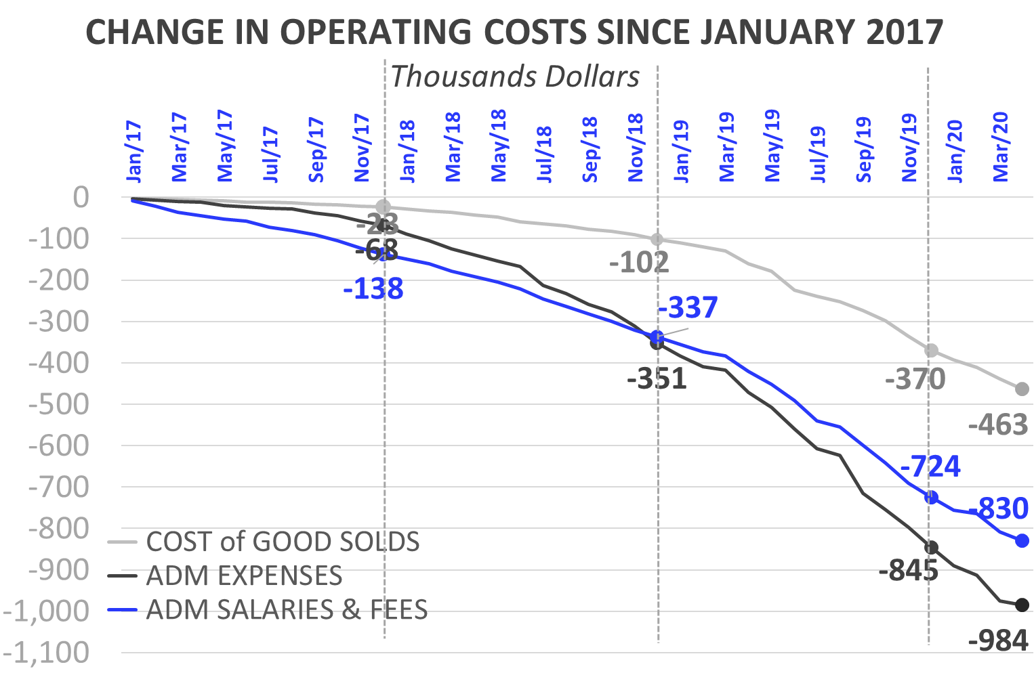
Income Statement: Change in Expenses
11
Burey’s operations have increased compared to 2017. This can be observed in the change of Operating Costs since Jan/17.
Cost of Goods Sold
  In 2019 (compared to the accumulated amount for 2018) the Cost of Goods Sold increased 242%: between Jan/19 and Dec/19 USD 268,173 was spent. Mainly this is due to: increase in plant salaries and labs inputs.
  In 2020, Cost of Goods Sold amounted to USD 92,758 (composed of 60% Plant Salaries, 25% Lab Salaries, 8% Production Inputs and 7% Labs Inputs).
Administrative Salaries & Fees
  In 2019 (compared to the accumulated amount for 2018) Administrative Salaries & Fees increased 95%: between Jan/19 and Dec/19 USD 387,507 was spent. Mainly this is due to: increase in Adm Salaries.
  In 2020, Administrative Salaries & Fees amounted to USD 105,550 (composed of 57% Adm. Salaries and 43% Prof. Fees).
Administrative Expenses
  In 2019 (compared to the accumulated amount for 2018) Administrative Expenses increased 74%: between Jan/19 and Dec/19 USD 494,004 was spent.
  In 2020, Administrative Expenses amounted to USD 139,086 (composed of 55% Corporate Expenses, 39% Social Charges and 6% Taxes).

Slide 12
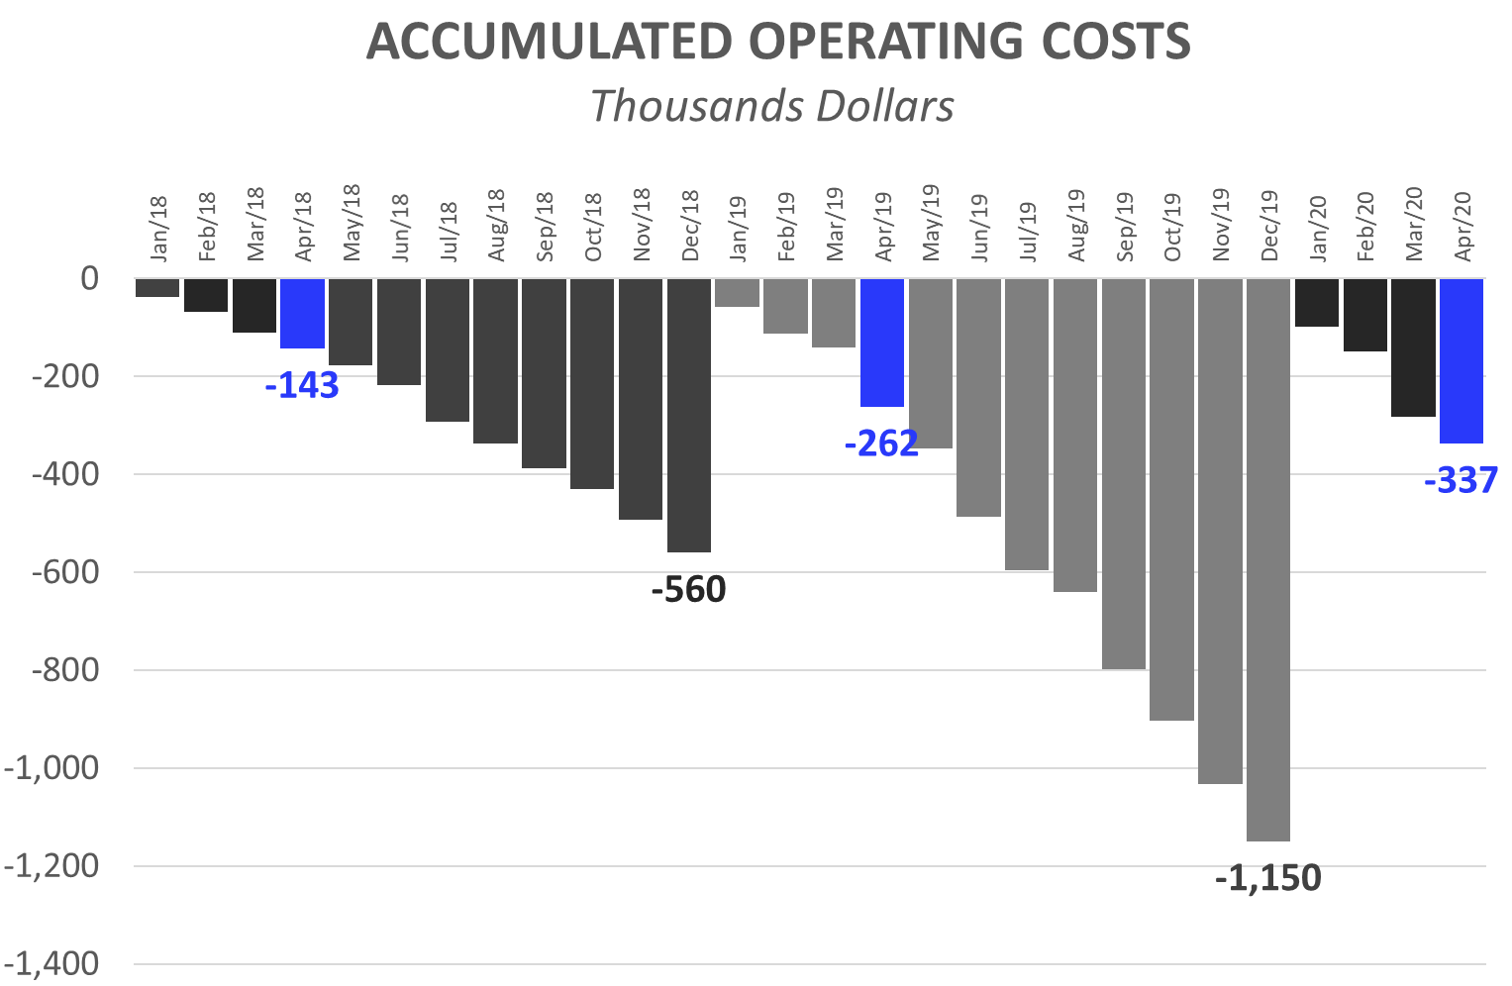
Operative Costs: 4 months of 2020
12
Operating Costs accumulated for calendar year
The accumulated expenses for the 12 months (12M) of 2019 represent 205% of total 2018 expenses. This reflects the increase in operating costs mentioned in the previous slide and is the result of research performed and preparations for our first commercial production.
First 4 Months (4M): Comparison 2020 vs. 2019:
While in the first 4M of 2019 we had operative costs for USD 262,258, in the first 4M of 2020 we reached USD 337,393. This growth in expenses is principally attributed to:
  First 4M of 2019, corporate expenses were USD 79,870. While, in the first 4M of 2020, USD 76,681 has been invested.
  First 4M of 2020: The monthly average of admin salaries remains constant, compared to 2019. This is due to:
    Although, first 4M of 2019 there was no Head of Accounting and Management and new other staff, in 2020, CEO Joao Rocha was transferred to Portugal.
  First 4M of 2020: Professional Fees reached USD 45,766, while in 2019 (4M) they were USD 23,122.
  First 4M of 2020: Plant Salaries rose (4M 2020: USD 55,592 vs. First 4M 2019: USD 36,304). As of Mar/19 an Auxiliary Corp was hired. As of Sep/19 a second Auxiliary Corp was hired. As of Dec/19 a third and fourth Auxiliary Corp were hired.
  At the same time, the raise in salaries increased contributions required by law (BPS), in 2020/19 with respect to 2017.

