Slide 1

BUREY SA – Grunelabs.com September 2020 presentation
Montevideo, October 14, 2020

Slide 2
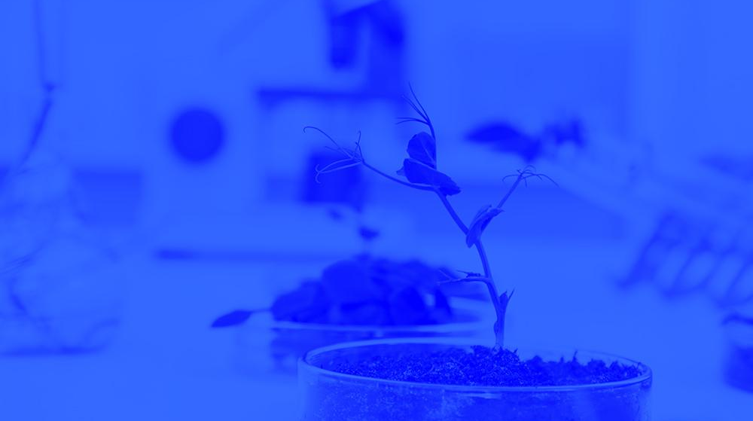
INDEX
Cash flow available data
Management tools
Balance Sheet
Income Statement
Harvest Valuation

Slide 3
INDEX
Cash flow available data
Management tools
Balance Sheet
Income Statement
Harvest Valuation

Slide 4
Cash Flow available data: September 2020
4
Accumulated cash balance at the end of 2019: USD 138,086.
Opening balance 2019 (end of 2018): USD 165,258
Inflows 2019: USD 1,850,086 (partner contributions and others)
Outflows 2019: USD (-) 1,877,259.
Final accumulated cash balance 2019: USD 138,086.
Accumulated cash balance at the end of September 2020: USD 38,094.
Opening balance (end of August/20): (+) USD 141,574.
Capital Income September/20 : (+) USD 45,000.
Loan GruneLabs Portugal: (-) USD 9,000.
Other Credits (-) USD 48.820. Payments of October 20
Installations: (-) USD 1,590.
Operating Expenses August/20 : (-) USD 102,147.
Forex rate : (-) USD 2
Final accumulated cash balance September 2020 : USD 38,094.
New partner contributions and Loans: September. 2020
Contribution of partners: USD 45.000

Slide 5
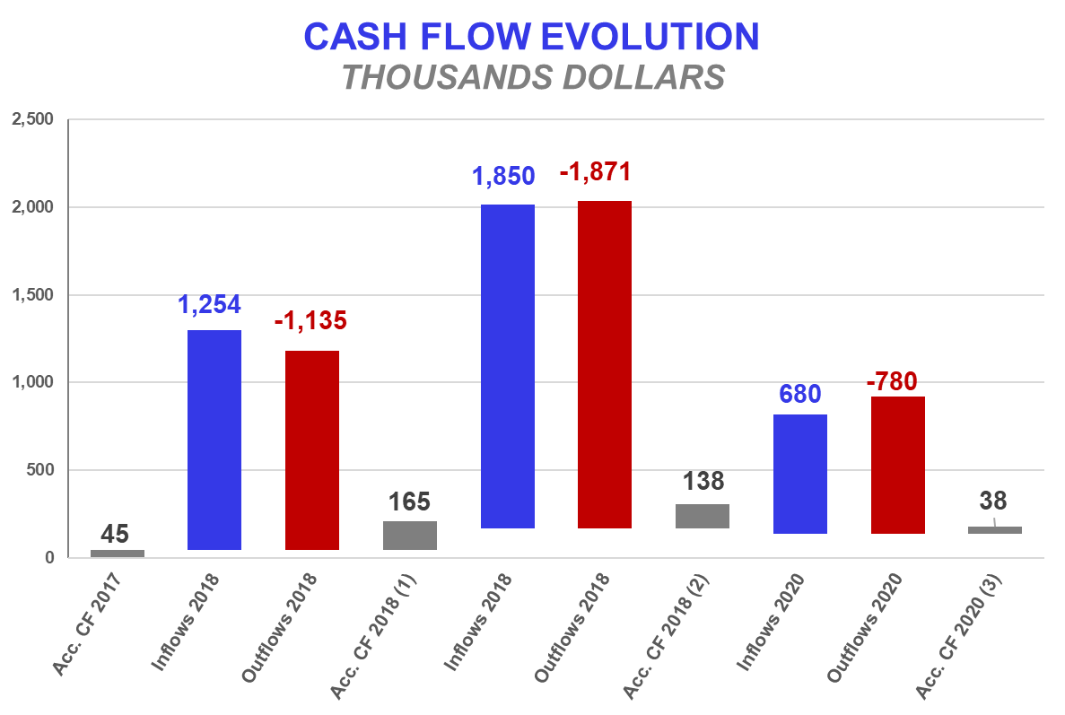

Accumulated Cash Flow – September 2020
5
Final Cash Balance 2016: USD 39 thousand
Final Cash Balance 2017: USD 46 thousand
Final Cash Balance 2018: USD 165 thousand
Final Cash Balance 2019: USD 138 thousand
Final Cash Balance 2020: USD 38 thousand
January 2020: USD (-) 100.3 thousand.
February 2020: USD (-) 37.1 thousand.
March 2020: USD (+) 53.8
April 2020: USD (-) 7.3
May 2020: USD (+) 38.5
June 2020 (-) 33.1
July 2020 (+) 49.7
August 2020 (+) 39.8
September 2020 (-) 104
Accumulated 2020
Acc. CF (1) – Accumulated Cash Flow (2016 - 2018)
Acc. CF (2) – Accumulated Cash Flow (2016 - December 2019)
Acc. CF (3) – Accumulated Cash Flow (2016 – Sep. 2020)

Slide 6
INDEX
Cash flow available data
Management tools
Balance Sheet
Income Statement
Harvest Valuation

Slide 7
Balance Sheet: September 2020
7
Continuous growth of plant and equipment
Property, Plant & Equipment growth in 2017: 200%
Property, Plant & Equipment growth in 2018: 138%
Property, Plant & Equipment growth in 2019: 65%
Property, Plant & Equipment growth in 2020: -1,62%
(Investments include Value Added Taxes: Tax Credit)
Fixed assets totally funded by capital injections and Government Subsidy.
2020: Vehicle sale one unit and change other unit for a cheaper one.

Slide 8
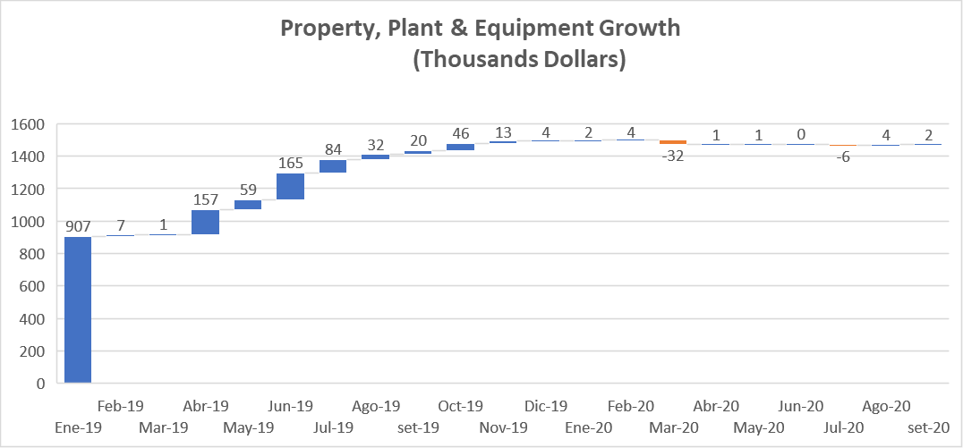
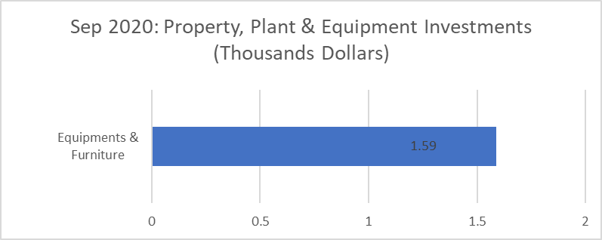
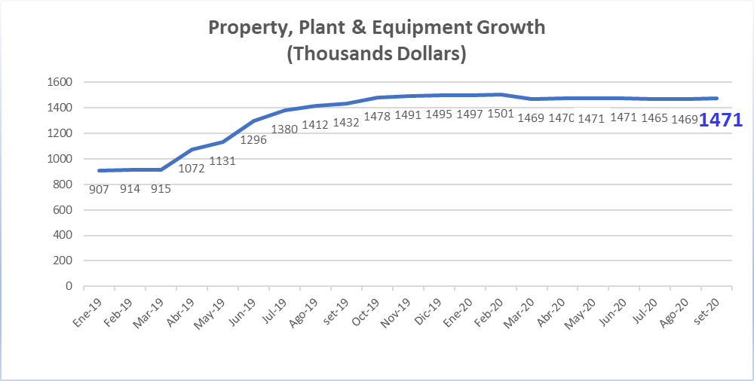
Investments_ Property, Plant & Eq.: September 2020
8

Slide 9
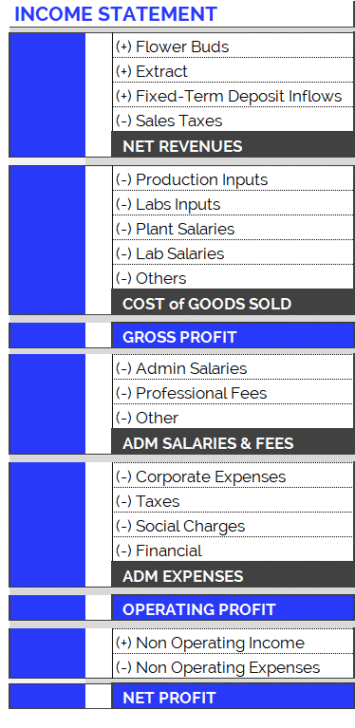
Income Statement: Change in Expenses
9
New Accounting Classification System for Operating Costs, since September 2019
In order to adequately present the company's areas of expense, the operating costs have been arranged according to item and category, as can be seen in the table on the right. Therefore:
Cost of Goods Sold
Shows direct costs of the production process: raw materials, tools, other materials and salaries of plant and laboratory employees.
Adm Salaries & Fees
Shows indirect costs of the production process: administrative salaries and professional fees.
Administration Expenses
Overhead and other expenses relating to the company’s structure.
The new accounting item classifications have generated small differences in the historical accumulated balances (in the new version of the Chart of Accounts compared to the previous one): for example, in the previous month's report (apr-19), differences can be observed in the accumulated flows of Cost of Good Sold. This is because all the accounts have been reclassified and, in order to maintain the same criteria, this generated variations in the historical presentation of the items. However, it should be kept in mind that the historical total expenditures remain unchanged, since the new order simply reorganizes the items for the purpose of better financial statements.

Slide 10
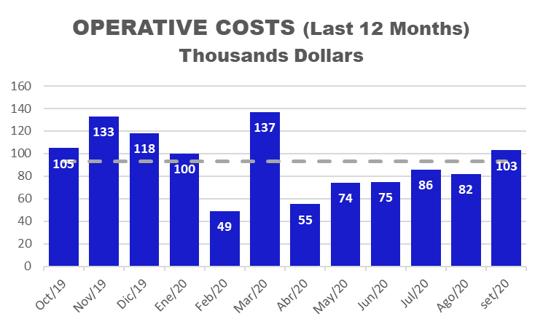
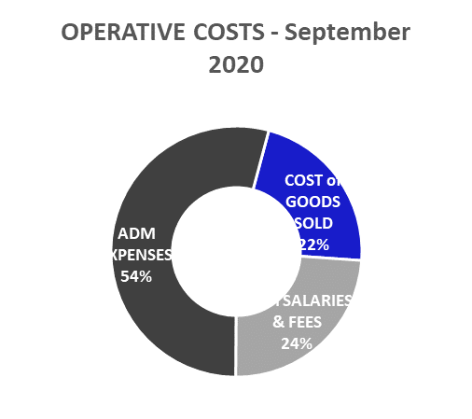
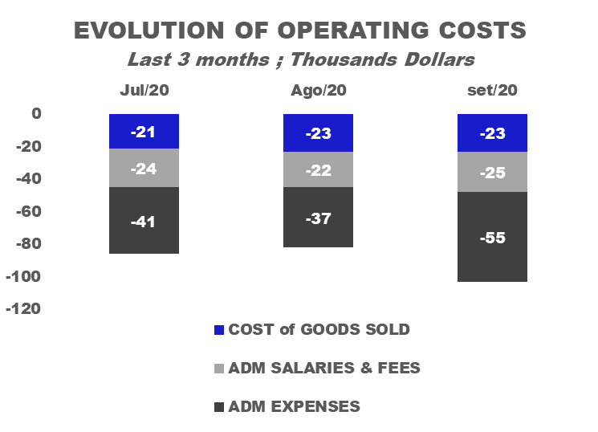
Income Statement: September. 2020
10
Highlights of September. 2020 Operative Costs:
USD 101,315
Total operating costs for June are below the average (last 12 months) (*).
Costs of Goods Sold: USD 22,249.
Admin Salaries: USD 15,728
Professional Fees: USD 8,556
Corporate Expenses : USD 29,415
Taxes : USD 3,196
Social Charges: USD 54,782

Slide 11
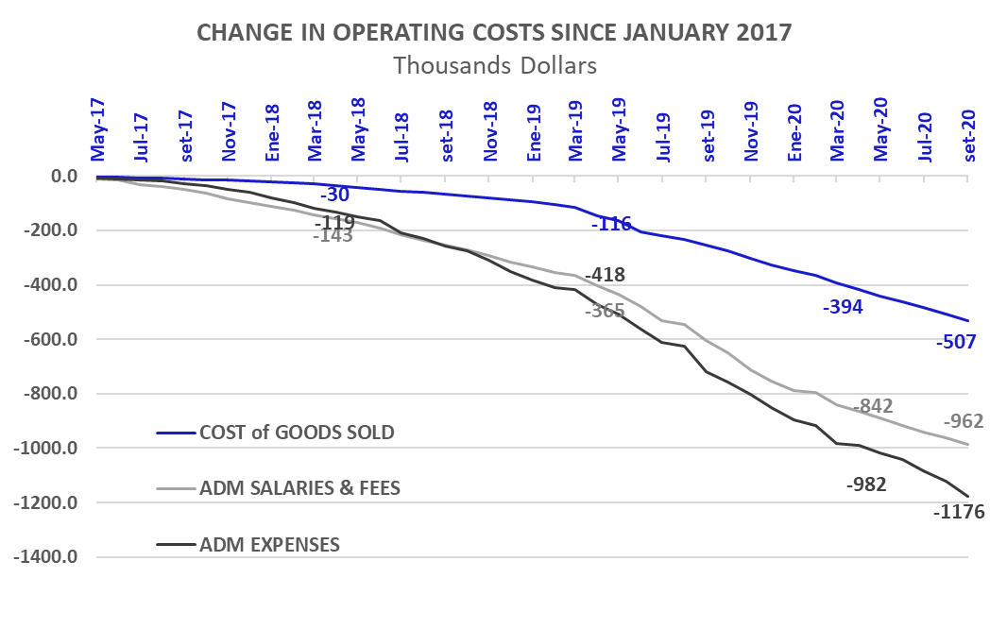
Income Statement: Change in Expenses
11
Burey’s operations have increased compared to 2017. This can be observed in the change of Operating Costs since Jan/17.
Cost of Goods Sold
In 2019 (compared to the accumulated amount for 2018) the Cost of Goods Sold increased 242%: between Jan/19 and Dec/19 USD 268,173 was spent. Mainly this is due to: increase in plant salaries and labs inputs.
In 2020, Cost of Goods Sold amounted to USD 199,918 (composed of 60% Plant Salaries, 27% Lab Salaries, 7% Production Inputs and 6% Labs Inputs).
Administrative Salaries & Fees
In 2019 (compared to the accumulated amount for 2018) Administrative Salaries & Fees increased 95%: between Jan/19 and Dec/19 USD 387,507 was spent. Mainly this is due to: increase in Adm Salaries.
In 2020, Administrative Salaries & Fees amounted to USD 226,763 (composed of 59% Adm. Salaries and 41% Prof. Fees).
Administrative Expenses
In 2019 (compared to the accumulated amount for 2018) Administrative Expenses increased 74%: between Jan/19 and Dec/19 USD 494,004 was spent.
In 2020, Administrative Expenses amounted to USD 322,714 (composed of 55% Corporate Expenses, 38% Social Charges and 7% Taxes).

Slide 12
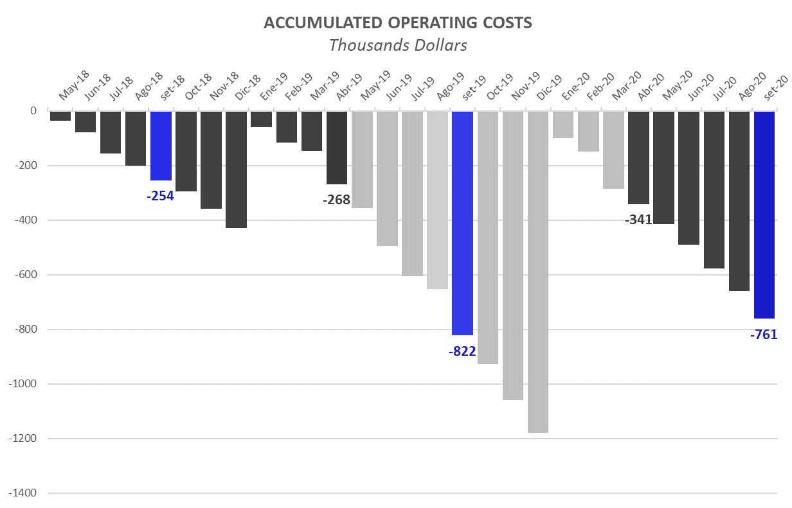
Operative Costs: 9 months of 2020
12
Operating Costs accumulated for calendar year
The accumulated expenses for the 12 months (12M) of 2019 represent 205% of total 2018 expenses. This reflects the increase in operating costs mentioned in the previous slide and is the result of research performed and preparations for our first commercial production.
First 8 Months (9M): Comparison 2020 vs. 2019:
While in the first 8M of 2019 we had operative costs for USD 652 K, in the first 9M of 2020 we reached USD 761 K. This growth in expenses is principally attributed to:

Slide 13
INDEX
Cash flow available data
Management tools
Balance Sheet
Income Statement
Harvest Valuation

Slide 14
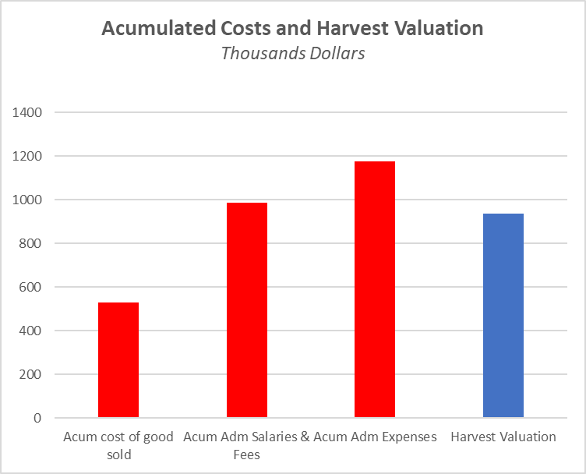
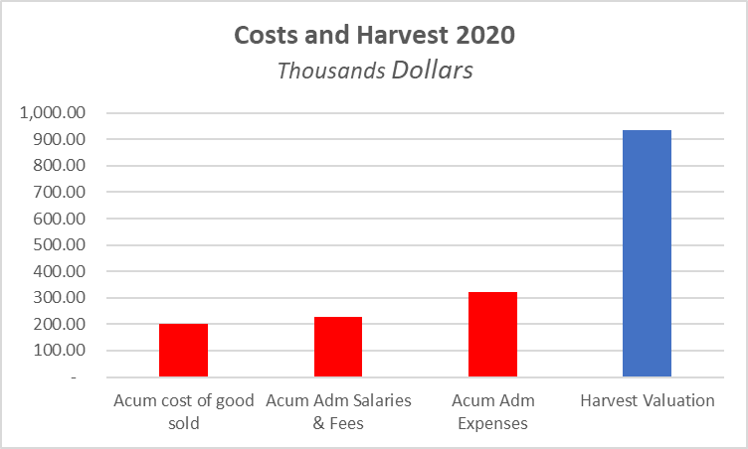
Harvest Valuation
14
The first harvest yielded 20% compared to what was expected.
Second harvest yielded 40 % compared to what was expected and 10% more compared with the first harvest of the year.
The increase in harvest is mainly due to the season of the year, a change in genetics in one of the rooms and the know-how of our staff.
We based on the studies carried out for the business plan to set the price in 3,5 USD/gr.

